Slide 1
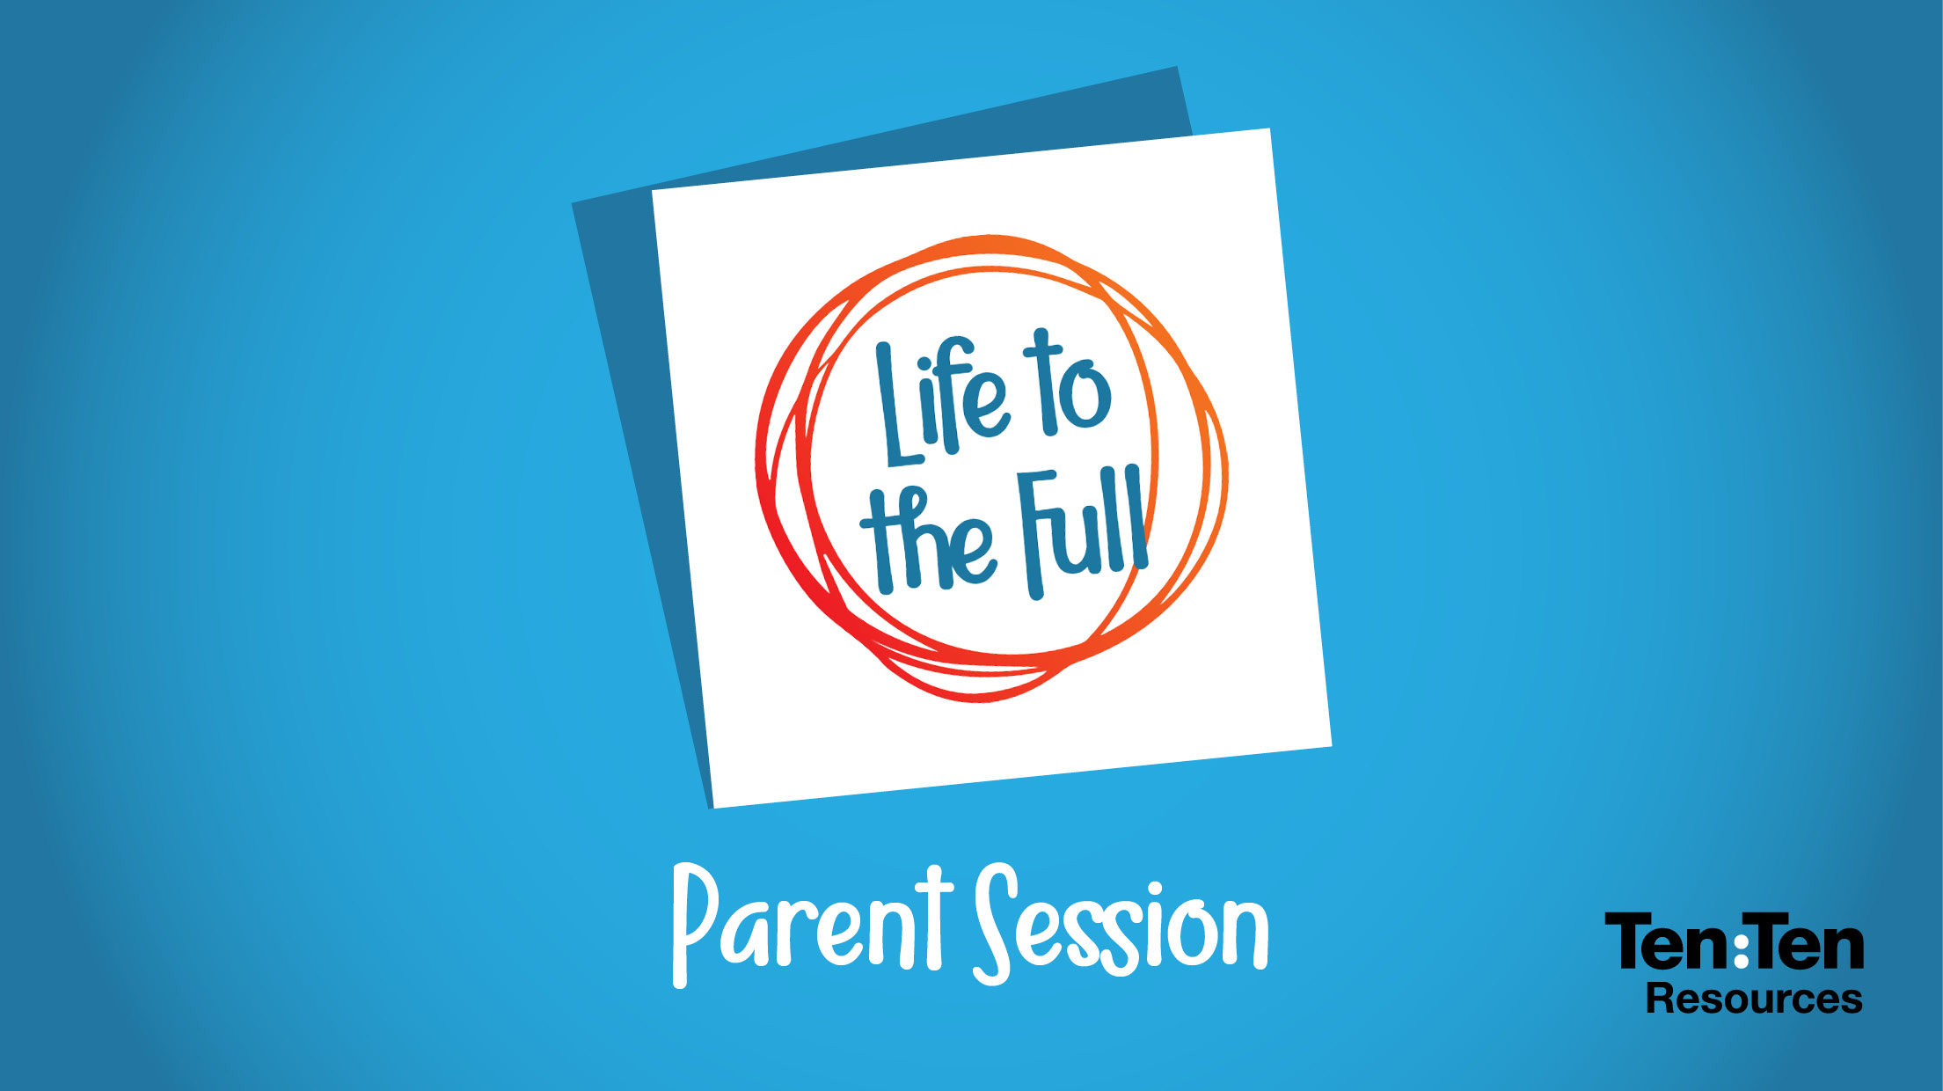

Slide 2
Context
Complex world
Personal, Social, Health & Economic Education (PSHE)
Relationships Education – compulsory
Contentious issues
Parents are first educators
Subject is a ‘building block’
Relationships Education compulsory

Slide 3
What is required
Policy
Parent information
Right to withdraw children

Slide 4
What we will do
Taught by our teachers
Teach what is required
Teach additional material as a result of consultation
Content – appropriate to age and maturity
Honour requests of withdrawal
Knowledge – planned sequence of lessons

Slide 5
Faith
Teach faith perspectives on relationships
Ten Ten Resources – Life to the Full
Diocese of Westminster/ Catholic Education Service

Slide 6
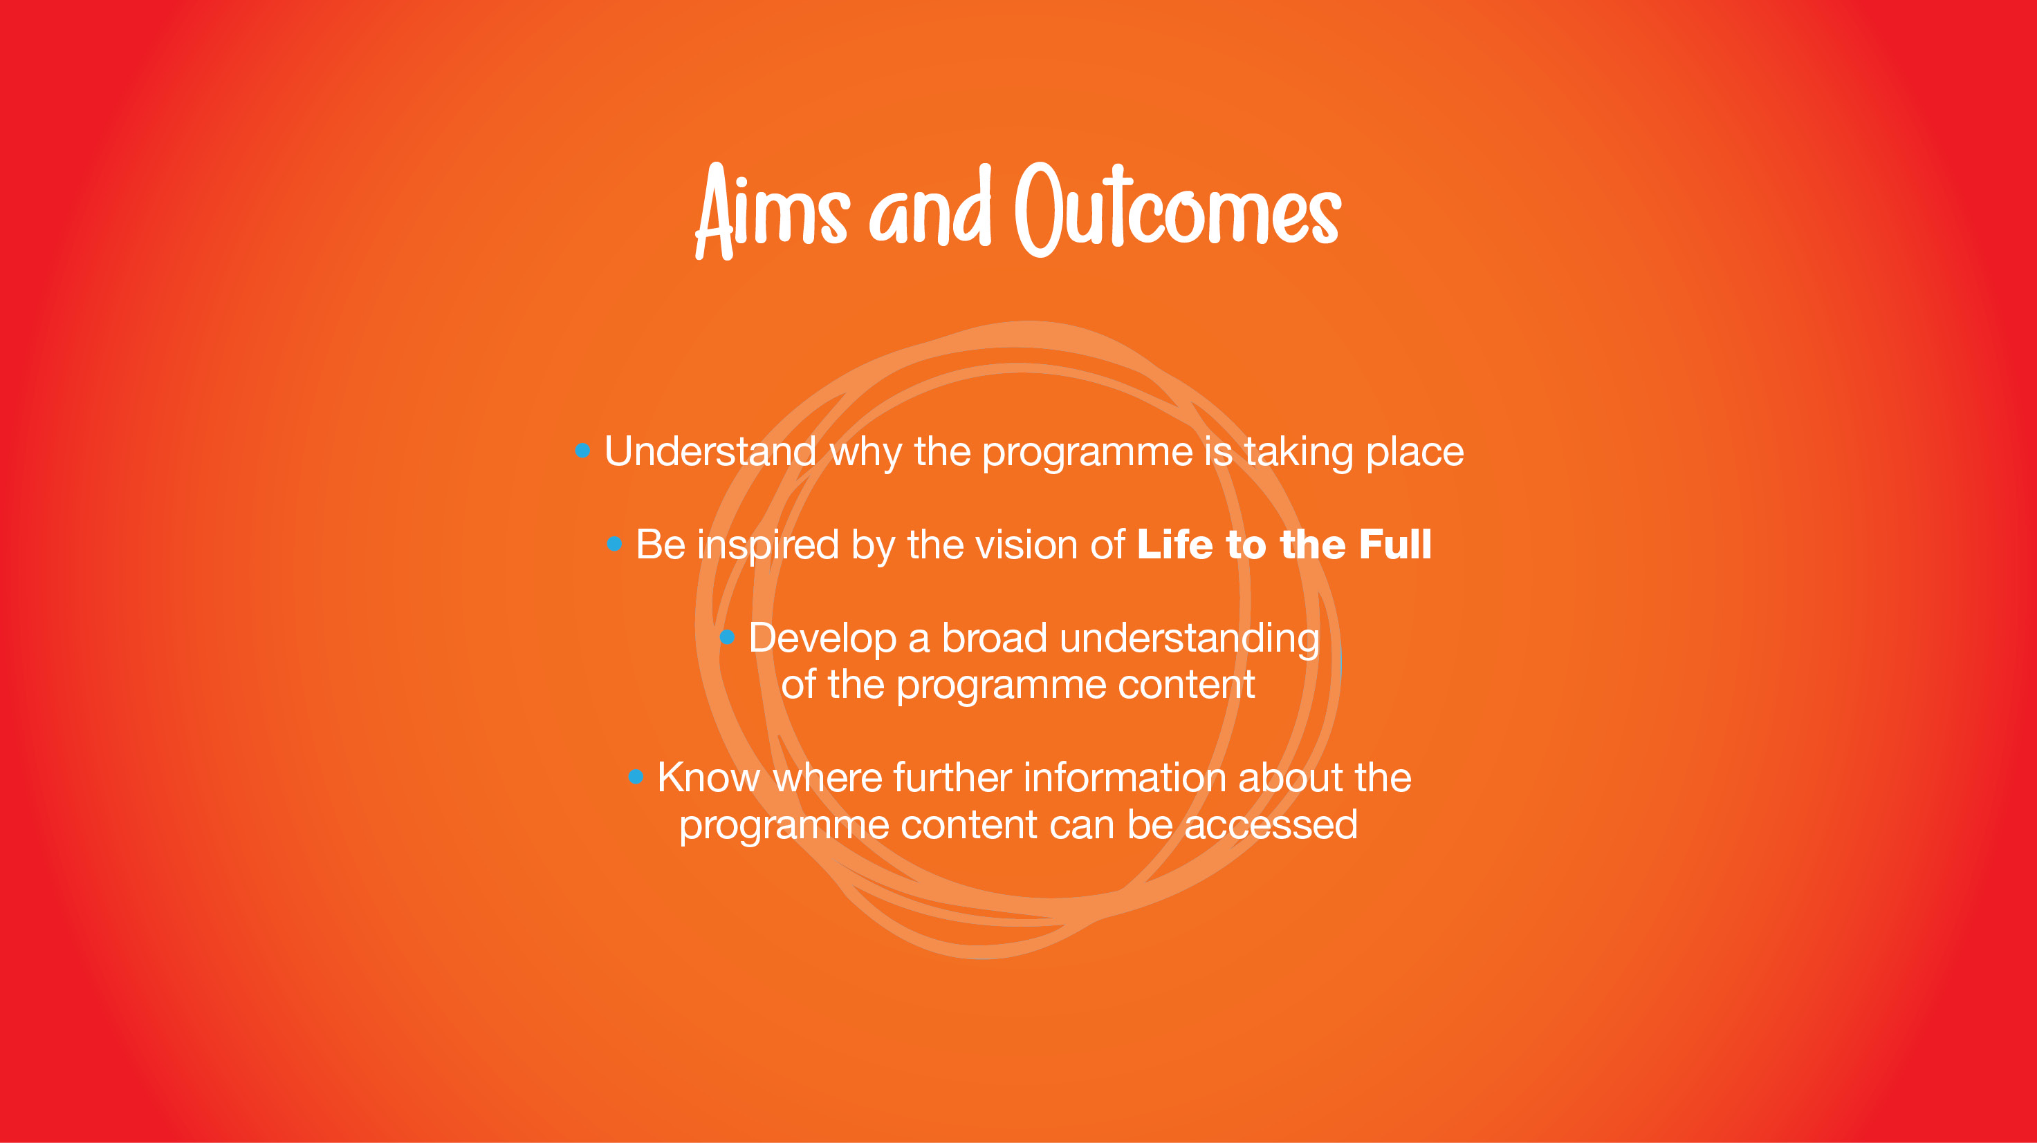

Slide 7

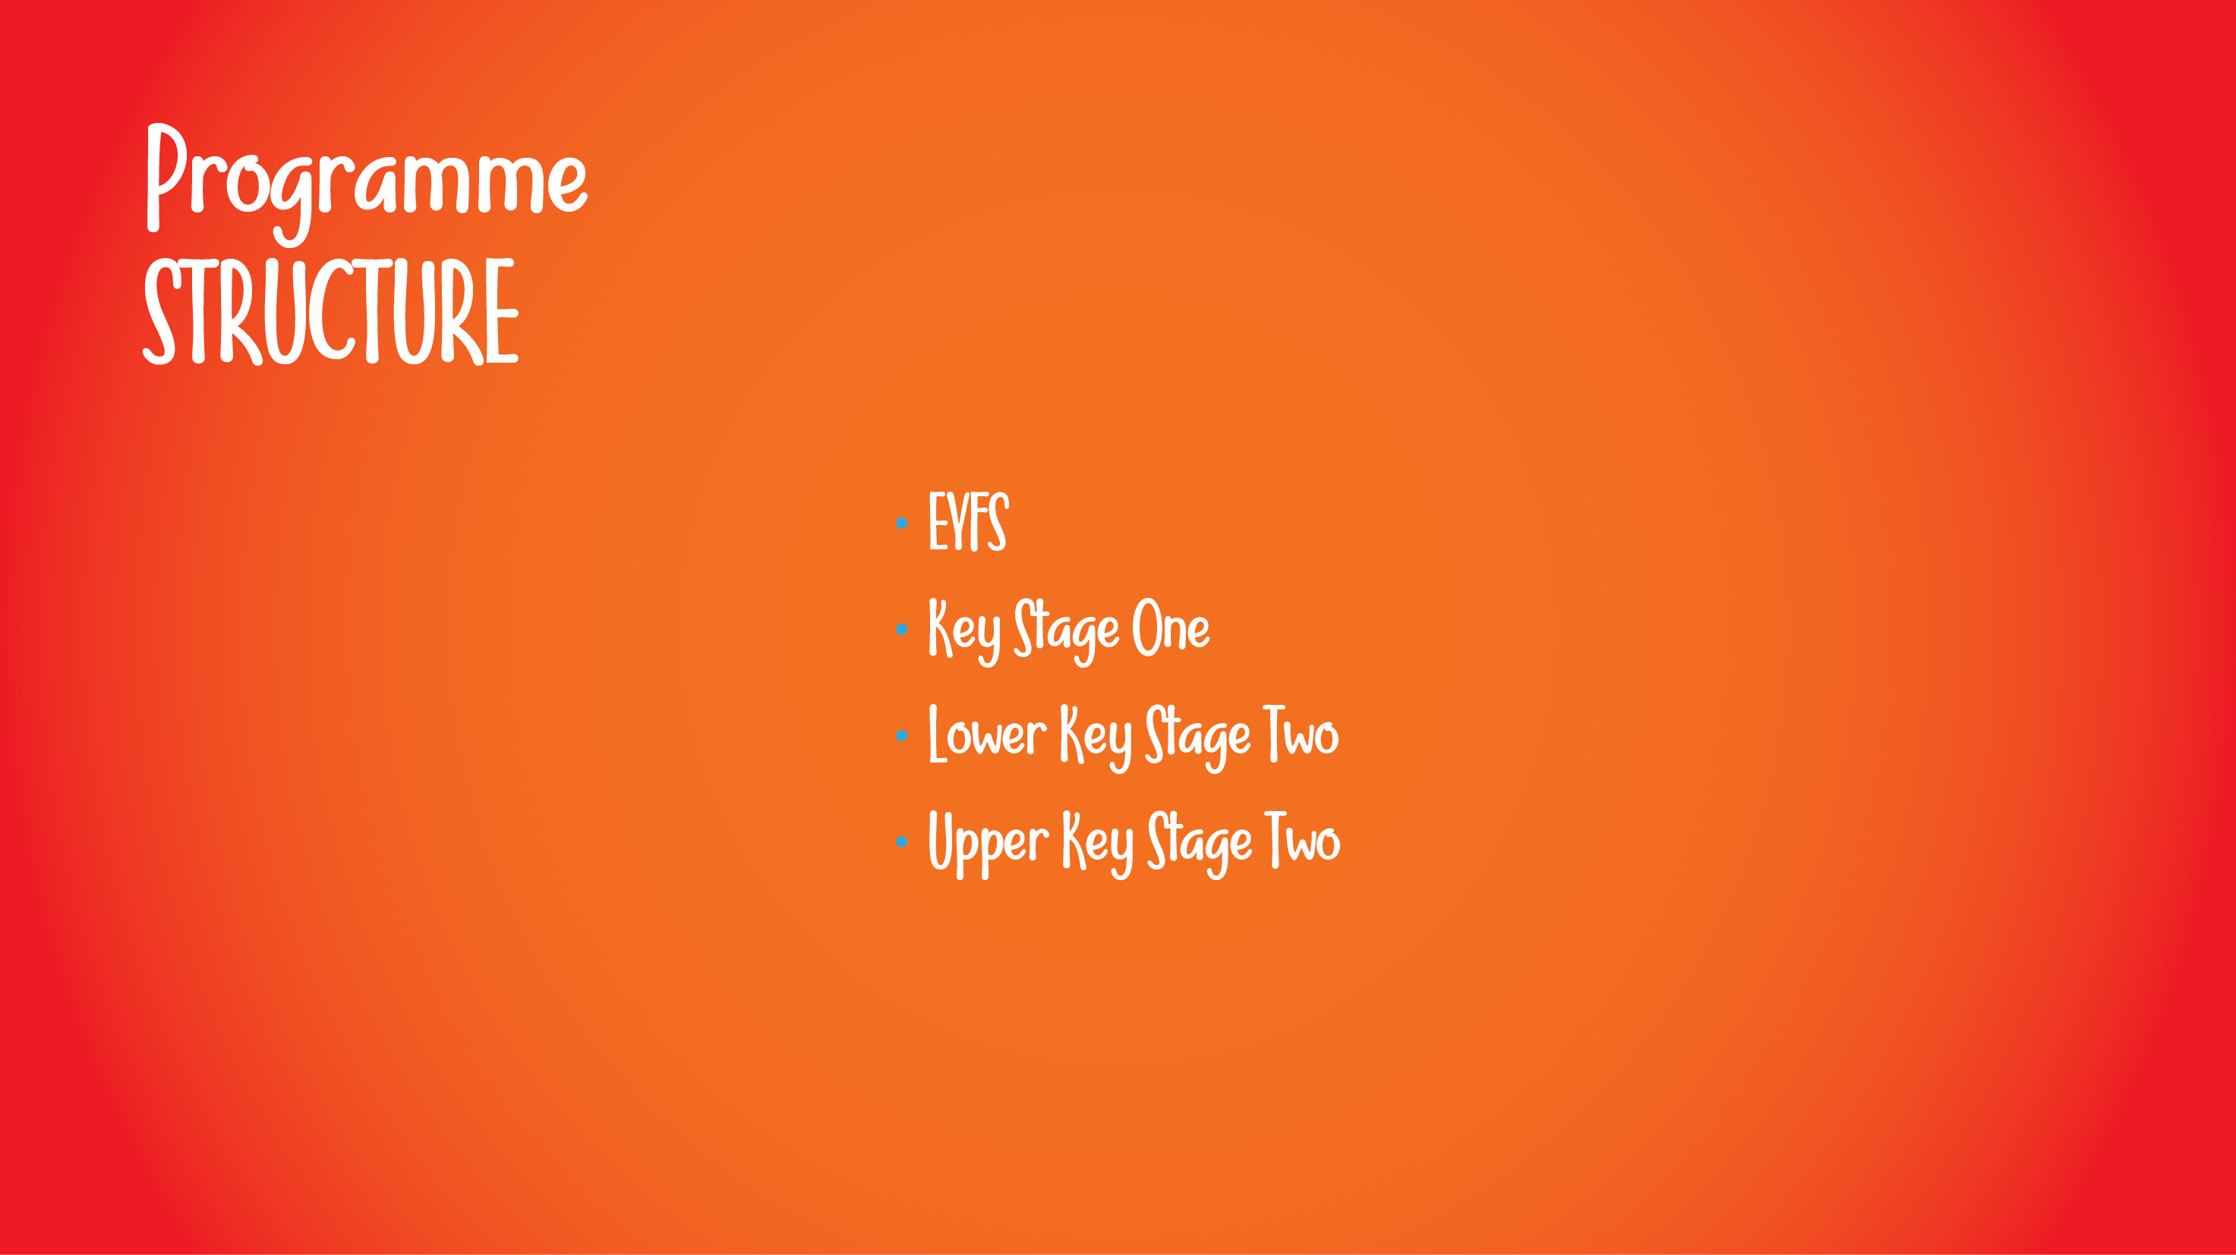
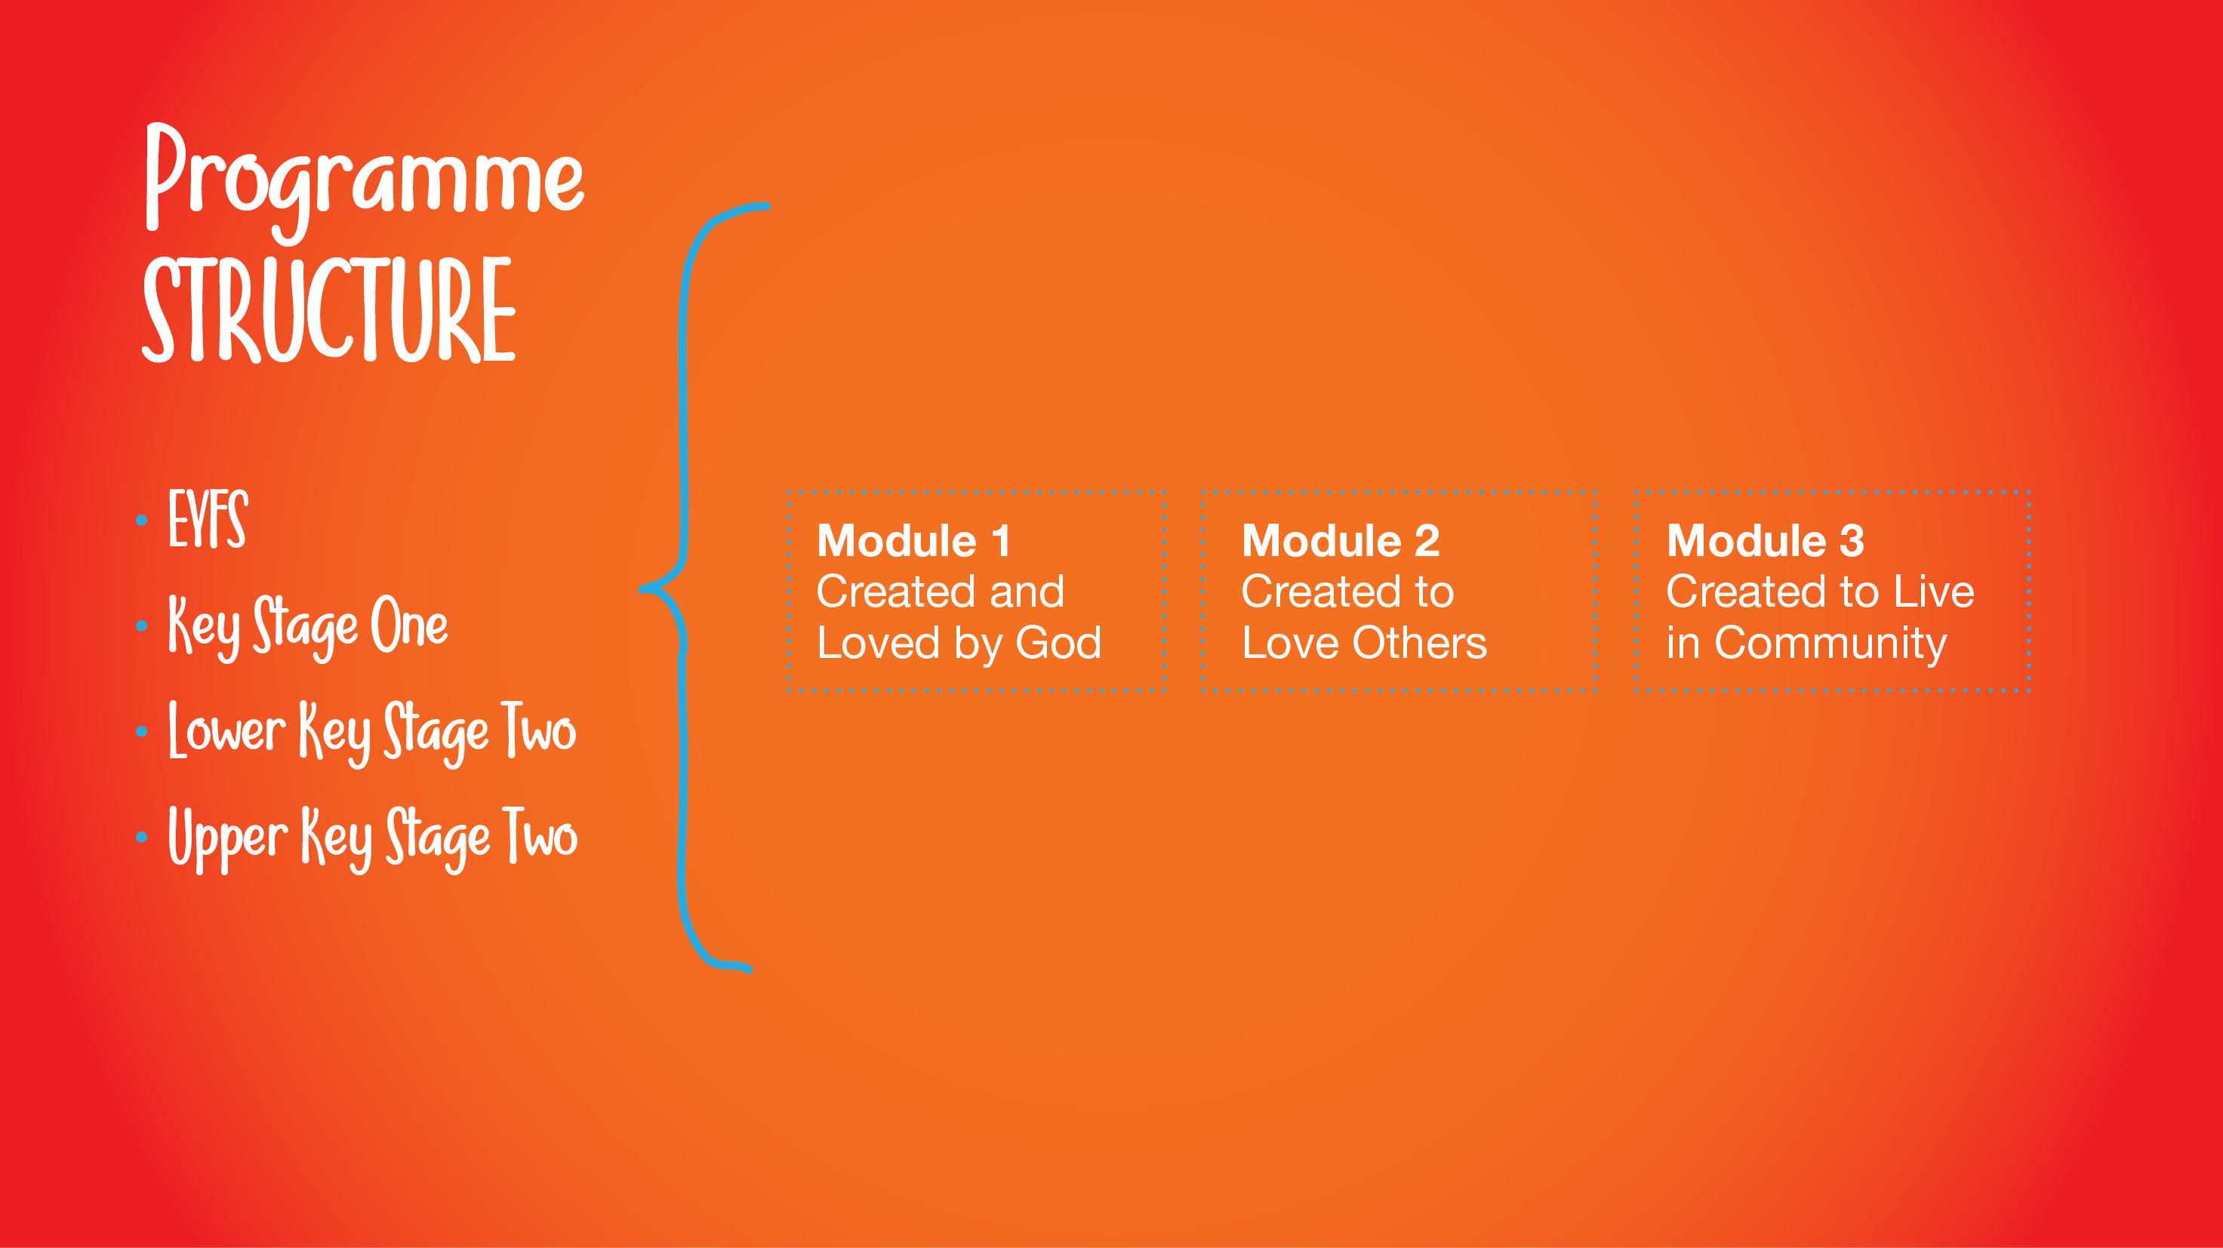
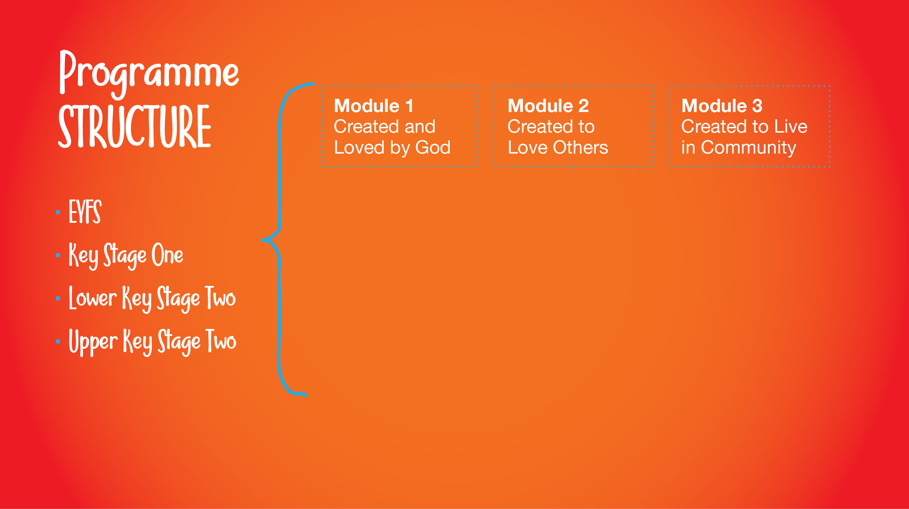
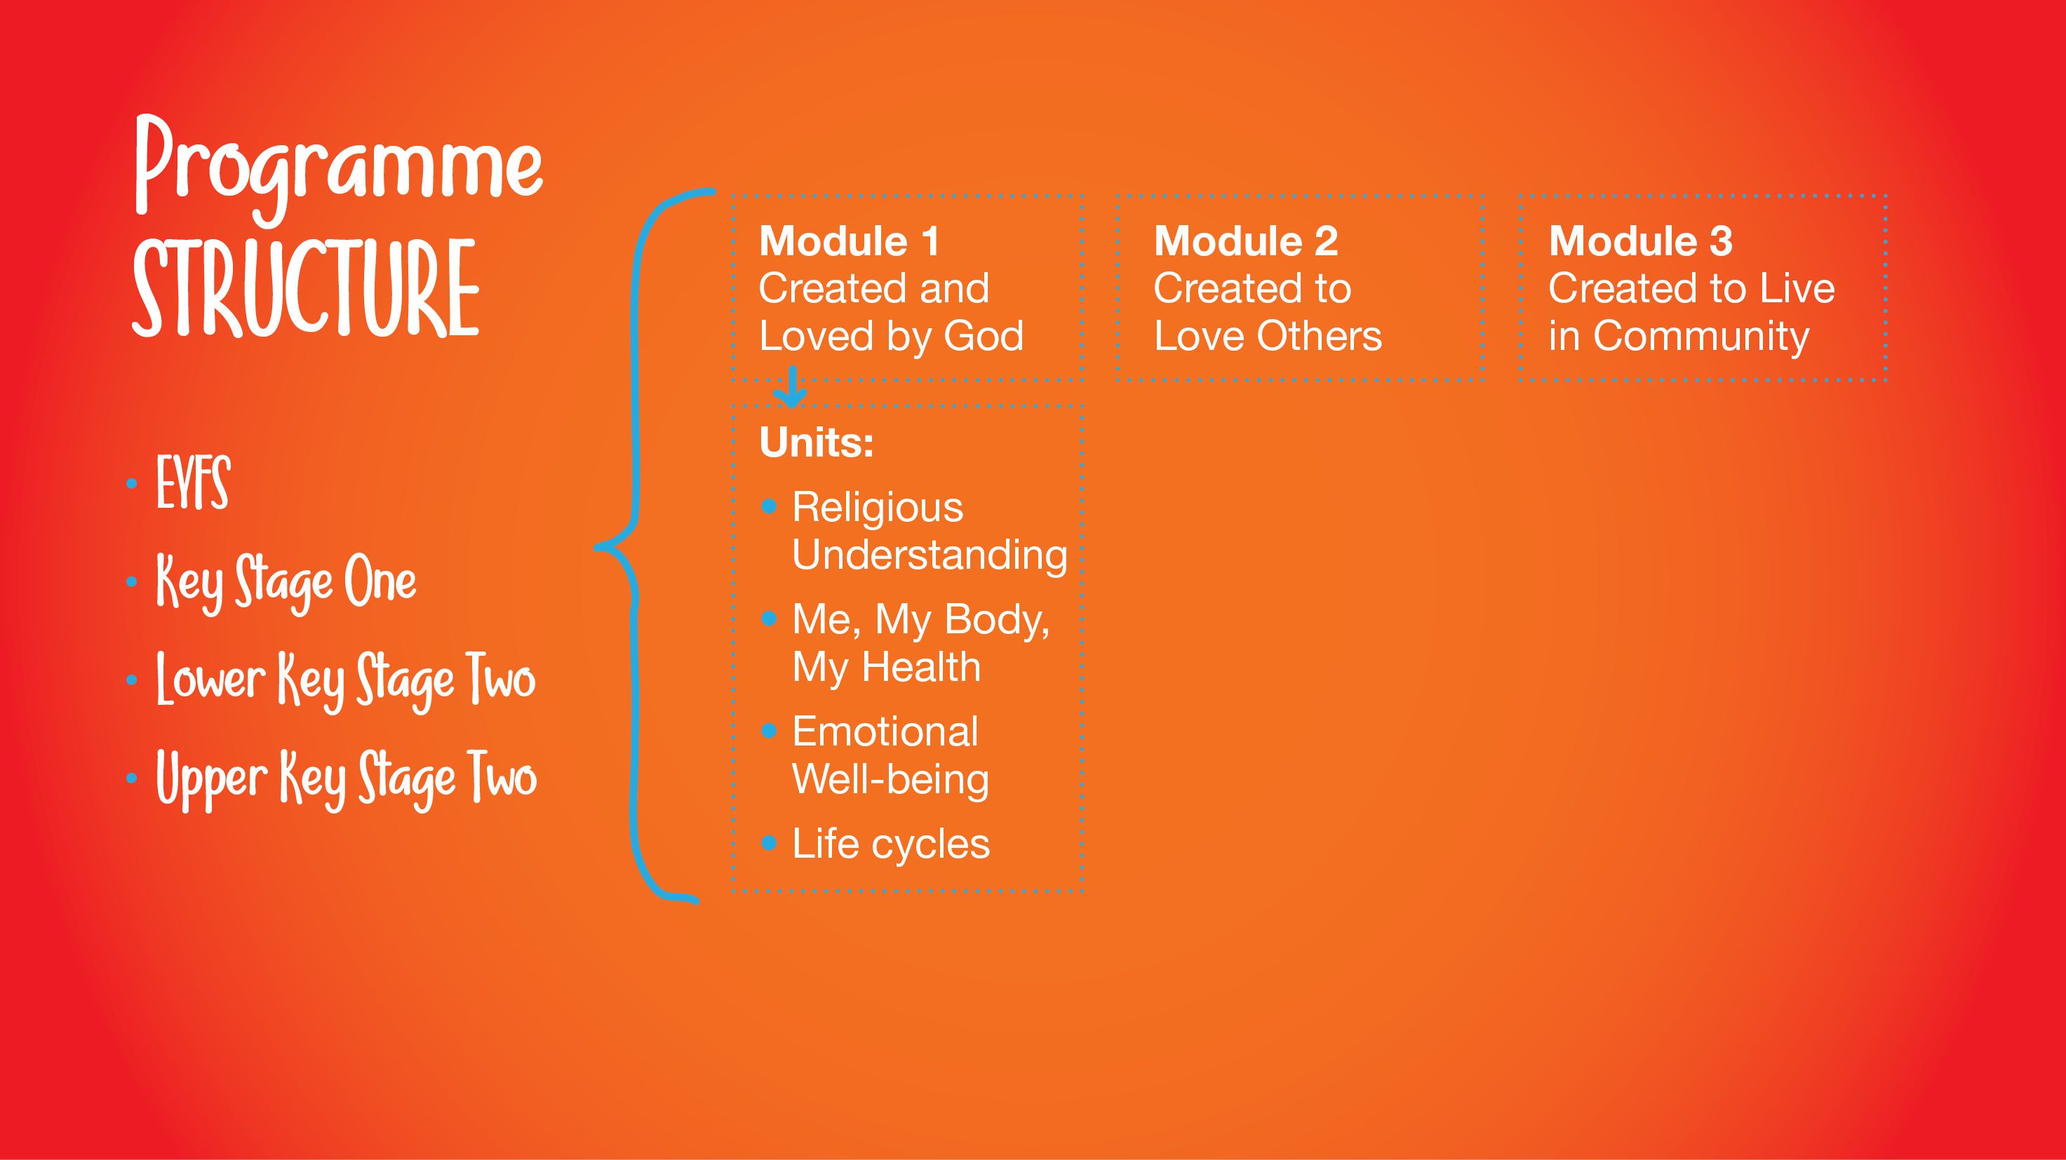
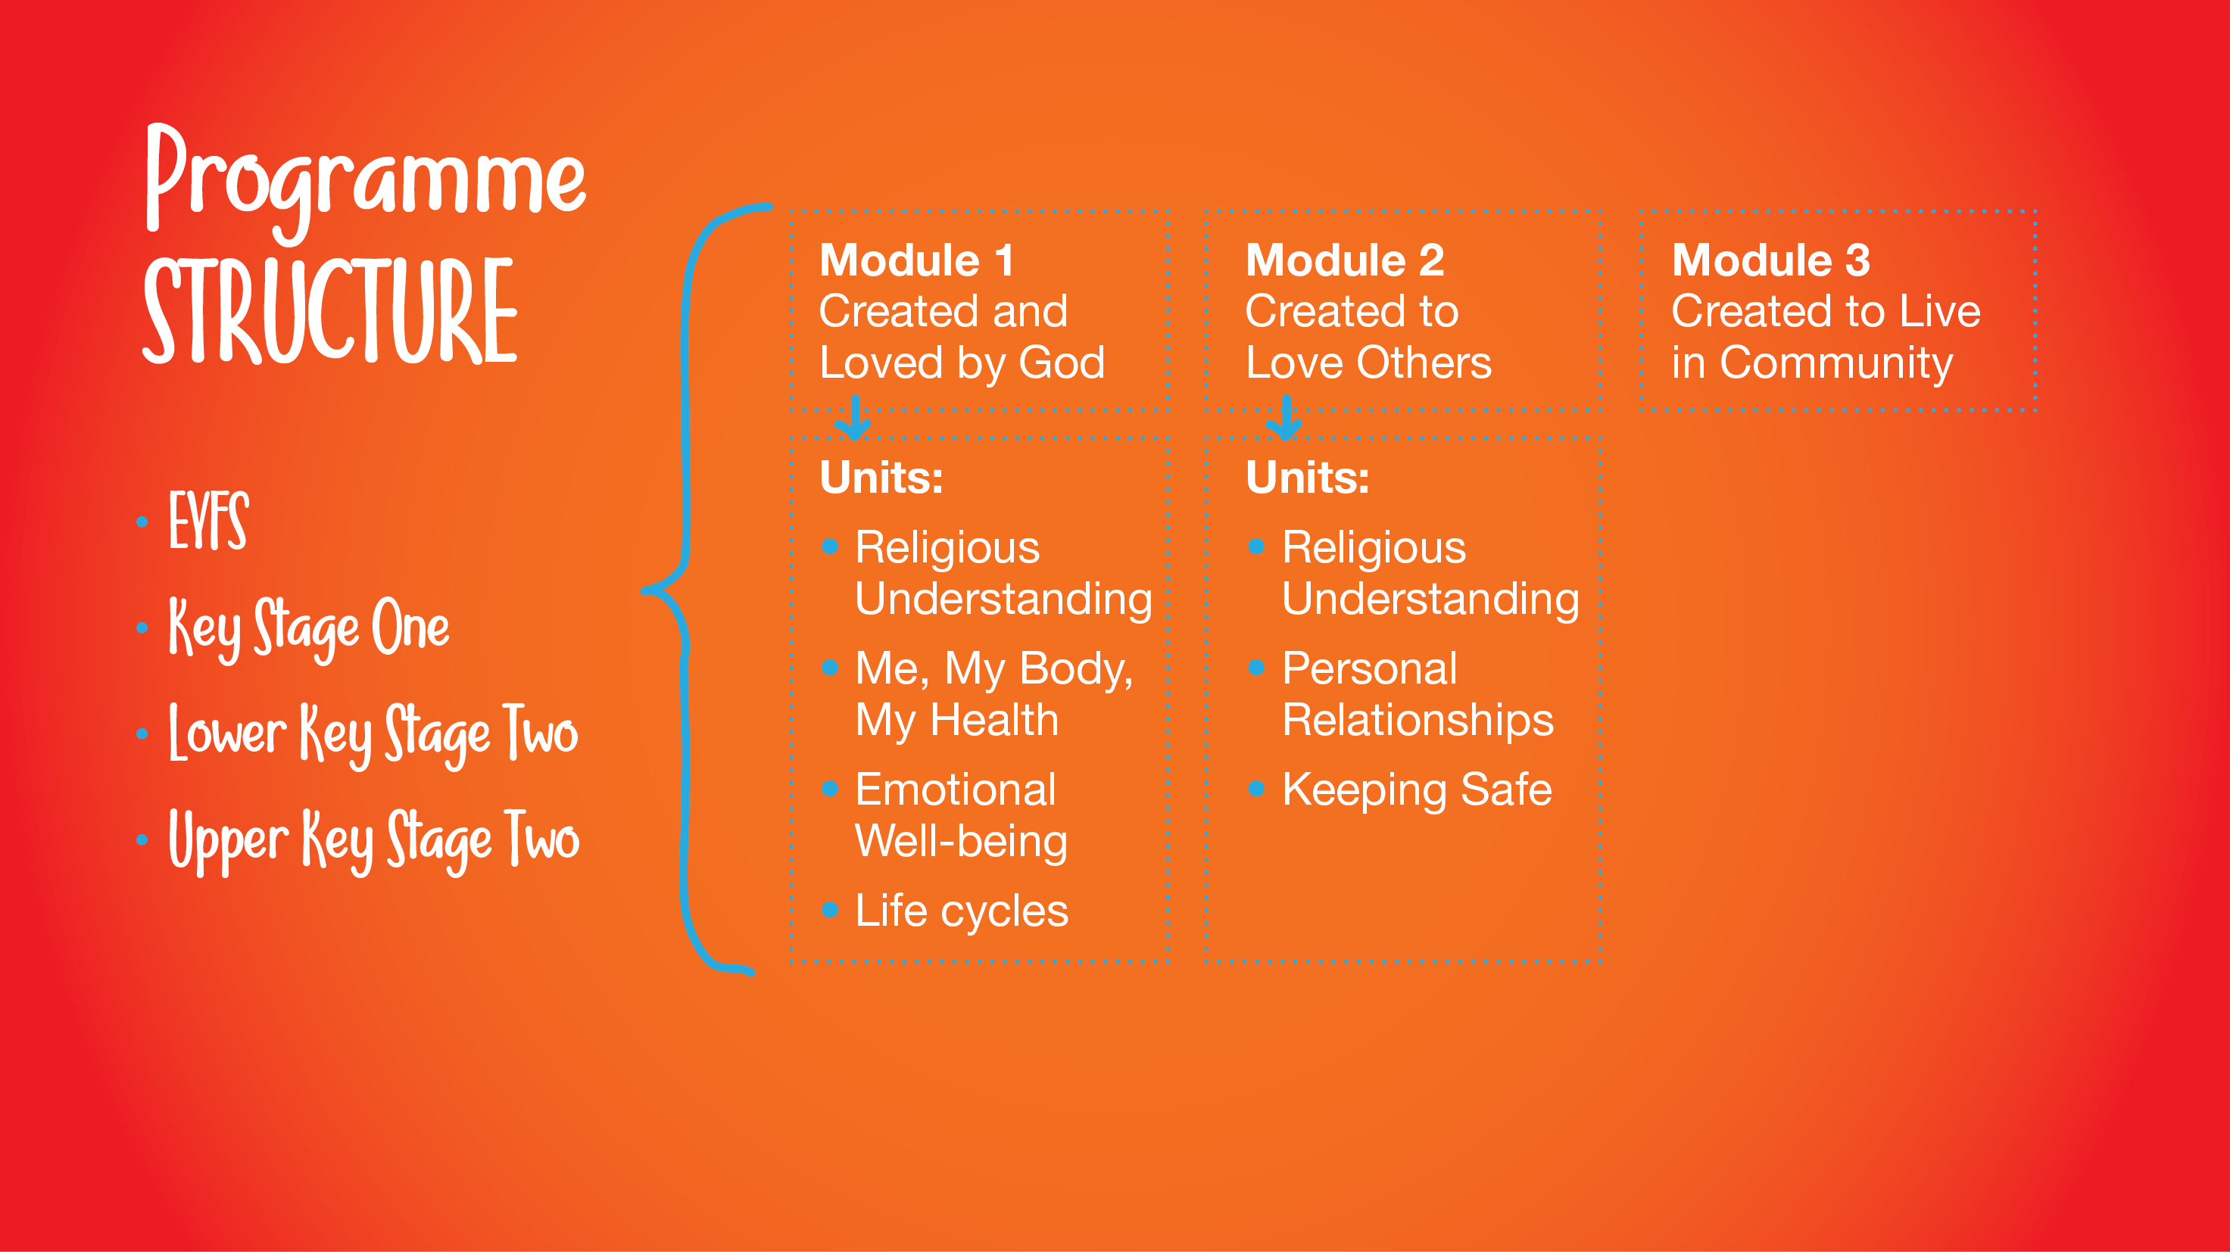
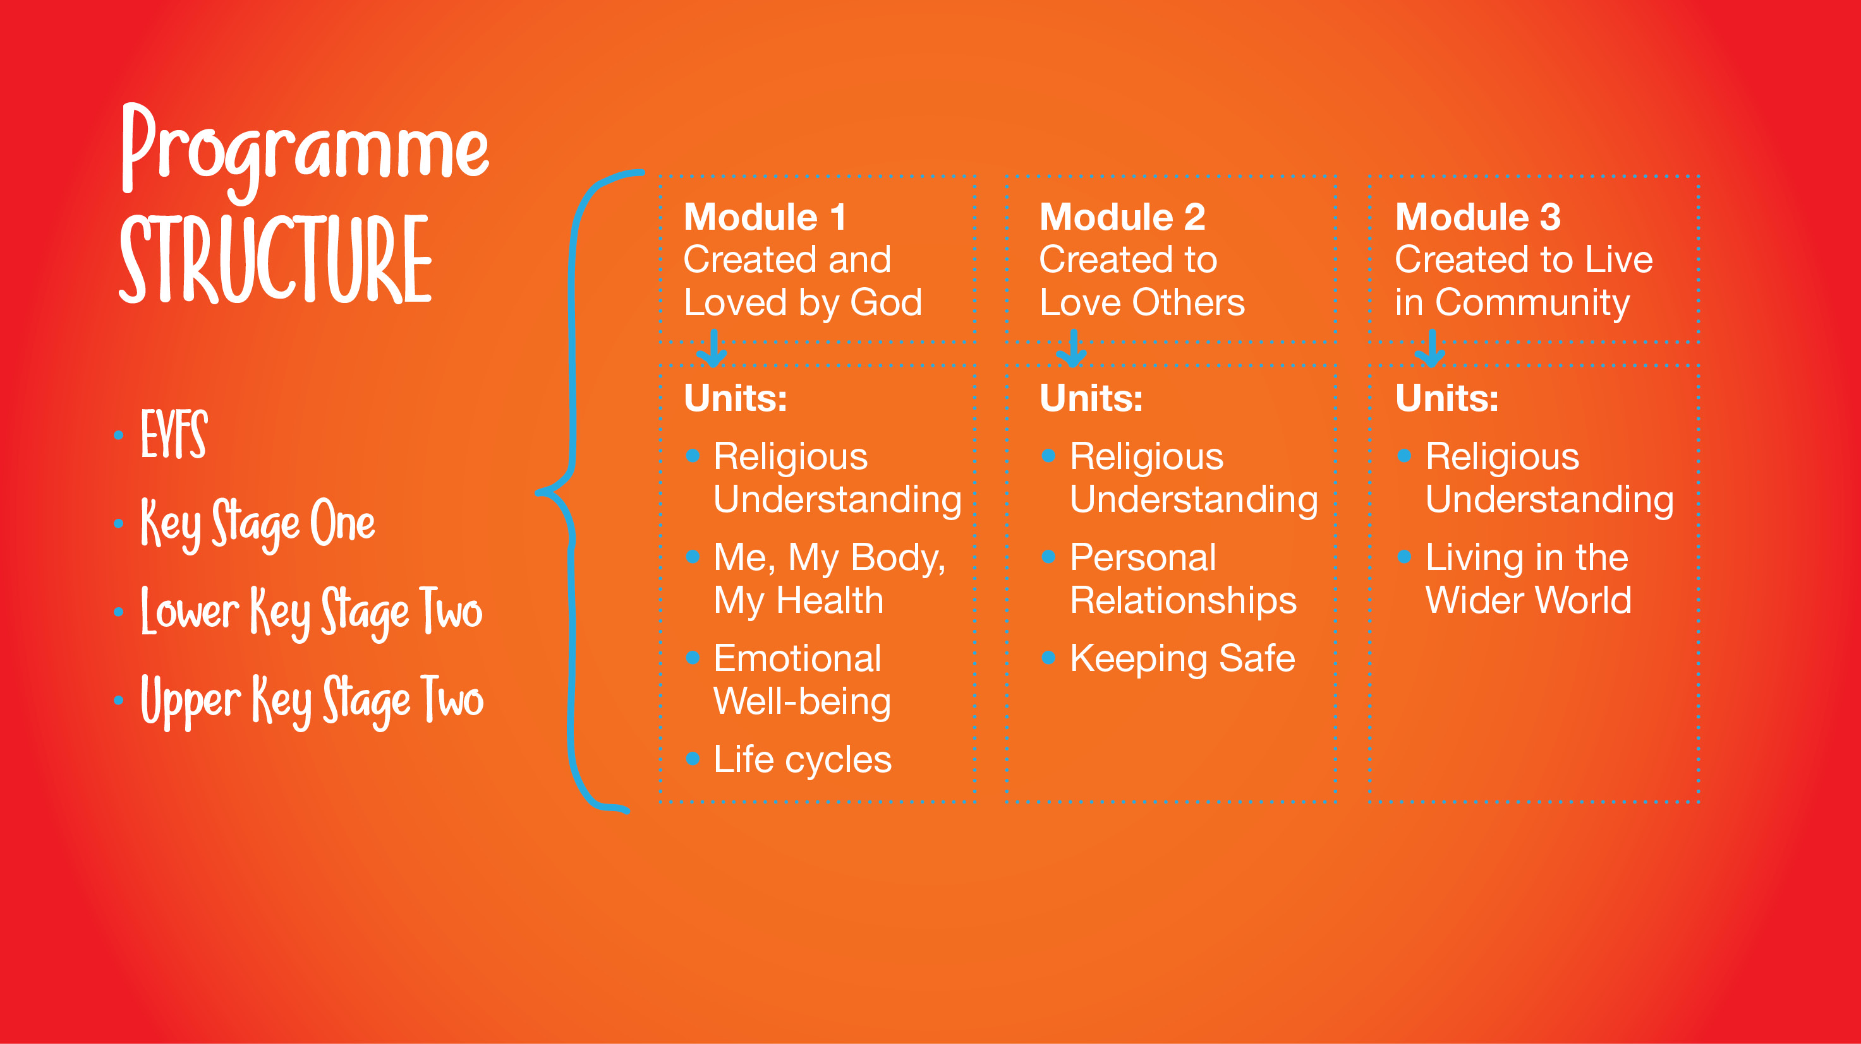
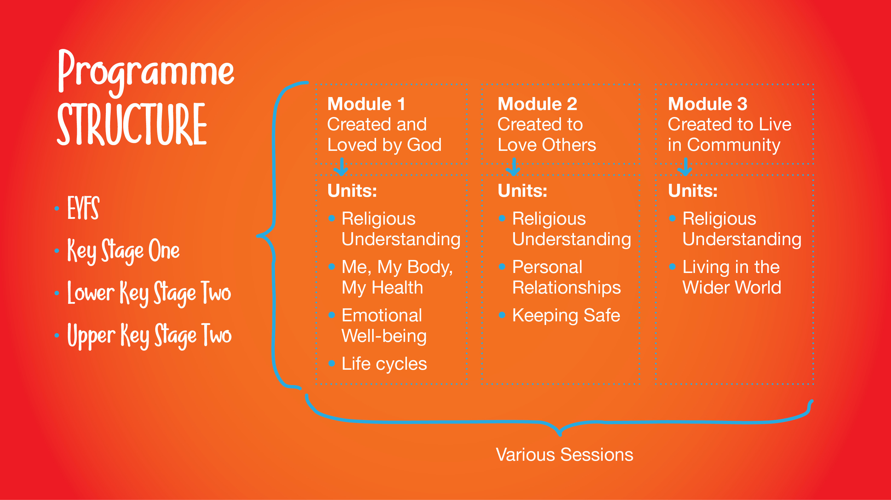

Slide 8
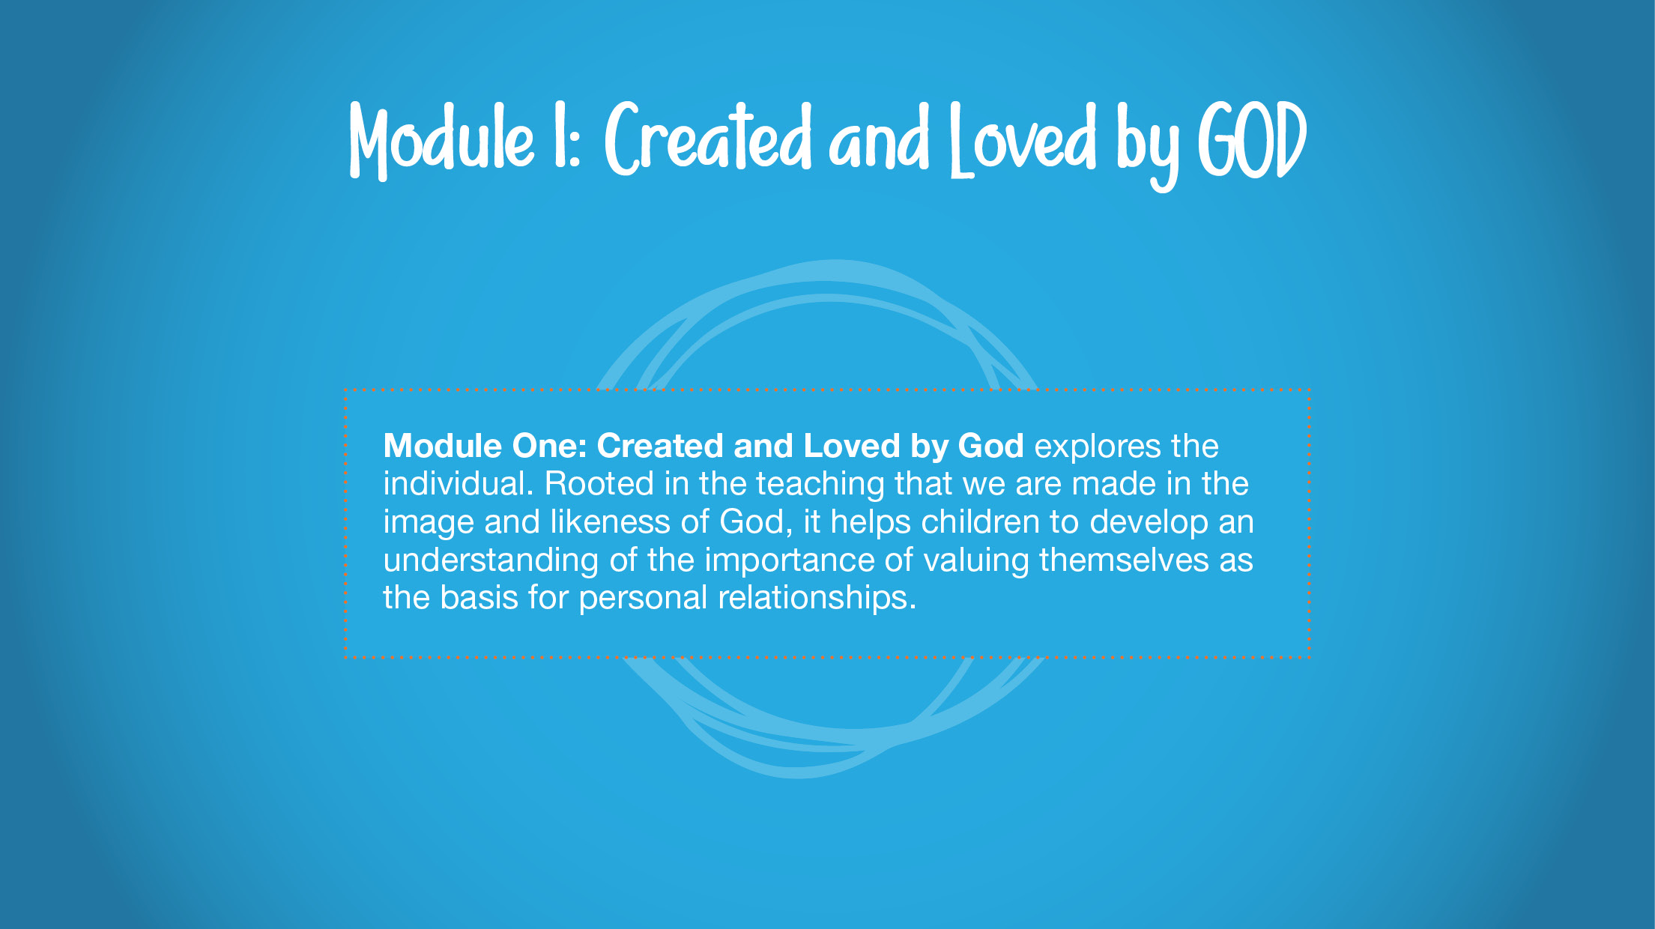

Slide 9
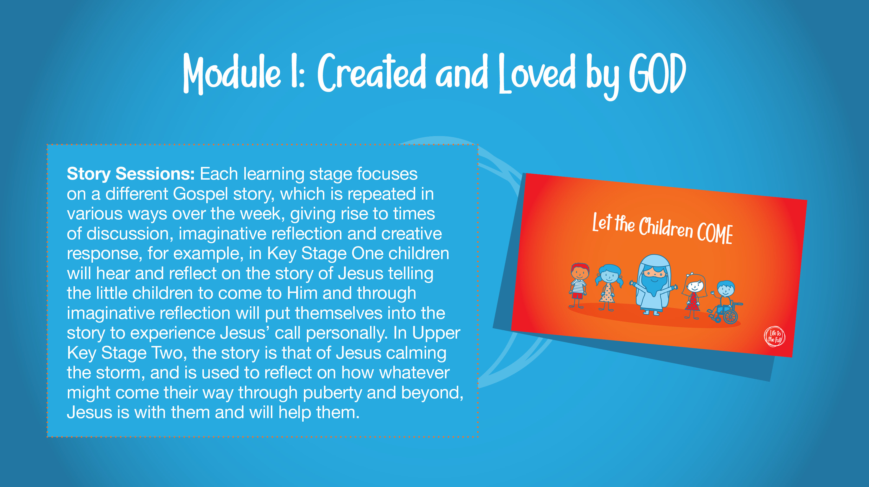

Slide 10
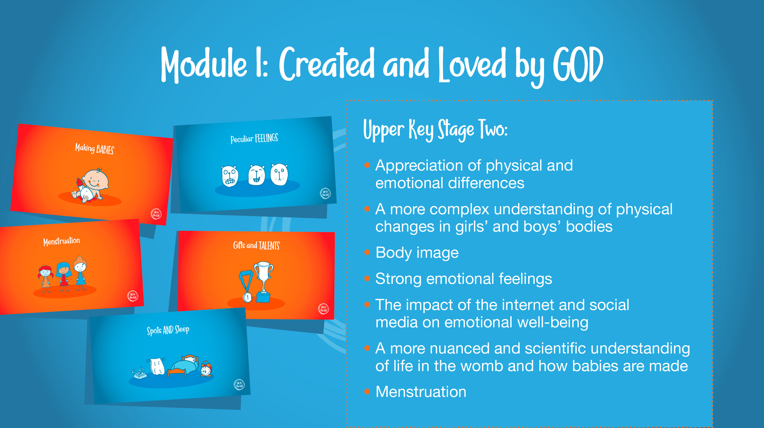

Slide 11
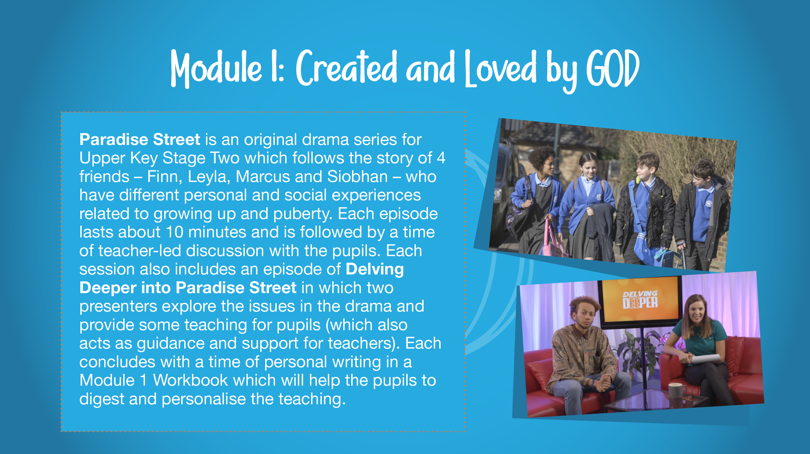

Slide 12
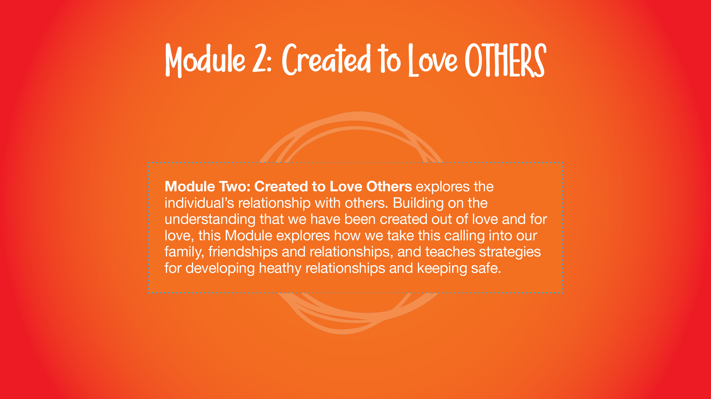

Slide 13
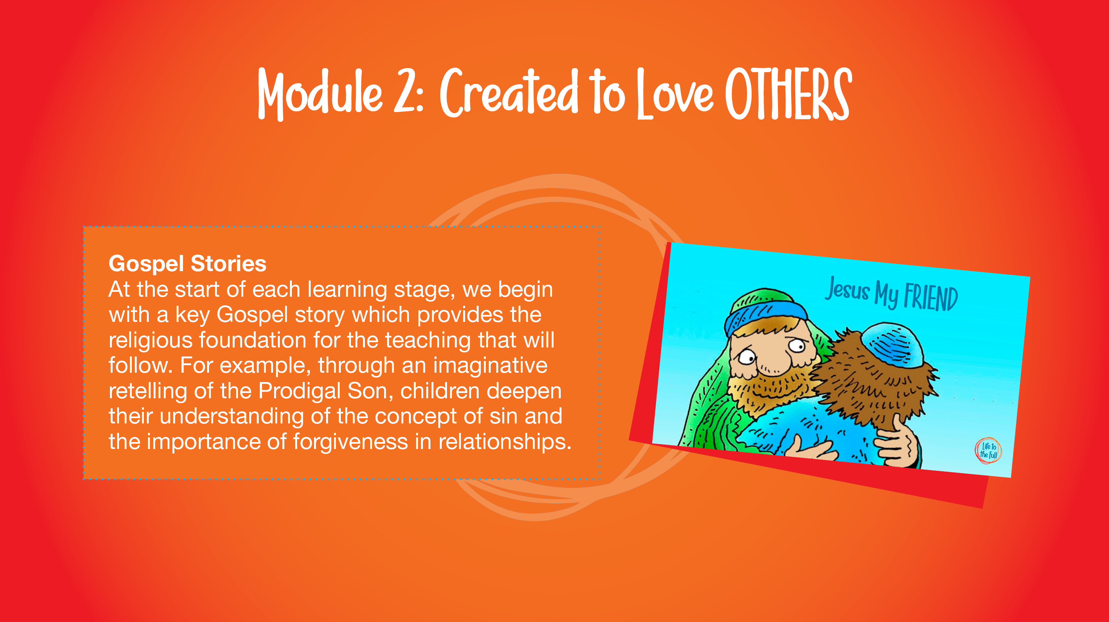

Slide 14
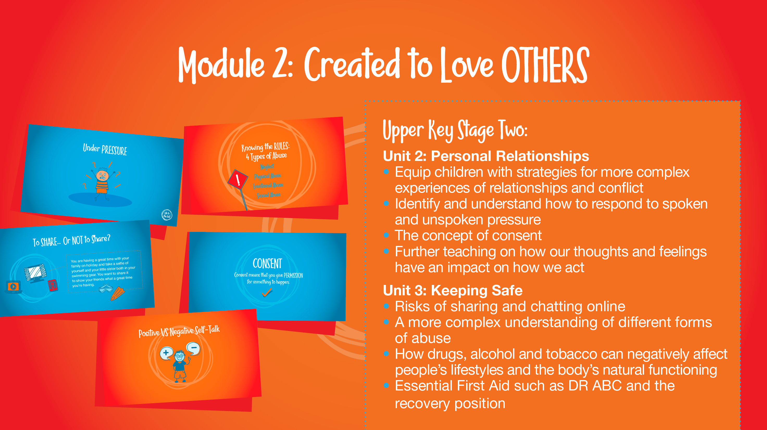

Slide 15
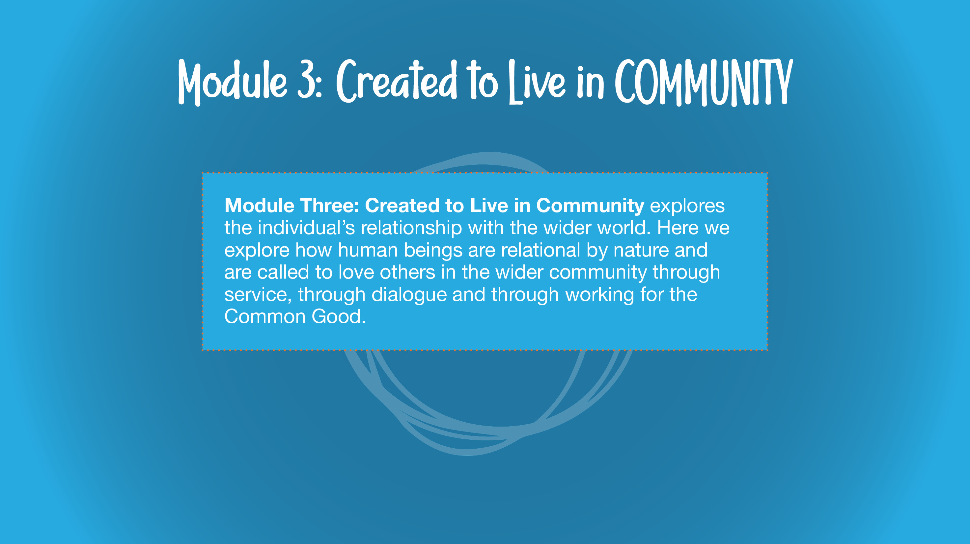
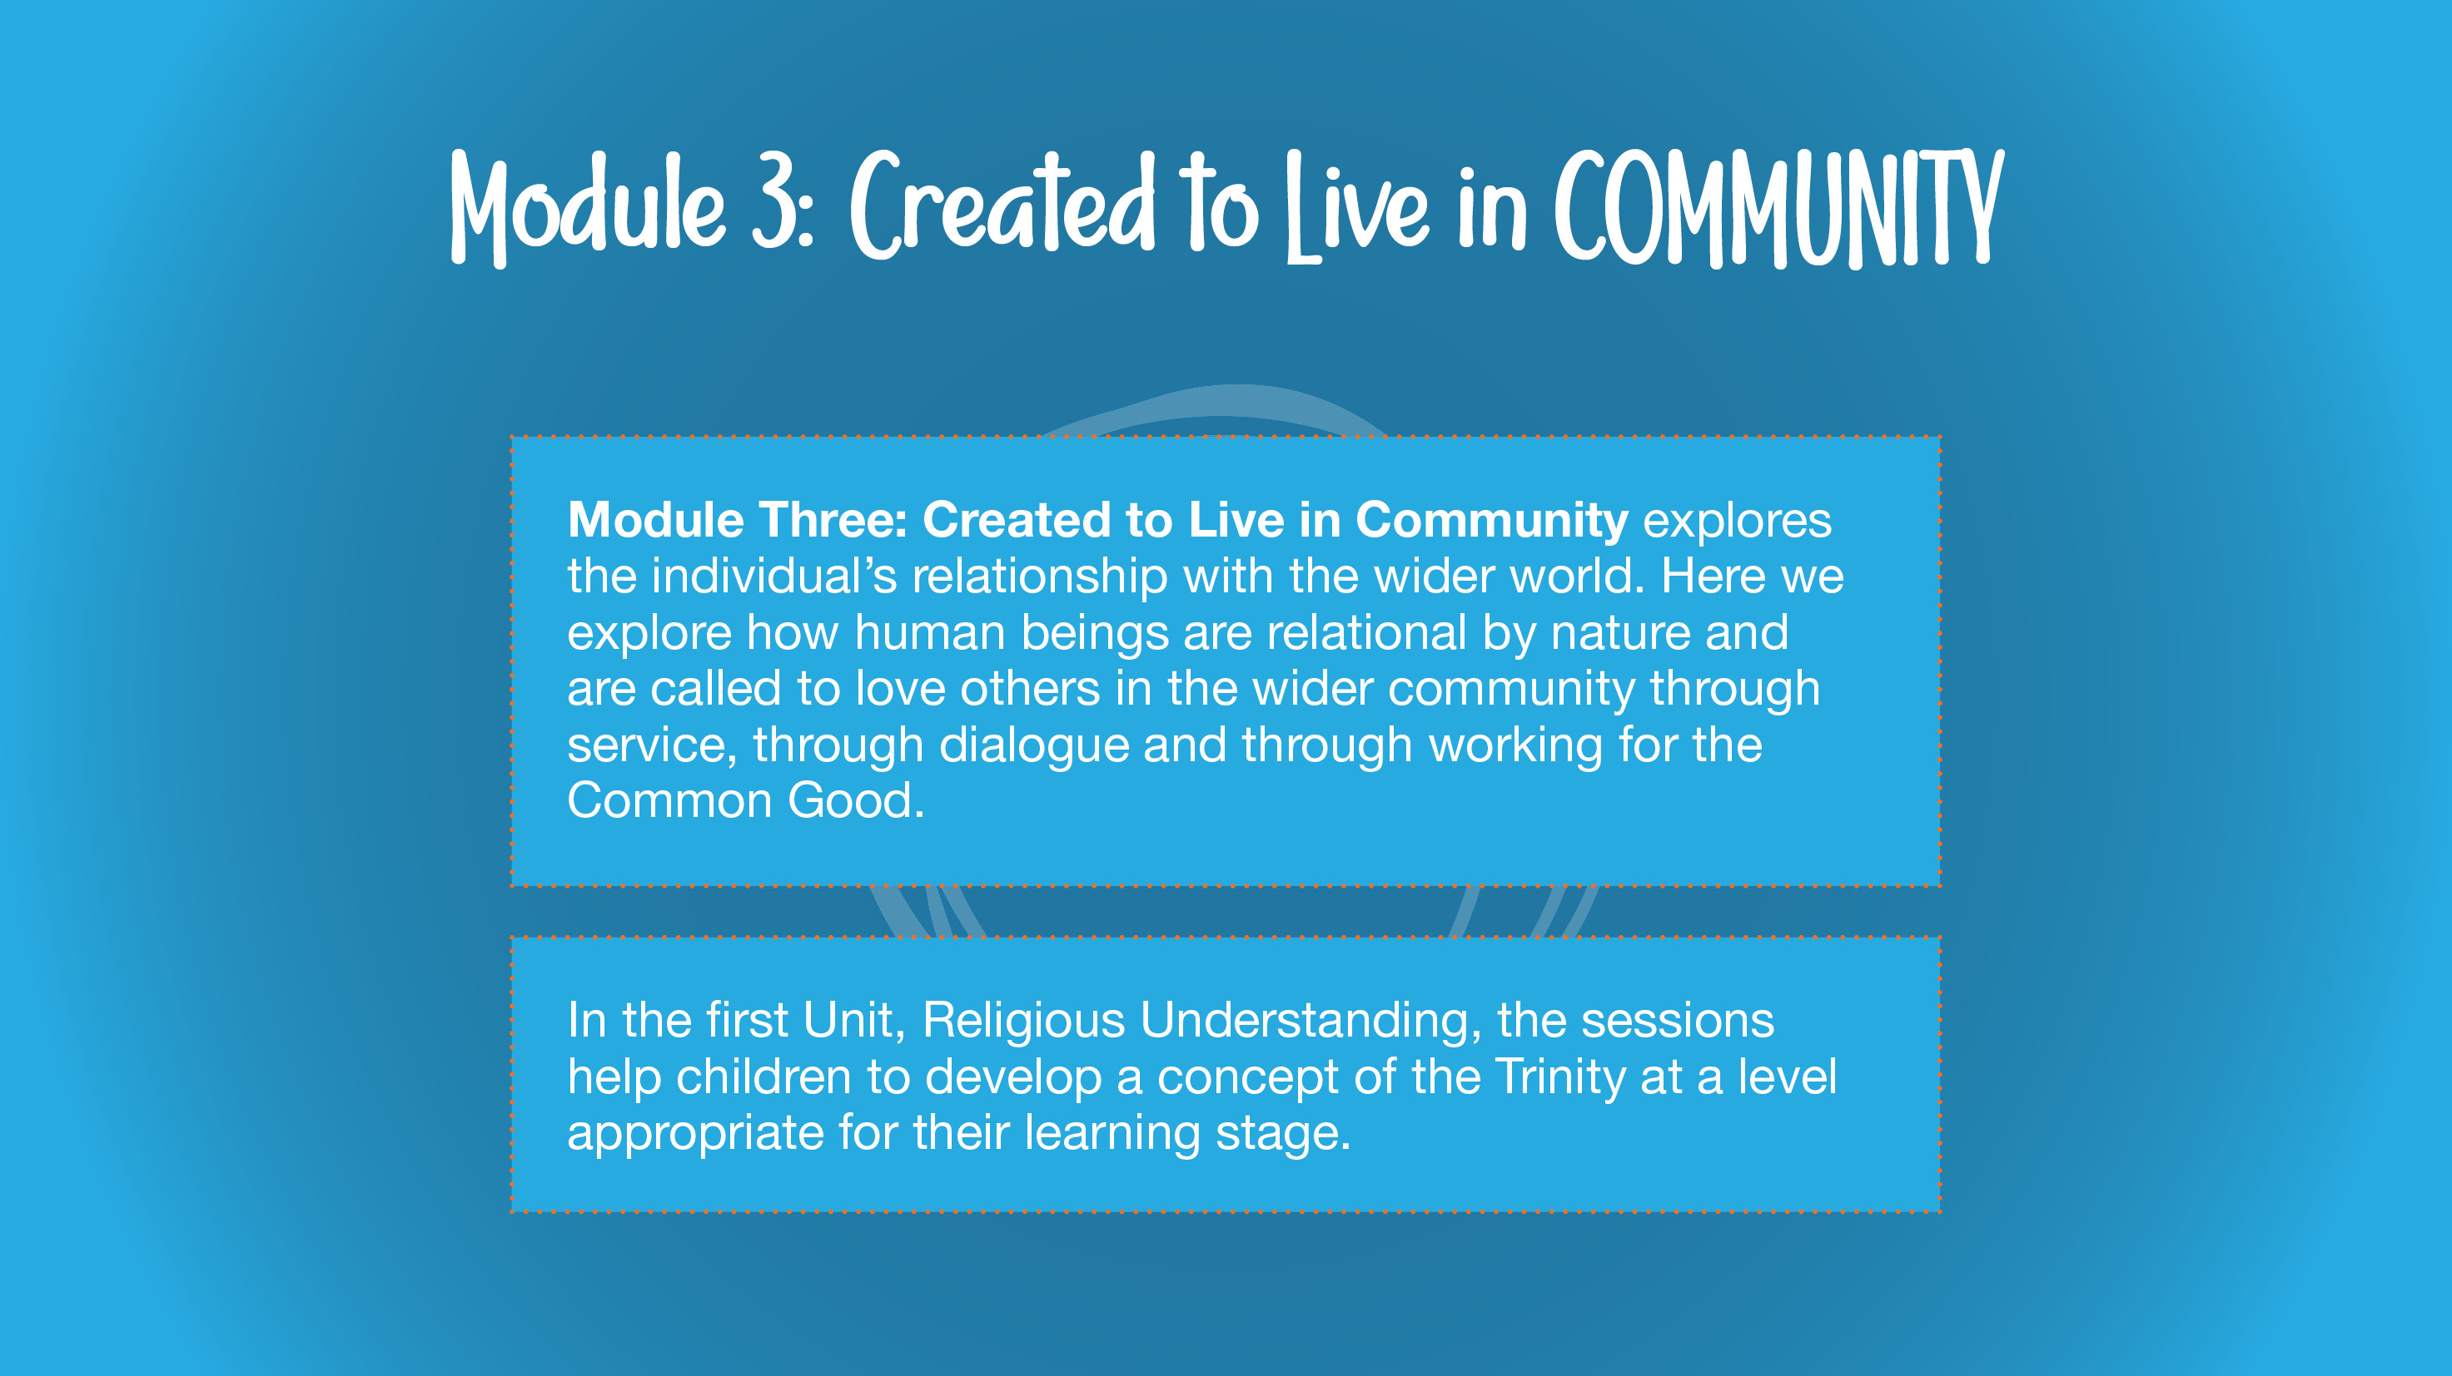

Slide 16
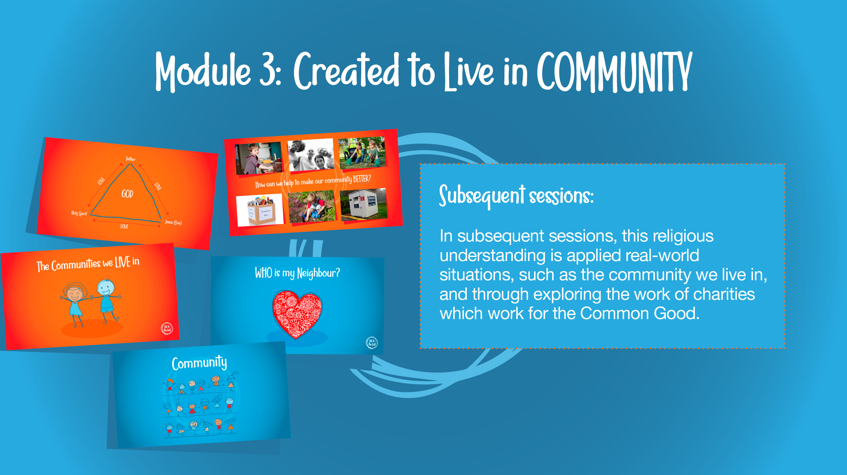

Slide 17
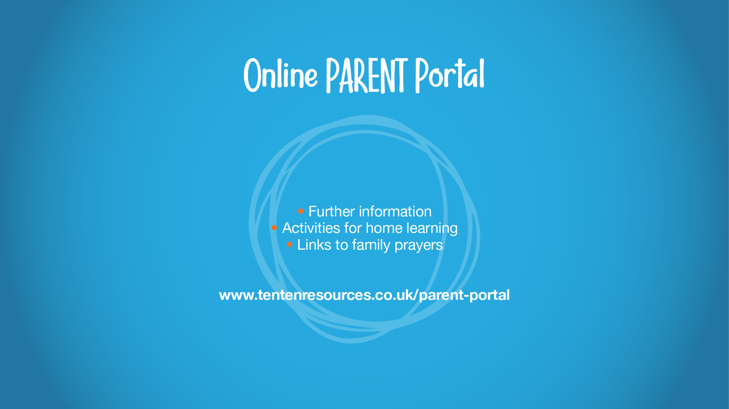

Slide 18
Module 1: Created and loved by God
Me, my body, my health
Session 1: Gifts and Talents
Session 2: Girls’ Bodies
Session 3: Boys’ Bodies
Session 4: Spots and Sleep
Emotional well-being
Session 5: Body Image
Session 6: Peculiar Feelings
Session 7: Emotional Changes
Session 8: Seeing Stuff Online
Life cycles
Session 9: Making Babies Pt1
Session 10: Menstruation
Making Babies Pt2 – this will not be taught in school as it is not statutory for UKS2– however you may wish to go through this with your child at home via the parent portal. Part 2 covers:
Basic scientific facts about sexual intercourse between a man and woman;
The physical, emotional, moral and spiritual implications of sexual intercourse;
The Christian viewpoint that sexual intercourse should be saved for marriage.

Slide 19
Me, my body, my health
Session 1: Gifts and Talents
Similarities and differences between people arise as they grow and mature, and that by living and working together (‘teamwork’) we create community;
Self-confidence arises from being loved by God (not status, etc).
Session 2: Girls’ Bodies
That human beings are different to other animals;
About the unique growth and development of humans, and the changes that girls will experience during puberty;
About the need to respect their bodies as a gift from God to be looked after well, and treated appropriately;
The need for modesty and appropriate boundaries.
Genitals are mentioned in this session.
Session 3: Boys’ Bodies
That human beings are different in kind to other animals;
About the unique growth and development of humans, and the changes that boys will experience during puberty;
About the need to respect their bodies as a gift from God to be looked after well, and treated appropriately;
The need for modesty and appropriate boundaries.
Genitals are mentioned in this session.
Session 4: Spots and Sleep
How to make good choices that have an impact on their health: rest and sleep, exercise, personal hygiene, avoiding the overuse of electronic entertainment, etc

Slide 20
Emotional well-being
Session 5: Body Image
To recognise that images in the media do not always reflect reality and can affect how people feel about themselves
That thankfulness builds resilience against feelings of envy, inadequacy, etc. and against pressure from peers or media
Session 6: Peculiar Feelings
To deepen their understanding of the range and intensity of their feelings; that ‘feelings’ are not good guides for action.
That some behaviour is wrong, unacceptable, unhealthy or risky.
Session 7: Emotional Changes
Emotions change as they grow up (including hormonal effects);
To deepen their understanding of the range and intensity of their feelings; that ‘feelings’ are not good guides for action;
About emotional well-being: that beauty, art, etc. can lift the spirit; and that also openness with trusted parents/carers/teachers when worried ensures healthy well-being.
Session 8: Seeing Stuff Online
The difference between harmful and harmless videos and images;
The impact that harmful videos and images can have on young minds;
Ways to combat and deal with viewing harmful videos and images.
This session explores the emotional and mental impact that videos and images of an adult nature can have on children and young people, particularly pornography. In the episode of “Paradise Street”, we explore the relationship that the characters have with their phone and online devices. Leyla and Siobhan rave about a vlogger they have discovered, whilst Finn secretly discovers a pornographic website. Initially shocked and scared by what he has seen, he becomes more and more drawn to it. When his Dad discovers what Finn has been looking at, he sits down with him for a chat to explain the effect that these videos and images will have on his young brain.

Slide 21
Life cycles
Session 9: Making Babies Pt1
How a baby grows and develops in its mother’s womb.
In this episode, Finn learns from his Mum how about the miraculous process of human life is conceived and developed in the womb.
Session 10: Menstruation
About the nature and role of menstruation in the fertility cycle, and that fertility is involved in the start of life;
Some practical help on how to manage the onset of menstruation.
In this session, we see that Siobhan gets her first period and doesn’t know quite what to do. She is sad that her Mum, who died a number of years ago, isn’t there to show her the ropes, but she is helped by her teacher and her Dad to become confident going forwards. Through this session, pupils will learn about how girls manage their periods, and understand some of their possible side effects. They will learn why periods happen; that fertility is necessary to bring a child into the world; and how periods are part of God’s plan for creation.

Slide 22
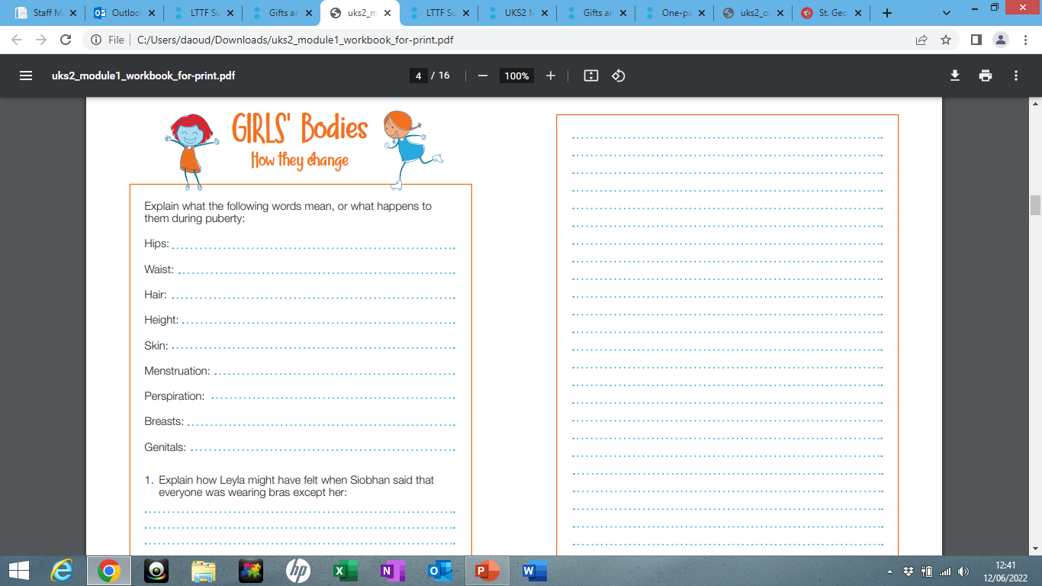
After each session, children will complete work in their workbooks.
On a separate piece of paper, children can write any other questions they have, with the option of being anonymous.
These questions will be addressed at the beginning of the next session.

Slide 23
Module 2: Created to love others
Personal Relationships
Session 1: Under Pressure
Session 2: Do You Want a Piece of Cake?
Session 3: Self-Talk
Keeping Safe
Session 4: Sharing Isn’t Always Caring
Session 5: Cyberbullying
Session 6: Types of Abuse
Session 7: Impacted Lifestyles
Session 8: Making Good Choices

Slide 24
Module 2: Created to love others
Personal Relationships
Session 1: Under Pressure
Pressure comes in different forms, and what those different forms are;
There are strategies that they can adopt to resist pressure.
Session 2: Do You Want a Piece of Cake?
Understand what consent and bodily autonomy means;
Discuss and reflect on different scenarios in which it is right to say ‘no’.
Session 3: Self-Talk
Learn about how thoughts and feelings impact on actions, and develop strategies that will positively impact their actions;
Apply this approach to personal friendships and relationships.

Slide 25
Keeping Safe
Session 4: Sharing Isn’t Always Caring
This session focuses children making safe and sensible decisions about what content to share or not share, including photos, passwords and other personal information. Children will discuss how this can be damaging and dangerous, and will rules to remember to keep themselves safe.
Session 5: Cyberbullying
What the term cyberbullying means and examples of it;
What cyberbullying feels like for the victim and how to get help if they experience cyberbullying.
Session 6: Types of Abuse
To judge well what kind of physical contact is acceptable or unacceptable and how to respond.
That there are different people we can trust for help, especially those closest to us who care for us, including parents, teachers and priests.
Session 7: Impacted Lifestyles
• Understand the effect that a range of substances including drugs, tobacco and alcohol can have on the body.
• Learn how to make good choices about substances that will have a positive impact on their health.
• Know that our bodies are created by God, so we should take care of them and be careful about what we consume.
Session 8: Making Good Choices
• Recognise how they may come under pressure when it comes to drugs, alcohol and tobacco
• Learn that they are entitled to say “no” for all sorts of reasons, but not least in order to protect their God-given bodies

Slide 26
Module 3: Created to live in community
Religious understanding
Session 1: The Trinity
To know that God the Father, God the Son and God the Holy Spirit make up the three persons of the Trinity.
To know that the Holy Spirit works through us to bring God’s love and goodness to others.
Session 2: Catholic Social Teaching (CST)
They will learn the principles of CST, how we can apply these to daily life and how ‘loving our neighbour’ might mean acting in ways that affect global organisations as well as individuals.
Living in the wider world
Session 3: Reaching out
Learn to apply the principles of Catholic Social Teaching to current issues.
Find ways in which they can spread God’s love in their community.

Slide 27


