Slide 1

Welcome to Year 1
October
2026
2026/2027
1

Slide 2
Meet the Staff
Mrs Combat
1C teacher
Year 1 lead
Ms Scott
1S teacher
Nadia
Teaching assistant
Helen
Teaching assistant
Mrs Barker
Teaching assistant

Slide 3
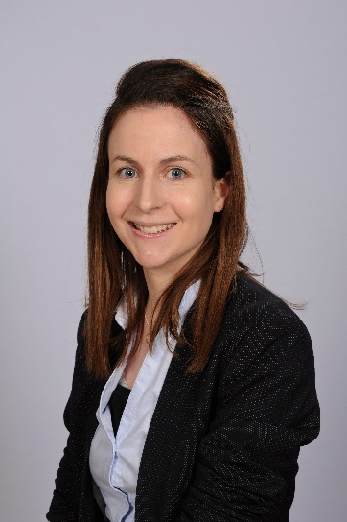
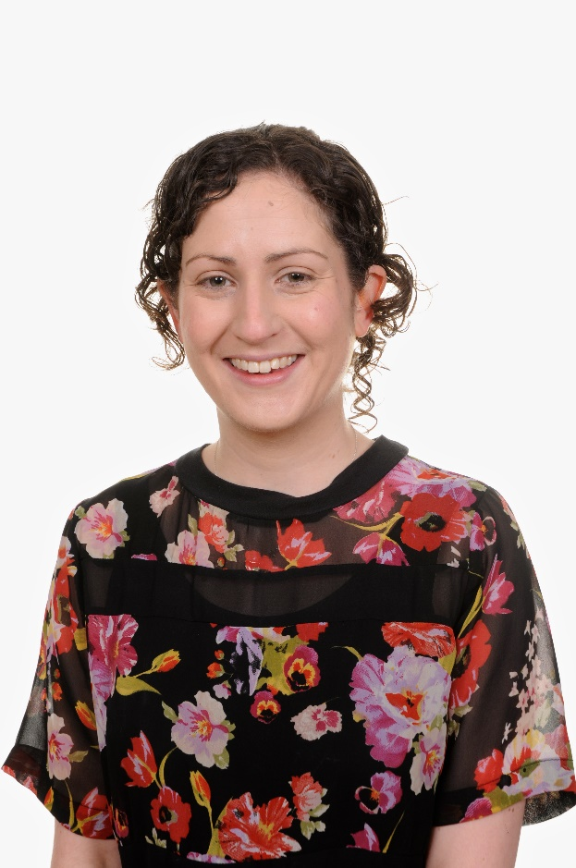
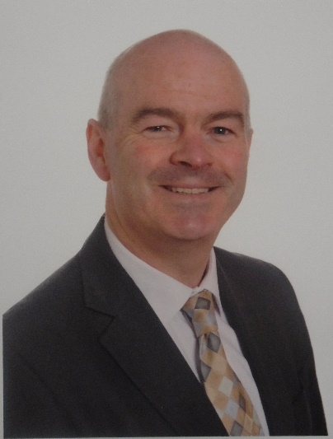
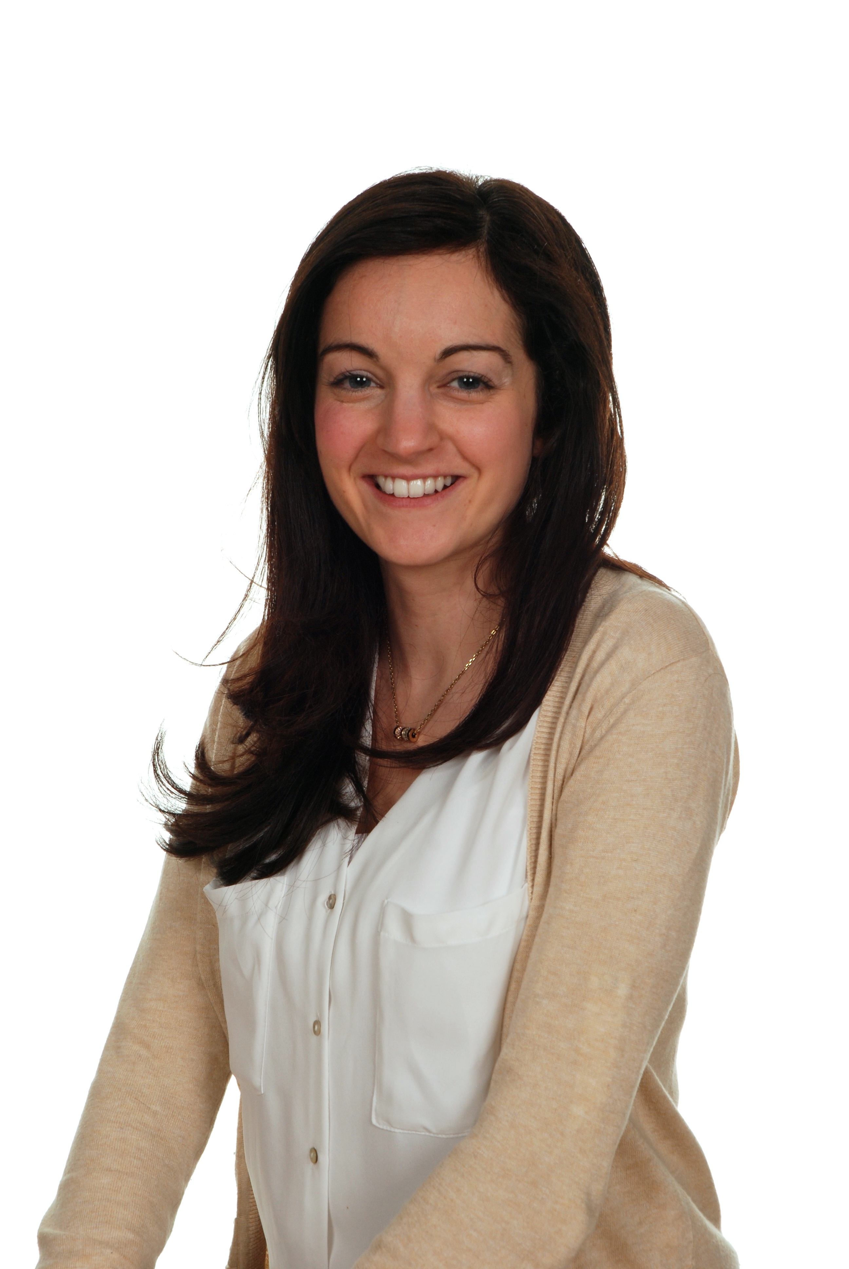
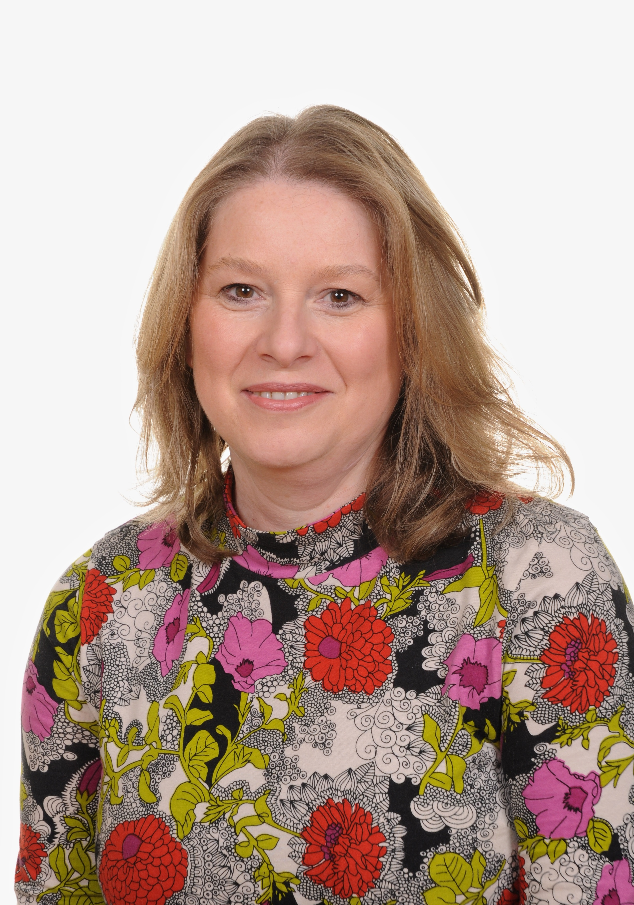
Senior Leadership Team
Mrs McGivern
Interim Deputy Headteacher
Mrs Hukowski
Deputy Headteacher
Mr O’Rourke
Headteacher
Mrs Burke
SENCO
Mrs Byfield
Assistant Headteacher

Slide 4
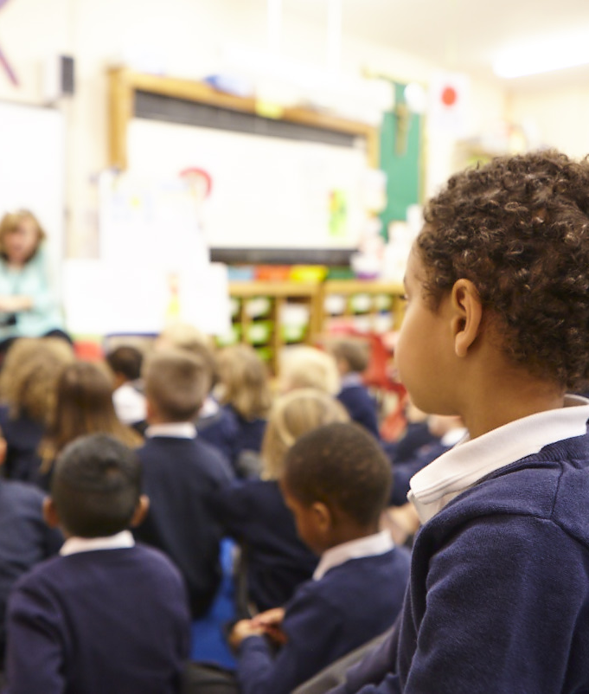
Transition
What to expect:
In year 1 we continue CPD (continuous play development) during the Autumn term and gradually introduce directed learning time, this includes the use of the outdoor area, practical resources during learning and small group activities.
Transitioning requires stopping one task, switching attention and preparing for what is next, we give children plenty of time to develop this skill using a visual timetable and lots of discussion.

Slide 5
A Typical Day
8.45: Soft Start and Registration
9.00: Guided reading
9.15: Phonics
9.45: Literacy
10.30: Playtime
10.45: Maths
12.00: Lunch
1.00: RE
2.15: Playtime
2.30: Topic/ Humanities
3.10: Act of worship
3.20: Story time
3.30: Home time

Slide 6
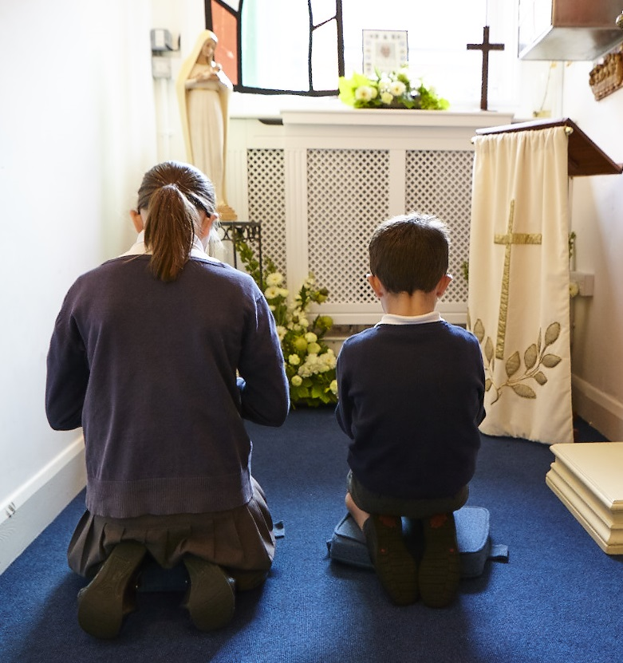
Catholic Life of the School
In everything we do today, we are following Jesus and His way.’
RE is at the heart of everything we do here at St George’s. It is through Religious Education that we that we lay the foundations for our pupils to grow into respectful, spiritual and moral individuals; supporting them in developing and deepening their relationship with God. The children are encouraged to reflect and ask questions about their faith.
Children engage and take part in Acts of Worship in the classroom, where the children have opportunities to plan and lead their own worship, choosing resources to aid this (i.e. candles, pebbles) and their own mission for everyone to work on (i.e. say kind words to someone). This ownership of their worship allows the children to further strengthen their beliefs and relationship with God.

Slide 7
Catholic Life of the School
In everything we do today, we are following Jesus and His way.’
Our topics this year in RE are:
Creation and Covenant
Prophecy and Promise
Galilee to Jerusalem
Desert to Garden
To The Ends of The Earth
Dialogue and Encounter

Slide 8

Homework
Homework will be set on DB Primary every Friday and is due to be completed by the following Thursday. If you have any issues accessing DB Primary, please do let us know. The homework that is set is for you to complete at your leisure with you child. This homework is for you to see what your child is doing in class and to consolidate their learning.

Slide 9

Reading
Home readers will be sent home on a Friday and should be returned on the following Thursday to enable your child’s class teacher to change and read the new book with your child. Please ensure that when you read with your child you are writing a small comment in their reading journal so that we can further monitor their progress in school. Children choose a reading for pleasure book from our library.

Slide 10
We want to know
How was your child’s…
Phonic knowledge
Segmenting and blending e.g. c-a-t -> cat
Pace of reading
Fluency with reading words
Expression and intonation throughout the book
For example;
James used his phonics to sound out the word snail really well.
Holly was able to identify the tricky words ‘the’ and ‘come’.
Robyn read using intonation which made her reading interesting.
William read with more fluency and pace today.

Slide 11

Guided Reading
In year 1, we will continue to use the reading scheme ‘Big Cats’ for our guided reading sessions and Bug club for our decodable home readers. Each child has been assessed and are matched with a book suitable to their reading ability.
The assessment covers both fluency and comprehension skills.
Children are mostly grouped with readers working at a similar level allowing them to read together through guided reading sessions and activities.

Slide 12

When do we read
at St George’s?
We read during our…
daily literacy lesson
daily phonics lesson
daily phonics game session
guided reading session 3 times a week
individual reading books once a week
adult lead storytelling

Slide 13
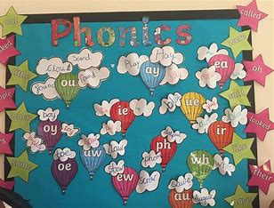
Why do we
teach phonics?
The ability to read has truly become a necessity to survive and thrive in today’s society. The best way to teach children to read is to ensure that a high quality, fun and engaging reading programme is delivered to children. This includes a structured phonics programme.
Phonics is a method for teaching reading and writing by developing learners’ phonemic awareness-the ability to hear, identify, and manipulate phonemes- in order to teach the correspondence between these sounds and the spelling patterns (graphemes) that represent them.

Slide 14
Did you know the English alphabet has 26 letters, which make 44 sounds and can be written 72 different ways?

Slide 15
How to say the sounds
Saying the sounds correctly with your child is extremely important
We say the shortest form of the sounds. No sound has an er or uh on the end
For example : a, b, c, d ,e, f, g, i, j,
Common mistakes: h, l, m, n, p, r, s, t

Slide 16
Phase 5
Children will be taught new graphemes and alternative pronunciations for these graphemes.
Digraphs (2 letters that make a sound): wh, ph, ay, ou, ie, ea, oy, ir, ue, aw, ew, oe, au
Trigraphs (3 letters that make a sound): igh, air, ear, oor, dge, tch
Split digraphs: a-e, e-e, i-e, o-e, u-e

Slide 17
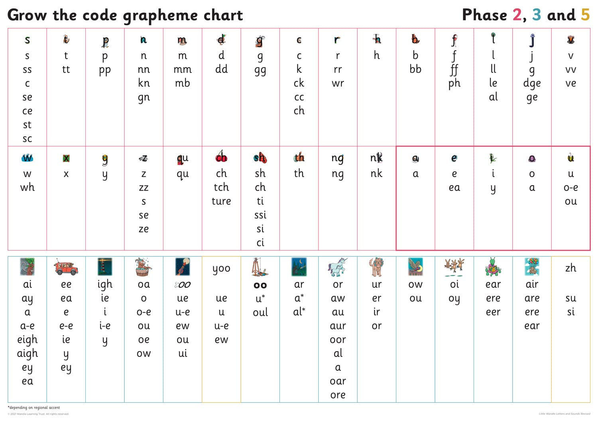

Slide 18
Spelling
Children’s spelling should be phonetically accurate, although it may still be a little unconventional at times. Spelling usually lags behind reading, as it is harder. Example:
It is tighm too gow hoam sed v katorpilla. But iy doat wont too gow howm sed th butt or flie. Iy wot to stai heyr.

Slide 19
What is the Phonics Screening Check?
Statutory Assessment for all Year 1 pupils in England
Designed to confirm whether pupils have learnt phonics sounds, decoding and blending to an appropriate standard and will identify pupils who need extra help to improve their skills.
The check consists of 20 real words and 20 alien-words that pupils read aloud.
Schools must administer the phonics screening check within the 1-week period from Monday 14 June 2027. (https://www.gov.uk/guidance/primary-assessments-future-dates)
If your child does not pass the Phonics screening check, they will sit it again in Year 2. Your child will receive further phonics support in Year 2.

Slide 20
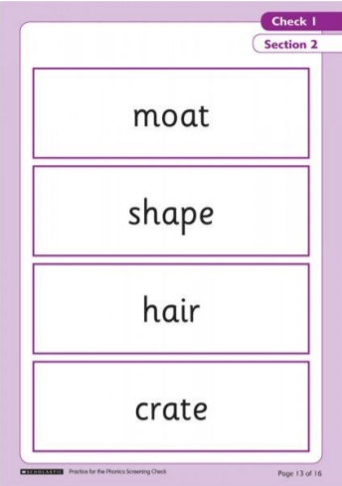
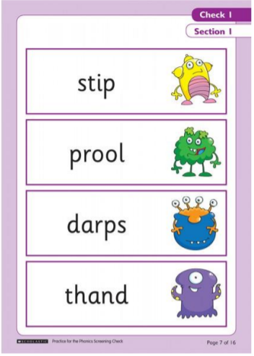
What is the Phonics Screening Check?
Real words
‘Alien’ words

Slide 21
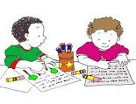
Literacy
Year 1: (statutory requirement)
Word: The grammatical difference between plural and possessive –s Standard English forms for verb inflections instead of local spoken forms [for example, we were instead of we was, or I did instead of I done]
Sentence: Noun phrases expanded by the addition of modifying adjectives, nouns and preposition phrases (e.g. the teacher expanded to: the strict maths teacher with curly hair)
Year 1 2026/2027

Slide 22
Topics
What makes me a me? (Autumn 1)
Toys (Autumn 2)
China (Spring 1)
Traditional tales (Spring 2)
Animals (Summer 1)
Minibeasts (Summer 2)
Topics are subject to change
Our Topic is interwoven within our humanities lessons, literacy lessons, art lessons, computing lessons.

Slide 23
Literacy
Writing expectations/Learning objectives in Year 1
Literacy writing | Autumn | Spring | Summer
Spelling | Can name and write the letter of the alphabet Spell words containing previously taught phonemes. Write from memory simple words dictated by the teacher (cvc words-phase 2) Can segment spoken words into their correct sounds. | Can spell words containing previously taught phonemes (See LW GPC’s) Can segment spoken words into individual phonemes and spell some correctly. Can spell some of year 1 common exception words | Can spell words containing previously taught phonemes (See LW GPC’s) Can spell most year 1 common exception words
Handwriting | Can use finger spaces between words. Can form capital letters. Can sit correctly at a table holding a pencil comfortably and correctly. Can write some lower case letters in the correct direction starting and finishing in the right place. Can form digits 0-9 | Can from most lower-case letters in the correct direction starting and finishing in the right place. Can from digits with the correct starting point and direction 0-9 | Can form all the lower case letters in the correct direction, starting and finishing in the right direction
Grammar | Can punctuate some sentences using capital letter and full stop. Can use a capital letter for the personal pronoun “I” | Can punctuate most sentences using a capital letter and a full stop. Joining words and joining clauses using ‘and’ Punctuate sentences using question mark. | Punctuate sentences using exclamation marks. Use a capital letter for names of people, places, the days of the week. Using the prefix un Can write words using -ing –ed -er and -est where no change is needed in the spelling of root words (eg helping, helper, eating, quicker, quickest)
Composition | Can verbalise what they are going to write about. Write sentences by composing a sentence orally before writing it. | Write sentences by sequencing sentences to form short narratives (real or fiction) Compose and write sentences independently to convey ideas. Discuss what they have written with the teacher or other pupils | Write sentences by re-reading what they have written to check that it makes sense. Read aloud their writing clearly enough to be heard by their peers and the teacher Write sentences to form short narratives or simple texts consisting of a paragraph or more.
Year 1: Detail of content to be introduced (statutory requirement)
Word: The grammatical difference between plural and possessive –s Standard English forms for verb inflections instead of local spoken forms [for example, we were instead of we was, or I did instead of I done]
Sentence: Noun phrases expanded by the addition of modifying adjectives, nouns and preposition phrases (e.g. the teacher expanded to: the strict maths teacher with curly hair) Fronted adverbials [for example, Later that day, I heard the bad news]
and the Use of commas after fronted adverbials.
23

Slide 24
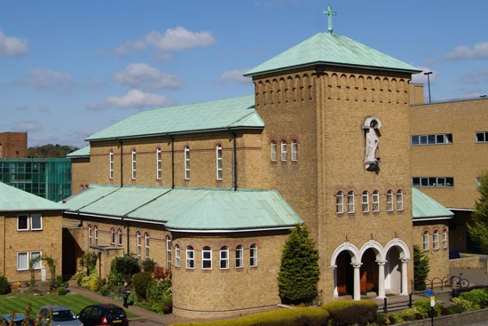

Educational Visits
Throughout the year, we intend use our local community area to help us enrich our children’s learning. We will visit Enfield Town, Enfield Town park and The Church often throughout the year. To do this we often will need your help to be part of the outing. Letters will be sent to you when this help is needed.
In the summer term we will be going on a educational visit further afield to enhance our summer term topic. Details will be sent out as soon as this has been confirmed.

Slide 25

Phonic Workshop
If you need help supporting your child with reading/phonics, Mrs Williams and I will be running a phonics workshop after school in the Spring term.
In this workshop you will become more confident in helping your child with phonics.
We will email you to let you know when this workshop will start running.

Slide 26

General Reminders
School uniform is to be worn each day. White shirt, grey trousers/shorts/skirt/dress, navy jumper and a school tie.
Please ensure children come to school in their PE kit on their PE days.
1C: Games Monday and PE Thursday
1S: Games Wednesday and PE Thursday
Please ensure your child has a named reusable water bottle each day. Hydration is important to health. No juice allowed.
No jewellery allowed including friendship bracelets.
(forms part of our risk assessment and school policy.)

Slide 27

How can you support your child at home?
Studies have shown that in Primary Schools, homework linked to learning in school, can have a positive impact of +3 months.
(EEF educational research).
Support children by encouraging them to set goals, plan, and manage their time, effort, and emotions. This type of support can help children to regulate their own learning and will often be more valuable than direct help with homework tasks. Ensure they have a quiet place to work – away from distractions. Discuss the task and ask them to explain what they need to do.
Year 1 2026/2027

Slide 28
How can you support your child at home?
Read with your child and encourage discussion around the book to develop children’s reading for meaning.
Practise weekly phonics homework.
Log in to DB Primary to access homework. (If you have any issues with passwords or logging into the learning platforms please let us know by emailing via the office).
Year 1 2026/2027

Slide 29

Thank You!
29
Year 1 2026/2027

