Slide 1

Year 2

Slide 2
The Year 2 Team
Year 2 Teachers:
2BN – Mrs Nugara (Monday and Tuesday)
Mrs Bedborough (Wednesday, Thursday, Friday)
2C – Mrs Chambi (Monday, Tuesday, Wednesday, Friday)
Mrs Conway (Thursday)
KS1 TAs:
Nadia, Helen (Monday-Friday)
Mrs Barker (Wednesday and Thursday)
KS1 Phase Leader: Mr Gavas

Slide 3

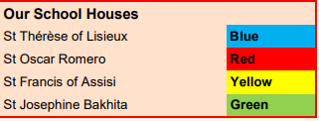
Each child is assigned a House Saint when they join our school and all siblings belong in the same House. Please ask your child’s class teacher if you are unsure which house they belong to.
Being a part of a Saint’s house reinforces our Mission Statement that we grow together as a family and also helps to nurture a sense of belonging.
Children in each house come together when it is their Saint’s feast day. We mark these days with a special Celebration of the Word where children from Reception to Year 6 gather together to hear more about the life of their Saint and to pray for their intercession.

Slide 4
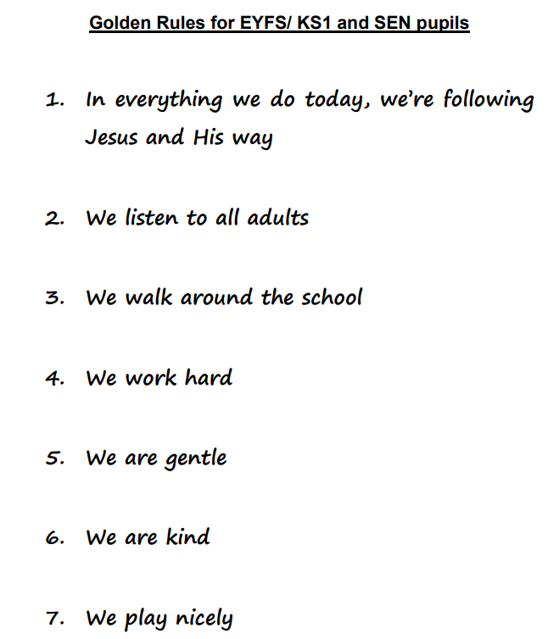
The Year 2
Learning Journey
The Golden Rules

Slide 5
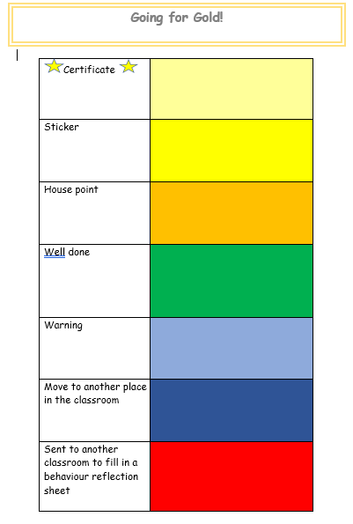
Behaviour
Children are rewarded for academic and non-academic achievements, for effort, for acts of kindness and for all aspects of good work and behaviour. Using a positive system of rewards, and reinforcing good behaviour, fosters children’s positive self-esteem.
In line with the School Behaviour policy, any negative behaviours/attitudes may result in consequences as children are moved down the chart – the consequences of their behaviour are designed to give them reflection time to consider their choices and think about how they can improve in the future.
Each class also has their own individual reward/behaviour management strategies which work alongside the chart to set expectations within the classroom.
2 merits are awarded in each class every week. This is a chance for children’s good achievements, efforts, kindness to be recognised and celebrated in our school community.

Slide 6
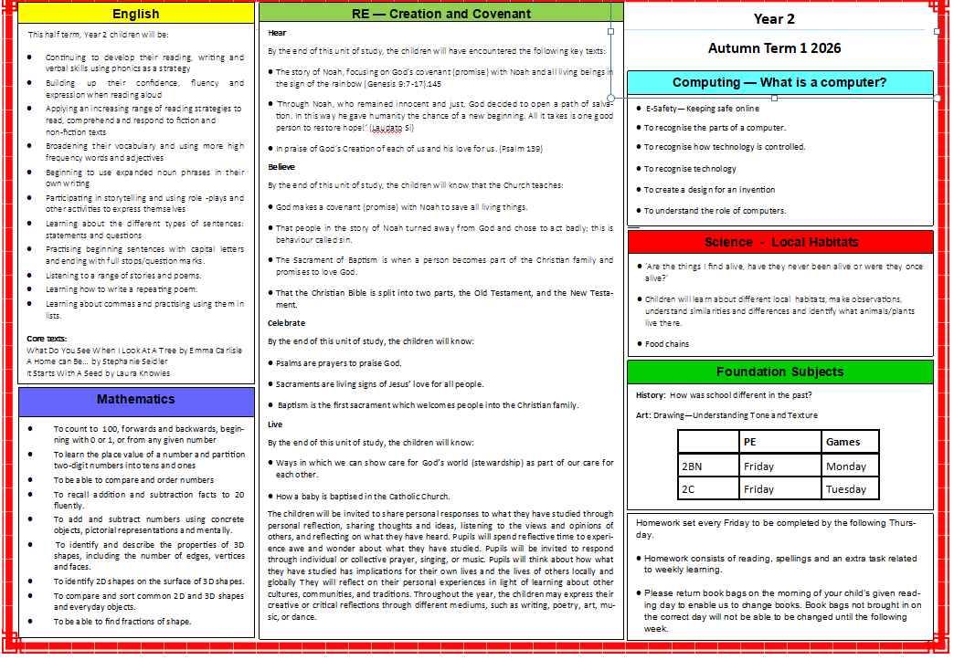
11th January
Beginning of new term Mass
27th March
Holy week Mass
1 Red
19/1/18
1 Ruby
26/1/18
Class
Class Mass
11am- Friday- in classroom
11th January
Beginning of new term Mass
27th March
Holy week Mass
1 Red
19/1/18
1 Ruby
26/1/18
Class
Class Mass
11am- Friday- in classroom
Curriculum
Each half term an overview of our learning will be uploaded onto the school website.
English
RE — Creation and Covenant
Year 2
Autumn Term 1 2024
English
RE — Creation and Covenant
Year 2
Autumn Term 1 2024
This half term, Year 2 children will be:
Continuing to develop their reading, writing and verbal skills using phonics as a strategy
Building up their confidence, fluency and
expression when reading aloud
Applying an increasing range of reading strategies to read, comprehend and respond to fiction and
non-fiction texts
Broadening their vocabulary and using more high frequency words and adjectives
Beginning to use expanded noun phrases in their own writing
Participating in storytelling and using role -plays and other activities to express themselves
Learning about the different types of sentences: statements and questions
Practising beginning sentences with capital letters and ending with full stops/question marks.
Listening to a range of stories and poems.
Learning how to write a repeating poem.
Learning about commas and practising using them in lists.
Core texts:
What Do You See When I Look At A Tree by Emma Carlisle
A Home can Be… by Stephanie Seidler
It starts with a seed by Laura Knowles
Hear
By the end of this unit of study, the children will have encountered the following key texts:
The story of Noah, focusing on God’s covenant (promise) with Noah and all living beings in the sign of the rainbow (Genesis 9:7-17).145
‘Through Noah, who remained innocent and just, God decided to open a path of salvation. In this way he gave humanity the chance of a new beginning. All it takes is one good person to restore hope!’ (Laudato Si)
In praise of God’s Creation of each of us and his love for us. (Psalm 139)
Believe
By the end of this unit of study, the children will know that the Church teaches:
God makes a covenant (promise) with Noah to save all living things.
That people in the story of Noah turned away from God and chose to act badly; this is behaviour called sin.
The Sacrament of Baptism is when a person becomes part of the Christian family and promises to love God.
That the Christian Bible is split into two parts, the Old Testament, and the New Testament.
Celebrate
By the end of this unit of study, the children will know:
Psalms are prayers to praise God.
Sacraments are living signs of Jesus’ love for all people.
Baptism is the first sacrament which welcomes people into the Christian family.
Live
By the end of this unit of study, the children will know:
Ways in which we can show care for God’s world (stewardship) as part of our care for each other.
How a baby is baptised in the Catholic Church.
The children will be invited to share personal responses to what they have studied through personal reflection, sharing thoughts and ideas, listening to the views and opinions of others, and reflecting on what they have heard. Pupils will spend reflective time to experience awe and wonder about what they have studied. Pupils will be invited to respond through individual or collective prayer, singing, or music. Pupils will think about how what they have studied has implications for their own lives and the lives of others locally and globally They will reflect on their personal experiences in light of learning about other cultures, communities, and traditions. Throughout the year, the children may express their creative or critical reflections through different mediums, such as writing, poetry, art, music, or dance.
This half term, Year 2 children will be:
Continuing to develop their reading, writing and verbal skills using phonics as a strategy
Building up their confidence, fluency and
expression when reading aloud
Applying an increasing range of reading strategies to read, comprehend and respond to fiction and
non-fiction texts
Broadening their vocabulary and using more high frequency words and adjectives
Beginning to use expanded noun phrases in their own writing
Participating in storytelling and using role -plays and other activities to express themselves
Learning about the different types of sentences: statements and questions
Practising beginning sentences with capital letters and ending with full stops/question marks.
Listening to a range of stories and poems.
Learning how to write a repeating poem.
Learning about commas and practising using them in lists.
Core texts:
What Do You See When I Look At A Tree by Emma Carlisle
A Home can Be… by Stephanie Seidler
It starts with a seed by Laura Knowles
Hear
By the end of this unit of study, the children will have encountered the following key texts:
The story of Noah, focusing on God’s covenant (promise) with Noah and all living beings in the sign of the rainbow (Genesis 9:7-17).145
‘Through Noah, who remained innocent and just, God decided to open a path of salvation. In this way he gave humanity the chance of a new beginning. All it takes is one good person to restore hope!’ (Laudato Si)
In praise of God’s Creation of each of us and his love for us. (Psalm 139)
Believe
By the end of this unit of study, the children will know that the Church teaches:
God makes a covenant (promise) with Noah to save all living things.
That people in the story of Noah turned away from God and chose to act badly; this is behaviour called sin.
The Sacrament of Baptism is when a person becomes part of the Christian family and promises to love God.
That the Christian Bible is split into two parts, the Old Testament, and the New Testament.
Celebrate
By the end of this unit of study, the children will know:
Psalms are prayers to praise God.
Sacraments are living signs of Jesus’ love for all people.
Baptism is the first sacrament which welcomes people into the Christian family.
Live
By the end of this unit of study, the children will know:
Ways in which we can show care for God’s world (stewardship) as part of our care for each other.
How a baby is baptised in the Catholic Church.
The children will be invited to share personal responses to what they have studied through personal reflection, sharing thoughts and ideas, listening to the views and opinions of others, and reflecting on what they have heard. Pupils will spend reflective time to experience awe and wonder about what they have studied. Pupils will be invited to respond through individual or collective prayer, singing, or music. Pupils will think about how what they have studied has implications for their own lives and the lives of others locally and globally They will reflect on their personal experiences in light of learning about other cultures, communities, and traditions. Throughout the year, the children may express their creative or critical reflections through different mediums, such as writing, poetry, art, music, or dance.
Computing — What is a computer?
Computing — What is a computer?
-Safety—Keeping safe online
To recognise the parts of a computer.
To recognise how technology is controlled.
To recognise technology
To create a design for an invention
To understand the role of computers.
-Safety—Keeping safe online
To recognise the parts of a computer.
To recognise how technology is controlled.
To recognise technology
To create a design for an invention
To understand the role of computers.
Science - Local Habitats
Science - Local Habitats
‘Are the things I find alive, have they never been alive or were they once alive?’
Children will learn about different local habitats, make observations, understand similarities and differences and identify what animals/plants live there.
Food chains
‘Are the things I find alive, have they never been alive or were they once alive?’
Children will learn about different local habitats, make observations, understand similarities and differences and identify what animals/plants live there.
Food chains
Foundation Subjects
Mathematics
Foundation Subjects
Mathematics
History: How was school different in the past?
Art: Drawing—Tell a story
To count to 100, forwards and backwards, beginning with 0 or 1, or from any given number
To learn the place value of a number and partition two-digit numbers into tens and ones
To be able to compare and order numbers
To recall addition and subtraction facts to 20 fluently.
To add and subtract numbers using concrete objects, pictorial representations and mentally.
To identify and describe the properties of 3D shapes, including the number of edges, vertices and faces.
To identify 2D shapes on the surface of 3D shapes.
To compare and sort common 2D and 3D shapes and everyday objects.
To be able to find fractions of shape.
History: How was school different in the past?
Art: Drawing—Tell a story
To count to 100, forwards and backwards, beginning with 0 or 1, or from any given number
To learn the place value of a number and partition two-digit numbers into tens and ones
To be able to compare and order numbers
To recall addition and subtraction facts to 20 fluently.
To add and subtract numbers using concrete objects, pictorial representations and mentally.
To identify and describe the properties of 3D shapes, including the number of edges, vertices and faces.
To identify 2D shapes on the surface of 3D shapes.
To compare and sort common 2D and 3D shapes and everyday objects.
To be able to find fractions of shape.
PE (Balance)
Games
2B
Thursday
Friday
2GS
Thursday
Tuesday
PE (Balance)
Games
2B
Thursday
Friday
2GS
Thursday
Tuesday
Homework set every Friday to be completed by the following Thursday.
Homework consists of reading, spellings and an extra task related to weekly learning.
Please return book bags on the morning of your child’s given reading day to enable us to change books. Book bags not brought in on the correct day will not be able to be changed until the following week.
Class
Class Mass
11am- Friday- in classroom
￼
￼
￼
￼
Homework set every Friday to be completed by the following Thursday.
Homework consists of reading, spellings and an extra task related to weekly learning.
Please return book bags on the morning of your child’s given reading day to enable us to change books. Book bags not brought in on the correct day will not be able to be changed until the following week.
Class
Class Mass
11am- Friday- in classroom
￼
￼
￼
￼

Slide 7
11th January
Beginning of new term Mass
27th March
Holy week Mass
1 Red
19/1/18
1 Ruby
26/1/18
Class
Class Mass
11am- Friday- in classroom
11th January
Beginning of new term Mass
27th March
Holy week Mass
1 Red
19/1/18
1 Ruby
26/1/18
Class
Class Mass
11am- Friday- in classroom
RE — Creation and Covenant
Hear
By the end of this unit of study, the children will have encountered the following key texts:
The story of Noah, focusing on God’s covenant (promise) with Noah and all living beings in the sign of the rainbow (Genesis 9:7-17).145
‘Through Noah, who remained innocent and just, God decided to open a path of salvation. In this way he gave humanity the chance of a new beginning. All it takes is one good person to restore hope!’ (Laudato Si)
In praise of God’s Creation of each of us and his love for us. (Psalm 139)
Believe
By the end of this unit of study, the children will know that the Church teaches:
God makes a covenant (promise) with Noah to save all living things.
That people in the story of Noah turned away from God and chose to act badly; this is behaviour called sin.
The Sacrament of Baptism is when a person becomes part of the Christian family and promises to love God.
That the Christian Bible is split into two parts, the Old Testament, and the New Testament.
Celebrate
By the end of this unit of study, the children will know:
Psalms are prayers to praise God.
Sacraments are living signs of Jesus’ love for all people.
Baptism is the first sacrament which welcomes people into the Christian family.
Live
By the end of this unit of study, the children will know:
Ways in which we can show care for God’s world (stewardship) as part of our care for each other.
How a baby is baptised in the Catholic Church.
The children will be invited to share personal responses to what they have studied through personal reflection, sharing thoughts and ideas, listening to the views and opinions of others, and reflecting on what they have heard. Pupils will spend reflective time to experience awe and wonder about what they have studied. Pupils will be invited to respond through individual or collective prayer, singing, or music. Pupils will think about how what they have studied has implications for their own lives and the lives of others locally and globally They will reflect on their personal experiences in light of learning about other cultures, communities, and traditions. Throughout the year, the children may express their creative or critical reflections through different mediums, such as writing, poetry, art, music, or dance.
English
RE — Creation and Covenant
Year 2
Autumn Term 1 2024
English
RE — Creation and Covenant
Year 2
Autumn Term 1 2024
This half term, Year 2 children will be:
Continuing to develop their reading, writing and verbal skills using phonics as a strategy
Building up their confidence, fluency and
expression when reading aloud
Applying an increasing range of reading strategies to read, comprehend and respond to fiction and
non-fiction texts
Broadening their vocabulary and using more high frequency words and adjectives
Beginning to use expanded noun phrases in their own writing
Participating in storytelling and using role -plays and other activities to express themselves
Learning about the different types of sentences: statements and questions
Practising beginning sentences with capital letters and ending with full stops/question marks.
Listening to a range of stories and poems.
Learning how to write a repeating poem.
Learning about commas and practising using them in lists.
Core texts:
What Do You See When I Look At A Tree by Emma Carlisle
A Home can Be… by Stephanie Seidler
It starts with a seed by Laura Knowles
Hear
By the end of this unit of study, the children will have encountered the following key texts:
The story of Noah, focusing on God’s covenant (promise) with Noah and all living beings in the sign of the rainbow (Genesis 9:7-17).145
‘Through Noah, who remained innocent and just, God decided to open a path of salvation. In this way he gave humanity the chance of a new beginning. All it takes is one good person to restore hope!’ (Laudato Si)
In praise of God’s Creation of each of us and his love for us. (Psalm 139)
Believe
By the end of this unit of study, the children will know that the Church teaches:
God makes a covenant (promise) with Noah to save all living things.
That people in the story of Noah turned away from God and chose to act badly; this is behaviour called sin.
The Sacrament of Baptism is when a person becomes part of the Christian family and promises to love God.
That the Christian Bible is split into two parts, the Old Testament, and the New Testament.
Celebrate
By the end of this unit of study, the children will know:
Psalms are prayers to praise God.
Sacraments are living signs of Jesus’ love for all people.
Baptism is the first sacrament which welcomes people into the Christian family.
Live
By the end of this unit of study, the children will know:
Ways in which we can show care for God’s world (stewardship) as part of our care for each other.
How a baby is baptised in the Catholic Church.
The children will be invited to share personal responses to what they have studied through personal reflection, sharing thoughts and ideas, listening to the views and opinions of others, and reflecting on what they have heard. Pupils will spend reflective time to experience awe and wonder about what they have studied. Pupils will be invited to respond through individual or collective prayer, singing, or music. Pupils will think about how what they have studied has implications for their own lives and the lives of others locally and globally They will reflect on their personal experiences in light of learning about other cultures, communities, and traditions. Throughout the year, the children may express their creative or critical reflections through different mediums, such as writing, poetry, art, music, or dance.
This half term, Year 2 children will be:
Continuing to develop their reading, writing and verbal skills using phonics as a strategy
Building up their confidence, fluency and
expression when reading aloud
Applying an increasing range of reading strategies to read, comprehend and respond to fiction and
non-fiction texts
Broadening their vocabulary and using more high frequency words and adjectives
Beginning to use expanded noun phrases in their own writing
Participating in storytelling and using role -plays and other activities to express themselves
Learning about the different types of sentences: statements and questions
Practising beginning sentences with capital letters and ending with full stops/question marks.
Listening to a range of stories and poems.
Learning how to write a repeating poem.
Learning about commas and practising using them in lists.
Core texts:
What Do You See When I Look At A Tree by Emma Carlisle
A Home can Be… by Stephanie Seidler
It starts with a seed by Laura Knowles
Hear
By the end of this unit of study, the children will have encountered the following key texts:
The story of Noah, focusing on God’s covenant (promise) with Noah and all living beings in the sign of the rainbow (Genesis 9:7-17).145
‘Through Noah, who remained innocent and just, God decided to open a path of salvation. In this way he gave humanity the chance of a new beginning. All it takes is one good person to restore hope!’ (Laudato Si)
In praise of God’s Creation of each of us and his love for us. (Psalm 139)
Believe
By the end of this unit of study, the children will know that the Church teaches:
God makes a covenant (promise) with Noah to save all living things.
That people in the story of Noah turned away from God and chose to act badly; this is behaviour called sin.
The Sacrament of Baptism is when a person becomes part of the Christian family and promises to love God.
That the Christian Bible is split into two parts, the Old Testament, and the New Testament.
Celebrate
By the end of this unit of study, the children will know:
Psalms are prayers to praise God.
Sacraments are living signs of Jesus’ love for all people.
Baptism is the first sacrament which welcomes people into the Christian family.
Live
By the end of this unit of study, the children will know:
Ways in which we can show care for God’s world (stewardship) as part of our care for each other.
How a baby is baptised in the Catholic Church.
The children will be invited to share personal responses to what they have studied through personal reflection, sharing thoughts and ideas, listening to the views and opinions of others, and reflecting on what they have heard. Pupils will spend reflective time to experience awe and wonder about what they have studied. Pupils will be invited to respond through individual or collective prayer, singing, or music. Pupils will think about how what they have studied has implications for their own lives and the lives of others locally and globally They will reflect on their personal experiences in light of learning about other cultures, communities, and traditions. Throughout the year, the children may express their creative or critical reflections through different mediums, such as writing, poetry, art, music, or dance.
Computing — What is a computer?
Computing — What is a computer?
-Safety—Keeping safe online
To recognise the parts of a computer.
To recognise how technology is controlled.
To recognise technology
To create a design for an invention
To understand the role of computers.
-Safety—Keeping safe online
To recognise the parts of a computer.
To recognise how technology is controlled.
To recognise technology
To create a design for an invention
To understand the role of computers.
Science - Local Habitats
Science - Local Habitats
‘Are the things I find alive, have they never been alive or were they once alive?’
Children will learn about different local habitats, make observations, understand similarities and differences and identify what animals/plants live there.
Food chains
‘Are the things I find alive, have they never been alive or were they once alive?’
Children will learn about different local habitats, make observations, understand similarities and differences and identify what animals/plants live there.
Food chains
Foundation Subjects
Mathematics
Foundation Subjects
Mathematics
History: How was school different in the past?
Art: Drawing—Tell a story
To count to 100, forwards and backwards, beginning with 0 or 1, or from any given number
To learn the place value of a number and partition two-digit numbers into tens and ones
To be able to compare and order numbers
To recall addition and subtraction facts to 20 fluently.
To add and subtract numbers using concrete objects, pictorial representations and mentally.
To identify and describe the properties of 3D shapes, including the number of edges, vertices and faces.
To identify 2D shapes on the surface of 3D shapes.
To compare and sort common 2D and 3D shapes and everyday objects.
To be able to find fractions of shape.
History: How was school different in the past?
Art: Drawing—Tell a story
To count to 100, forwards and backwards, beginning with 0 or 1, or from any given number
To learn the place value of a number and partition two-digit numbers into tens and ones
To be able to compare and order numbers
To recall addition and subtraction facts to 20 fluently.
To add and subtract numbers using concrete objects, pictorial representations and mentally.
To identify and describe the properties of 3D shapes, including the number of edges, vertices and faces.
To identify 2D shapes on the surface of 3D shapes.
To compare and sort common 2D and 3D shapes and everyday objects.
To be able to find fractions of shape.
PE (Balance)
Games
2B
Thursday
Friday
2GS
Thursday
Tuesday
PE (Balance)
Games
2B
Thursday
Friday
2GS
Thursday
Tuesday
Homework set every Friday to be completed by the following Thursday.
Homework consists of reading, spellings and an extra task related to weekly learning.
Please return book bags on the morning of your child’s given reading day to enable us to change books. Book bags not brought in on the correct day will not be able to be changed until the following week.
Class
Class Mass
11am- Friday- in classroom
￼
￼
￼
￼
Homework set every Friday to be completed by the following Thursday.
Homework consists of reading, spellings and an extra task related to weekly learning.
Please return book bags on the morning of your child’s given reading day to enable us to change books. Book bags not brought in on the correct day will not be able to be changed until the following week.
Class
Class Mass
11am- Friday- in classroom
￼
￼
￼
￼

Slide 8
11th January
Beginning of new term Mass
27th March
Holy week Mass
1 Red
19/1/18
1 Ruby
26/1/18
Class
Class Mass
11am- Friday- in classroom
11th January
Beginning of new term Mass
27th March
Holy week Mass
1 Red
19/1/18
1 Ruby
26/1/18
Class
Class Mass
11am- Friday- in classroom
English
This half term, Year 2 children will be:
Continuing to develop their reading, writing and verbal skills using phonics as a strategy
Building up their confidence, fluency and
expression when reading aloud
Applying an increasing range of reading strategies to read, comprehend and respond to fiction and
non-fiction texts
Broadening their vocabulary and using more high frequency words and adjectives
Beginning to use expanded noun phrases in their own writing
Participating in storytelling and using role -plays and other activities to express themselves
Learning about the different types of sentences: statements and questions
Practising beginning sentences with capital letters and ending with full stops/question marks.
Listening to a range of stories and poems.
Learning how to write a repeating poem.
Learning about commas and practising using them in lists.
Core texts:
What Do You See When I Look At A Tree by Emma Carlisle
A Home can Be… by Stephanie Seidler
It starts with a seed by Laura Knowles
English
RE — Creation and Covenant
Year 2
Autumn Term 1 2024
English
RE — Creation and Covenant
Year 2
Autumn Term 1 2024
This half term, Year 2 children will be:
Continuing to develop their reading, writing and verbal skills using phonics as a strategy
Building up their confidence, fluency and
expression when reading aloud
Applying an increasing range of reading strategies to read, comprehend and respond to fiction and
non-fiction texts
Broadening their vocabulary and using more high frequency words and adjectives
Beginning to use expanded noun phrases in their own writing
Participating in storytelling and using role -plays and other activities to express themselves
Learning about the different types of sentences: statements and questions
Practising beginning sentences with capital letters and ending with full stops/question marks.
Listening to a range of stories and poems.
Learning how to write a repeating poem.
Learning about commas and practising using them in lists.
Core texts:
What Do You See When I Look At A Tree by Emma Carlisle
A Home can Be… by Stephanie Seidler
It starts with a seed by Laura Knowles
Hear
By the end of this unit of study, the children will have encountered the following key texts:
The story of Noah, focusing on God’s covenant (promise) with Noah and all living beings in the sign of the rainbow (Genesis 9:7-17).145
‘Through Noah, who remained innocent and just, God decided to open a path of salvation. In this way he gave humanity the chance of a new beginning. All it takes is one good person to restore hope!’ (Laudato Si)
In praise of God’s Creation of each of us and his love for us. (Psalm 139)
Believe
By the end of this unit of study, the children will know that the Church teaches:
God makes a covenant (promise) with Noah to save all living things.
That people in the story of Noah turned away from God and chose to act badly; this is behaviour called sin.
The Sacrament of Baptism is when a person becomes part of the Christian family and promises to love God.
That the Christian Bible is split into two parts, the Old Testament, and the New Testament.
Celebrate
By the end of this unit of study, the children will know:
Psalms are prayers to praise God.
Sacraments are living signs of Jesus’ love for all people.
Baptism is the first sacrament which welcomes people into the Christian family.
Live
By the end of this unit of study, the children will know:
Ways in which we can show care for God’s world (stewardship) as part of our care for each other.
How a baby is baptised in the Catholic Church.
The children will be invited to share personal responses to what they have studied through personal reflection, sharing thoughts and ideas, listening to the views and opinions of others, and reflecting on what they have heard. Pupils will spend reflective time to experience awe and wonder about what they have studied. Pupils will be invited to respond through individual or collective prayer, singing, or music. Pupils will think about how what they have studied has implications for their own lives and the lives of others locally and globally They will reflect on their personal experiences in light of learning about other cultures, communities, and traditions. Throughout the year, the children may express their creative or critical reflections through different mediums, such as writing, poetry, art, music, or dance.
This half term, Year 2 children will be:
Continuing to develop their reading, writing and verbal skills using phonics as a strategy
Building up their confidence, fluency and
expression when reading aloud
Applying an increasing range of reading strategies to read, comprehend and respond to fiction and
non-fiction texts
Broadening their vocabulary and using more high frequency words and adjectives
Beginning to use expanded noun phrases in their own writing
Participating in storytelling and using role -plays and other activities to express themselves
Learning about the different types of sentences: statements and questions
Practising beginning sentences with capital letters and ending with full stops/question marks.
Listening to a range of stories and poems.
Learning how to write a repeating poem.
Learning about commas and practising using them in lists.
Core texts:
What Do You See When I Look At A Tree by Emma Carlisle
A Home can Be… by Stephanie Seidler
It starts with a seed by Laura Knowles
Hear
By the end of this unit of study, the children will have encountered the following key texts:
The story of Noah, focusing on God’s covenant (promise) with Noah and all living beings in the sign of the rainbow (Genesis 9:7-17).145
‘Through Noah, who remained innocent and just, God decided to open a path of salvation. In this way he gave humanity the chance of a new beginning. All it takes is one good person to restore hope!’ (Laudato Si)
In praise of God’s Creation of each of us and his love for us. (Psalm 139)
Believe
By the end of this unit of study, the children will know that the Church teaches:
God makes a covenant (promise) with Noah to save all living things.
That people in the story of Noah turned away from God and chose to act badly; this is behaviour called sin.
The Sacrament of Baptism is when a person becomes part of the Christian family and promises to love God.
That the Christian Bible is split into two parts, the Old Testament, and the New Testament.
Celebrate
By the end of this unit of study, the children will know:
Psalms are prayers to praise God.
Sacraments are living signs of Jesus’ love for all people.
Baptism is the first sacrament which welcomes people into the Christian family.
Live
By the end of this unit of study, the children will know:
Ways in which we can show care for God’s world (stewardship) as part of our care for each other.
How a baby is baptised in the Catholic Church.
The children will be invited to share personal responses to what they have studied through personal reflection, sharing thoughts and ideas, listening to the views and opinions of others, and reflecting on what they have heard. Pupils will spend reflective time to experience awe and wonder about what they have studied. Pupils will be invited to respond through individual or collective prayer, singing, or music. Pupils will think about how what they have studied has implications for their own lives and the lives of others locally and globally They will reflect on their personal experiences in light of learning about other cultures, communities, and traditions. Throughout the year, the children may express their creative or critical reflections through different mediums, such as writing, poetry, art, music, or dance.
Computing — What is a computer?
Computing — What is a computer?
-Safety—Keeping safe online
To recognise the parts of a computer.
To recognise how technology is controlled.
To recognise technology
To create a design for an invention
To understand the role of computers.
-Safety—Keeping safe online
To recognise the parts of a computer.
To recognise how technology is controlled.
To recognise technology
To create a design for an invention
To understand the role of computers.
Science - Local Habitats
Science - Local Habitats
‘Are the things I find alive, have they never been alive or were they once alive?’
Children will learn about different local habitats, make observations, understand similarities and differences and identify what animals/plants live there.
Food chains
‘Are the things I find alive, have they never been alive or were they once alive?’
Children will learn about different local habitats, make observations, understand similarities and differences and identify what animals/plants live there.
Food chains
Foundation Subjects
Mathematics
Foundation Subjects
Mathematics
History: How was school different in the past?
Art: Drawing—Tell a story
To count to 100, forwards and backwards, beginning with 0 or 1, or from any given number
To learn the place value of a number and partition two-digit numbers into tens and ones
To be able to compare and order numbers
To recall addition and subtraction facts to 20 fluently.
To add and subtract numbers using concrete objects, pictorial representations and mentally.
To identify and describe the properties of 3D shapes, including the number of edges, vertices and faces.
To identify 2D shapes on the surface of 3D shapes.
To compare and sort common 2D and 3D shapes and everyday objects.
To be able to find fractions of shape.
History: How was school different in the past?
Art: Drawing—Tell a story
To count to 100, forwards and backwards, beginning with 0 or 1, or from any given number
To learn the place value of a number and partition two-digit numbers into tens and ones
To be able to compare and order numbers
To recall addition and subtraction facts to 20 fluently.
To add and subtract numbers using concrete objects, pictorial representations and mentally.
To identify and describe the properties of 3D shapes, including the number of edges, vertices and faces.
To identify 2D shapes on the surface of 3D shapes.
To compare and sort common 2D and 3D shapes and everyday objects.
To be able to find fractions of shape.
PE (Balance)
Games
2B
Thursday
Friday
2GS
Thursday
Tuesday
PE (Balance)
Games
2B
Thursday
Friday
2GS
Thursday
Tuesday
Homework set every Friday to be completed by the following Thursday.
Homework consists of reading, spellings and an extra task related to weekly learning.
Please return book bags on the morning of your child’s given reading day to enable us to change books. Book bags not brought in on the correct day will not be able to be changed until the following week.
Class
Class Mass
11am- Friday- in classroom
￼
￼
￼
￼
Homework set every Friday to be completed by the following Thursday.
Homework consists of reading, spellings and an extra task related to weekly learning.
Please return book bags on the morning of your child’s given reading day to enable us to change books. Book bags not brought in on the correct day will not be able to be changed until the following week.
Class
Class Mass
11am- Friday- in classroom
￼
￼
￼
￼

Slide 9
Reading in Year 2
In Year 2, reading is not just focused on word recognition. There is a greater emphasis on reading with fluency and comprehension, asking questions to check the children’s understanding of new vocabulary and the meaning of what they are reading. There is also a greater emphasis on reading with intonation and expression. This often means that the children won’t change levels as frequently so they have chance to develop their comprehension skills including answering questions using inferences and read different genres and types of text.

Slide 10
Guided Reading
In Year 2, we have 3 Guided Reading session a week. During these sessions, the children read with adults in school in a group of children at a similar reading level to them.
The children and adults enjoy these sessions as they give the children a real chance to make predictions, discuss their opinions on the text and relate them to their own experiences.
Session 1 - Decoding, recognising and understanding
vocabulary and predicting
Session 2 – Fluency and Prosody (reading with expression)
Session 3 - Comprehension - process written text and
understand it’s meaning

Slide 11
Book Bags
In Year 2 we will begin visiting the School Library on Wednesday. This is when the children will change their reading book and it is a chance for them to choose a book from the Library to take home. This book will be your child’s choice for them to read with you for pleasure. It is important that book bags are brought in on the correct day to enable the children to receive a new reading book.
Please do not bring book bags in until the correct day on the following week as the children should be reading as much as possible throughout the week. Reading is about more than just recognition of the words.
We would appreciate you writing a little comment in the yellow reading record so we know how the children got on reading at home. The reading book in the book bag is not the book we read with them. We read a book of the same level in our Guided Reading sessions.

Slide 12
Reading for pleasure
We want to encourage the children to develop a love of reading.
We have a wide selection of book in our classrooms and in the library and communal reading areas around the school but some children enjoy bringing a book of their choice in from home.
As we only want to encourage reading, we are happy for this to happen but we do ask these books are labelled to avoid any mix ups and with the amount of books in our classrooms we are unable to accept responsibility of these books.

Slide 13
Writing
In Year 2 we encourage the children to take care of the presentation of their work and we are continuing to practise cursive letter formation and joined up letters.
We are working on the children writing coherent sentences, beginning with a capital letter and ending with a full stop. The children are encouraged to read through the sentences they have written to check that they make sense and to check for any mistakes or areas for improvement.

Slide 14
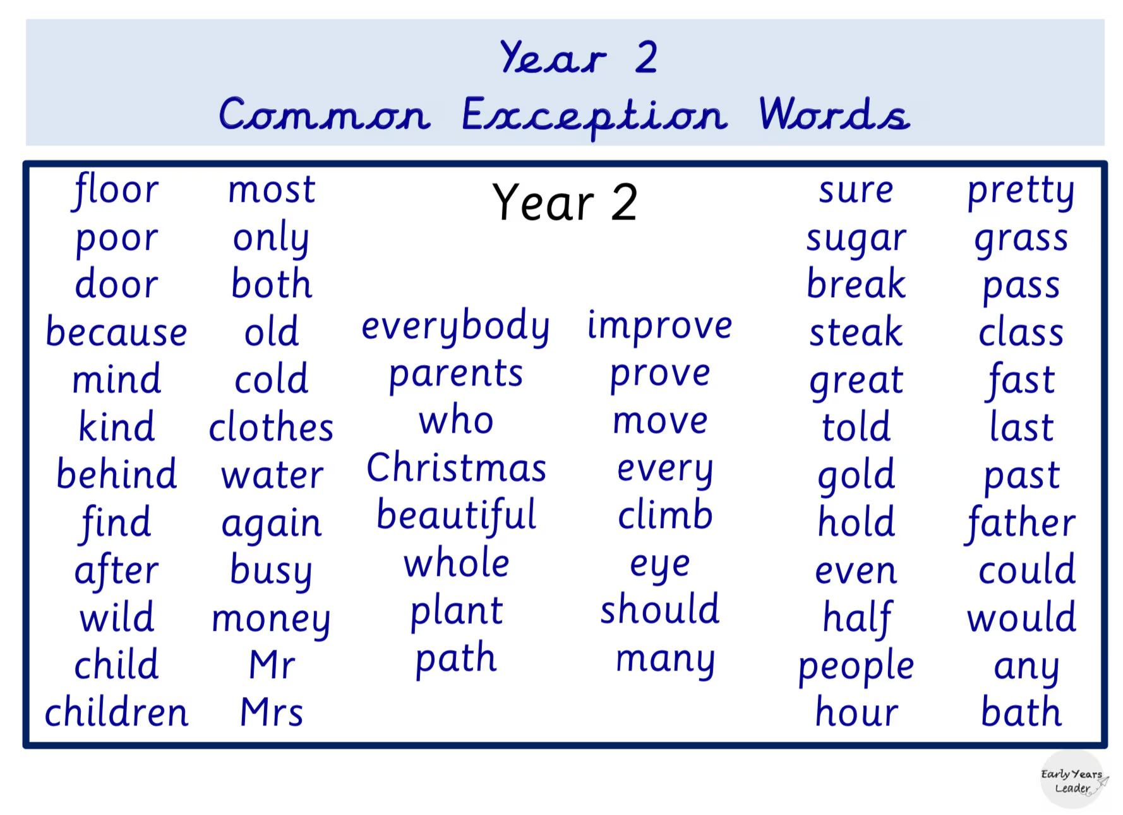
11th January
Beginning of new term Mass
27th March
Holy week Mass
1 Red
19/1/18
1 Ruby
26/1/18
Class
Class Mass
11am- Friday- in classroom
11th January
Beginning of new term Mass
27th March
Holy week Mass
1 Red
19/1/18
1 Ruby
26/1/18
Class
Class Mass
11am- Friday- in classroom
Spelling
English
RE — Creation and Covenant
Year 2
Autumn Term 1 2024
English
RE — Creation and Covenant
Year 2
Autumn Term 1 2024
This half term, Year 2 children will be:
Continuing to develop their reading, writing and verbal skills using phonics as a strategy
Building up their confidence, fluency and
expression when reading aloud
Applying an increasing range of reading strategies to read, comprehend and respond to fiction and
non-fiction texts
Broadening their vocabulary and using more high frequency words and adjectives
Beginning to use expanded noun phrases in their own writing
Participating in storytelling and using role -plays and other activities to express themselves
Learning about the different types of sentences: statements and questions
Practising beginning sentences with capital letters and ending with full stops/question marks.
Listening to a range of stories and poems.
Learning how to write a repeating poem.
Learning about commas and practising using them in lists.
Core texts:
What Do You See When I Look At A Tree by Emma Carlisle
A Home can Be… by Stephanie Seidler
It starts with a seed by Laura Knowles
Hear
By the end of this unit of study, the children will have encountered the following key texts:
The story of Noah, focusing on God’s covenant (promise) with Noah and all living beings in the sign of the rainbow (Genesis 9:7-17).145
‘Through Noah, who remained innocent and just, God decided to open a path of salvation. In this way he gave humanity the chance of a new beginning. All it takes is one good person to restore hope!’ (Laudato Si)
In praise of God’s Creation of each of us and his love for us. (Psalm 139)
Believe
By the end of this unit of study, the children will know that the Church teaches:
God makes a covenant (promise) with Noah to save all living things.
That people in the story of Noah turned away from God and chose to act badly; this is behaviour called sin.
The Sacrament of Baptism is when a person becomes part of the Christian family and promises to love God.
That the Christian Bible is split into two parts, the Old Testament, and the New Testament.
Celebrate
By the end of this unit of study, the children will know:
Psalms are prayers to praise God.
Sacraments are living signs of Jesus’ love for all people.
Baptism is the first sacrament which welcomes people into the Christian family.
Live
By the end of this unit of study, the children will know:
Ways in which we can show care for God’s world (stewardship) as part of our care for each other.
How a baby is baptised in the Catholic Church.
The children will be invited to share personal responses to what they have studied through personal reflection, sharing thoughts and ideas, listening to the views and opinions of others, and reflecting on what they have heard. Pupils will spend reflective time to experience awe and wonder about what they have studied. Pupils will be invited to respond through individual or collective prayer, singing, or music. Pupils will think about how what they have studied has implications for their own lives and the lives of others locally and globally They will reflect on their personal experiences in light of learning about other cultures, communities, and traditions. Throughout the year, the children may express their creative or critical reflections through different mediums, such as writing, poetry, art, music, or dance.
This half term, Year 2 children will be:
Continuing to develop their reading, writing and verbal skills using phonics as a strategy
Building up their confidence, fluency and
expression when reading aloud
Applying an increasing range of reading strategies to read, comprehend and respond to fiction and
non-fiction texts
Broadening their vocabulary and using more high frequency words and adjectives
Beginning to use expanded noun phrases in their own writing
Participating in storytelling and using role -plays and other activities to express themselves
Learning about the different types of sentences: statements and questions
Practising beginning sentences with capital letters and ending with full stops/question marks.
Listening to a range of stories and poems.
Learning how to write a repeating poem.
Learning about commas and practising using them in lists.
Core texts:
What Do You See When I Look At A Tree by Emma Carlisle
A Home can Be… by Stephanie Seidler
It starts with a seed by Laura Knowles
Hear
By the end of this unit of study, the children will have encountered the following key texts:
The story of Noah, focusing on God’s covenant (promise) with Noah and all living beings in the sign of the rainbow (Genesis 9:7-17).145
‘Through Noah, who remained innocent and just, God decided to open a path of salvation. In this way he gave humanity the chance of a new beginning. All it takes is one good person to restore hope!’ (Laudato Si)
In praise of God’s Creation of each of us and his love for us. (Psalm 139)
Believe
By the end of this unit of study, the children will know that the Church teaches:
God makes a covenant (promise) with Noah to save all living things.
That people in the story of Noah turned away from God and chose to act badly; this is behaviour called sin.
The Sacrament of Baptism is when a person becomes part of the Christian family and promises to love God.
That the Christian Bible is split into two parts, the Old Testament, and the New Testament.
Celebrate
By the end of this unit of study, the children will know:
Psalms are prayers to praise God.
Sacraments are living signs of Jesus’ love for all people.
Baptism is the first sacrament which welcomes people into the Christian family.
Live
By the end of this unit of study, the children will know:
Ways in which we can show care for God’s world (stewardship) as part of our care for each other.
How a baby is baptised in the Catholic Church.
The children will be invited to share personal responses to what they have studied through personal reflection, sharing thoughts and ideas, listening to the views and opinions of others, and reflecting on what they have heard. Pupils will spend reflective time to experience awe and wonder about what they have studied. Pupils will be invited to respond through individual or collective prayer, singing, or music. Pupils will think about how what they have studied has implications for their own lives and the lives of others locally and globally They will reflect on their personal experiences in light of learning about other cultures, communities, and traditions. Throughout the year, the children may express their creative or critical reflections through different mediums, such as writing, poetry, art, music, or dance.
Computing — What is a computer?
Computing — What is a computer?
-Safety—Keeping safe online
To recognise the parts of a computer.
To recognise how technology is controlled.
To recognise technology
To create a design for an invention
To understand the role of computers.
-Safety—Keeping safe online
To recognise the parts of a computer.
To recognise how technology is controlled.
To recognise technology
To create a design for an invention
To understand the role of computers.
Science - Local Habitats
Science - Local Habitats
‘Are the things I find alive, have they never been alive or were they once alive?’
Children will learn about different local habitats, make observations, understand similarities and differences and identify what animals/plants live there.
Food chains
‘Are the things I find alive, have they never been alive or were they once alive?’
Children will learn about different local habitats, make observations, understand similarities and differences and identify what animals/plants live there.
Food chains
Foundation Subjects
Mathematics
Foundation Subjects
Mathematics
History: How was school different in the past?
Art: Drawing—Tell a story
To count to 100, forwards and backwards, beginning with 0 or 1, or from any given number
To learn the place value of a number and partition two-digit numbers into tens and ones
To be able to compare and order numbers
To recall addition and subtraction facts to 20 fluently.
To add and subtract numbers using concrete objects, pictorial representations and mentally.
To identify and describe the properties of 3D shapes, including the number of edges, vertices and faces.
To identify 2D shapes on the surface of 3D shapes.
To compare and sort common 2D and 3D shapes and everyday objects.
To be able to find fractions of shape.
History: How was school different in the past?
Art: Drawing—Tell a story
To count to 100, forwards and backwards, beginning with 0 or 1, or from any given number
To learn the place value of a number and partition two-digit numbers into tens and ones
To be able to compare and order numbers
To recall addition and subtraction facts to 20 fluently.
To add and subtract numbers using concrete objects, pictorial representations and mentally.
To identify and describe the properties of 3D shapes, including the number of edges, vertices and faces.
To identify 2D shapes on the surface of 3D shapes.
To compare and sort common 2D and 3D shapes and everyday objects.
To be able to find fractions of shape.
PE (Balance)
Games
2B
Thursday
Friday
2GS
Thursday
Tuesday
PE (Balance)
Games
2B
Thursday
Friday
2GS
Thursday
Tuesday
Homework set every Friday to be completed by the following Thursday.
Homework consists of reading, spellings and an extra task related to weekly learning.
Please return book bags on the morning of your child’s given reading day to enable us to change books. Book bags not brought in on the correct day will not be able to be changed until the following week.
Class
Class Mass
11am- Friday- in classroom
￼
￼
￼
￼
Homework set every Friday to be completed by the following Thursday.
Homework consists of reading, spellings and an extra task related to weekly learning.
Please return book bags on the morning of your child’s given reading day to enable us to change books. Book bags not brought in on the correct day will not be able to be changed until the following week.
Class
Class Mass
11am- Friday- in classroom
￼
￼
￼
￼

Slide 15

11th January
Beginning of new term Mass
27th March
Holy week Mass
1 Red
19/1/18
1 Ruby
26/1/18
Class
Class Mass
11am- Friday- in classroom
11th January
Beginning of new term Mass
27th March
Holy week Mass
1 Red
19/1/18
1 Ruby
26/1/18
Class
Class Mass
11am- Friday- in classroom
The weekly spellings that we send home for practise are from the Little Wandle scheme which follows on from the Little Wandle Letters and Sounds used in Reception and Year 1 for Phonics.
We are not only looking for these words to be learnt for our Spelling Quiz on Friday but also for them to be continued to practise and applied in the children’s writing. These spellings are also practised at school throughout the week.
English
RE — Creation and Covenant
Year 2
Autumn Term 1 2024
English
RE — Creation and Covenant
Year 2
Autumn Term 1 2024
This half term, Year 2 children will be:
Continuing to develop their reading, writing and verbal skills using phonics as a strategy
Building up their confidence, fluency and
expression when reading aloud
Applying an increasing range of reading strategies to read, comprehend and respond to fiction and
non-fiction texts
Broadening their vocabulary and using more high frequency words and adjectives
Beginning to use expanded noun phrases in their own writing
Participating in storytelling and using role -plays and other activities to express themselves
Learning about the different types of sentences: statements and questions
Practising beginning sentences with capital letters and ending with full stops/question marks.
Listening to a range of stories and poems.
Learning how to write a repeating poem.
Learning about commas and practising using them in lists.
Core texts:
What Do You See When I Look At A Tree by Emma Carlisle
A Home can Be… by Stephanie Seidler
It starts with a seed by Laura Knowles
Hear
By the end of this unit of study, the children will have encountered the following key texts:
The story of Noah, focusing on God’s covenant (promise) with Noah and all living beings in the sign of the rainbow (Genesis 9:7-17).145
‘Through Noah, who remained innocent and just, God decided to open a path of salvation. In this way he gave humanity the chance of a new beginning. All it takes is one good person to restore hope!’ (Laudato Si)
In praise of God’s Creation of each of us and his love for us. (Psalm 139)
Believe
By the end of this unit of study, the children will know that the Church teaches:
God makes a covenant (promise) with Noah to save all living things.
That people in the story of Noah turned away from God and chose to act badly; this is behaviour called sin.
The Sacrament of Baptism is when a person becomes part of the Christian family and promises to love God.
That the Christian Bible is split into two parts, the Old Testament, and the New Testament.
Celebrate
By the end of this unit of study, the children will know:
Psalms are prayers to praise God.
Sacraments are living signs of Jesus’ love for all people.
Baptism is the first sacrament which welcomes people into the Christian family.
Live
By the end of this unit of study, the children will know:
Ways in which we can show care for God’s world (stewardship) as part of our care for each other.
How a baby is baptised in the Catholic Church.
The children will be invited to share personal responses to what they have studied through personal reflection, sharing thoughts and ideas, listening to the views and opinions of others, and reflecting on what they have heard. Pupils will spend reflective time to experience awe and wonder about what they have studied. Pupils will be invited to respond through individual or collective prayer, singing, or music. Pupils will think about how what they have studied has implications for their own lives and the lives of others locally and globally They will reflect on their personal experiences in light of learning about other cultures, communities, and traditions. Throughout the year, the children may express their creative or critical reflections through different mediums, such as writing, poetry, art, music, or dance.
This half term, Year 2 children will be:
Continuing to develop their reading, writing and verbal skills using phonics as a strategy
Building up their confidence, fluency and
expression when reading aloud
Applying an increasing range of reading strategies to read, comprehend and respond to fiction and
non-fiction texts
Broadening their vocabulary and using more high frequency words and adjectives
Beginning to use expanded noun phrases in their own writing
Participating in storytelling and using role -plays and other activities to express themselves
Learning about the different types of sentences: statements and questions
Practising beginning sentences with capital letters and ending with full stops/question marks.
Listening to a range of stories and poems.
Learning how to write a repeating poem.
Learning about commas and practising using them in lists.
Core texts:
What Do You See When I Look At A Tree by Emma Carlisle
A Home can Be… by Stephanie Seidler
It starts with a seed by Laura Knowles
Hear
By the end of this unit of study, the children will have encountered the following key texts:
The story of Noah, focusing on God’s covenant (promise) with Noah and all living beings in the sign of the rainbow (Genesis 9:7-17).145
‘Through Noah, who remained innocent and just, God decided to open a path of salvation. In this way he gave humanity the chance of a new beginning. All it takes is one good person to restore hope!’ (Laudato Si)
In praise of God’s Creation of each of us and his love for us. (Psalm 139)
Believe
By the end of this unit of study, the children will know that the Church teaches:
God makes a covenant (promise) with Noah to save all living things.
That people in the story of Noah turned away from God and chose to act badly; this is behaviour called sin.
The Sacrament of Baptism is when a person becomes part of the Christian family and promises to love God.
That the Christian Bible is split into two parts, the Old Testament, and the New Testament.
Celebrate
By the end of this unit of study, the children will know:
Psalms are prayers to praise God.
Sacraments are living signs of Jesus’ love for all people.
Baptism is the first sacrament which welcomes people into the Christian family.
Live
By the end of this unit of study, the children will know:
Ways in which we can show care for God’s world (stewardship) as part of our care for each other.
How a baby is baptised in the Catholic Church.
The children will be invited to share personal responses to what they have studied through personal reflection, sharing thoughts and ideas, listening to the views and opinions of others, and reflecting on what they have heard. Pupils will spend reflective time to experience awe and wonder about what they have studied. Pupils will be invited to respond through individual or collective prayer, singing, or music. Pupils will think about how what they have studied has implications for their own lives and the lives of others locally and globally They will reflect on their personal experiences in light of learning about other cultures, communities, and traditions. Throughout the year, the children may express their creative or critical reflections through different mediums, such as writing, poetry, art, music, or dance.
Computing — What is a computer?
Computing — What is a computer?
-Safety—Keeping safe online
To recognise the parts of a computer.
To recognise how technology is controlled.
To recognise technology
To create a design for an invention
To understand the role of computers.
-Safety—Keeping safe online
To recognise the parts of a computer.
To recognise how technology is controlled.
To recognise technology
To create a design for an invention
To understand the role of computers.
Science - Local Habitats
Science - Local Habitats
‘Are the things I find alive, have they never been alive or were they once alive?’
Children will learn about different local habitats, make observations, understand similarities and differences and identify what animals/plants live there.
Food chains
‘Are the things I find alive, have they never been alive or were they once alive?’
Children will learn about different local habitats, make observations, understand similarities and differences and identify what animals/plants live there.
Food chains
Foundation Subjects
Mathematics
Foundation Subjects
Mathematics
History: How was school different in the past?
Art: Drawing—Tell a story
To count to 100, forwards and backwards, beginning with 0 or 1, or from any given number
To learn the place value of a number and partition two-digit numbers into tens and ones
To be able to compare and order numbers
To recall addition and subtraction facts to 20 fluently.
To add and subtract numbers using concrete objects, pictorial representations and mentally.
To identify and describe the properties of 3D shapes, including the number of edges, vertices and faces.
To identify 2D shapes on the surface of 3D shapes.
To compare and sort common 2D and 3D shapes and everyday objects.
To be able to find fractions of shape.
History: How was school different in the past?
Art: Drawing—Tell a story
To count to 100, forwards and backwards, beginning with 0 or 1, or from any given number
To learn the place value of a number and partition two-digit numbers into tens and ones
To be able to compare and order numbers
To recall addition and subtraction facts to 20 fluently.
To add and subtract numbers using concrete objects, pictorial representations and mentally.
To identify and describe the properties of 3D shapes, including the number of edges, vertices and faces.
To identify 2D shapes on the surface of 3D shapes.
To compare and sort common 2D and 3D shapes and everyday objects.
To be able to find fractions of shape.
PE (Balance)
Games
2B
Thursday
Friday
2GS
Thursday
Tuesday
PE (Balance)
Games
2B
Thursday
Friday
2GS
Thursday
Tuesday
Homework set every Friday to be completed by the following Thursday.
Homework consists of reading, spellings and an extra task related to weekly learning.
Please return book bags on the morning of your child’s given reading day to enable us to change books. Book bags not brought in on the correct day will not be able to be changed until the following week.
Class
Class Mass
11am- Friday- in classroom
￼
￼
￼
￼
Homework set every Friday to be completed by the following Thursday.
Homework consists of reading, spellings and an extra task related to weekly learning.
Please return book bags on the morning of your child’s given reading day to enable us to change books. Book bags not brought in on the correct day will not be able to be changed until the following week.
Class
Class Mass
11am- Friday- in classroom
￼
￼
￼
￼

Slide 16
11th January
Beginning of new term Mass
27th March
Holy week Mass
1 Red
19/1/18
1 Ruby
26/1/18
Class
Class Mass
11am- Friday- in classroom
11th January
Beginning of new term Mass
27th March
Holy week Mass
1 Red
19/1/18
1 Ruby
26/1/18
Class
Class Mass
11am- Friday- in classroom
Mathematics
To count to 100, forwards and backwards, beginning with 0 or 1, or from any given number
To learn the place value of a number and partition two-digit numbers into tens and ones
To be able to compare and order numbers
To recall addition and subtraction facts to 20 fluently.
To add and subtract numbers using concrete objects, pictorial representations and mentally.
To identify and describe the properties of 3D shapes, including the number of edges, vertices and faces.
To identify 2D shapes on the surface of 3D shapes.
To compare and sort common 2D and 3D shapes and everyday objects.
To be able to find fractions of shape.
English
RE — Creation and Covenant
Year 2
Autumn Term 1 2024
English
RE — Creation and Covenant
Year 2
Autumn Term 1 2024
This half term, Year 2 children will be:
Continuing to develop their reading, writing and verbal skills using phonics as a strategy
Building up their confidence, fluency and
expression when reading aloud
Applying an increasing range of reading strategies to read, comprehend and respond to fiction and
non-fiction texts
Broadening their vocabulary and using more high frequency words and adjectives
Beginning to use expanded noun phrases in their own writing
Participating in storytelling and using role -plays and other activities to express themselves
Learning about the different types of sentences: statements and questions
Practising beginning sentences with capital letters and ending with full stops/question marks.
Listening to a range of stories and poems.
Learning how to write a repeating poem.
Learning about commas and practising using them in lists.
Core texts:
What Do You See When I Look At A Tree by Emma Carlisle
A Home can Be… by Stephanie Seidler
It starts with a seed by Laura Knowles
Hear
By the end of this unit of study, the children will have encountered the following key texts:
The story of Noah, focusing on God’s covenant (promise) with Noah and all living beings in the sign of the rainbow (Genesis 9:7-17).145
‘Through Noah, who remained innocent and just, God decided to open a path of salvation. In this way he gave humanity the chance of a new beginning. All it takes is one good person to restore hope!’ (Laudato Si)
In praise of God’s Creation of each of us and his love for us. (Psalm 139)
Believe
By the end of this unit of study, the children will know that the Church teaches:
God makes a covenant (promise) with Noah to save all living things.
That people in the story of Noah turned away from God and chose to act badly; this is behaviour called sin.
The Sacrament of Baptism is when a person becomes part of the Christian family and promises to love God.
That the Christian Bible is split into two parts, the Old Testament, and the New Testament.
Celebrate
By the end of this unit of study, the children will know:
Psalms are prayers to praise God.
Sacraments are living signs of Jesus’ love for all people.
Baptism is the first sacrament which welcomes people into the Christian family.
Live
By the end of this unit of study, the children will know:
Ways in which we can show care for God’s world (stewardship) as part of our care for each other.
How a baby is baptised in the Catholic Church.
The children will be invited to share personal responses to what they have studied through personal reflection, sharing thoughts and ideas, listening to the views and opinions of others, and reflecting on what they have heard. Pupils will spend reflective time to experience awe and wonder about what they have studied. Pupils will be invited to respond through individual or collective prayer, singing, or music. Pupils will think about how what they have studied has implications for their own lives and the lives of others locally and globally They will reflect on their personal experiences in light of learning about other cultures, communities, and traditions. Throughout the year, the children may express their creative or critical reflections through different mediums, such as writing, poetry, art, music, or dance.
This half term, Year 2 children will be:
Continuing to develop their reading, writing and verbal skills using phonics as a strategy
Building up their confidence, fluency and
expression when reading aloud
Applying an increasing range of reading strategies to read, comprehend and respond to fiction and
non-fiction texts
Broadening their vocabulary and using more high frequency words and adjectives
Beginning to use expanded noun phrases in their own writing
Participating in storytelling and using role -plays and other activities to express themselves
Learning about the different types of sentences: statements and questions
Practising beginning sentences with capital letters and ending with full stops/question marks.
Listening to a range of stories and poems.
Learning how to write a repeating poem.
Learning about commas and practising using them in lists.
Core texts:
What Do You See When I Look At A Tree by Emma Carlisle
A Home can Be… by Stephanie Seidler
It starts with a seed by Laura Knowles
Hear
By the end of this unit of study, the children will have encountered the following key texts:
The story of Noah, focusing on God’s covenant (promise) with Noah and all living beings in the sign of the rainbow (Genesis 9:7-17).145
‘Through Noah, who remained innocent and just, God decided to open a path of salvation. In this way he gave humanity the chance of a new beginning. All it takes is one good person to restore hope!’ (Laudato Si)
In praise of God’s Creation of each of us and his love for us. (Psalm 139)
Believe
By the end of this unit of study, the children will know that the Church teaches:
God makes a covenant (promise) with Noah to save all living things.
That people in the story of Noah turned away from God and chose to act badly; this is behaviour called sin.
The Sacrament of Baptism is when a person becomes part of the Christian family and promises to love God.
That the Christian Bible is split into two parts, the Old Testament, and the New Testament.
Celebrate
By the end of this unit of study, the children will know:
Psalms are prayers to praise God.
Sacraments are living signs of Jesus’ love for all people.
Baptism is the first sacrament which welcomes people into the Christian family.
Live
By the end of this unit of study, the children will know:
Ways in which we can show care for God’s world (stewardship) as part of our care for each other.
How a baby is baptised in the Catholic Church.
The children will be invited to share personal responses to what they have studied through personal reflection, sharing thoughts and ideas, listening to the views and opinions of others, and reflecting on what they have heard. Pupils will spend reflective time to experience awe and wonder about what they have studied. Pupils will be invited to respond through individual or collective prayer, singing, or music. Pupils will think about how what they have studied has implications for their own lives and the lives of others locally and globally They will reflect on their personal experiences in light of learning about other cultures, communities, and traditions. Throughout the year, the children may express their creative or critical reflections through different mediums, such as writing, poetry, art, music, or dance.
Computing — What is a computer?
Computing — What is a computer?
-Safety—Keeping safe online
To recognise the parts of a computer.
To recognise how technology is controlled.
To recognise technology
To create a design for an invention
To understand the role of computers.
-Safety—Keeping safe online
To recognise the parts of a computer.
To recognise how technology is controlled.
To recognise technology
To create a design for an invention
To understand the role of computers.
Science - Local Habitats
Science - Local Habitats
‘Are the things I find alive, have they never been alive or were they once alive?’
Children will learn about different local habitats, make observations, understand similarities and differences and identify what animals/plants live there.
Food chains
‘Are the things I find alive, have they never been alive or were they once alive?’
Children will learn about different local habitats, make observations, understand similarities and differences and identify what animals/plants live there.
Food chains
Foundation Subjects
Mathematics
Foundation Subjects
Mathematics
History: How was school different in the past?
Art: Drawing—Tell a story
To count to 100, forwards and backwards, beginning with 0 or 1, or from any given number
To learn the place value of a number and partition two-digit numbers into tens and ones
To be able to compare and order numbers
To recall addition and subtraction facts to 20 fluently.
To add and subtract numbers using concrete objects, pictorial representations and mentally.
To identify and describe the properties of 3D shapes, including the number of edges, vertices and faces.
To identify 2D shapes on the surface of 3D shapes.
To compare and sort common 2D and 3D shapes and everyday objects.
To be able to find fractions of shape.
History: How was school different in the past?
Art: Drawing—Tell a story
To count to 100, forwards and backwards, beginning with 0 or 1, or from any given number
To learn the place value of a number and partition two-digit numbers into tens and ones
To be able to compare and order numbers
To recall addition and subtraction facts to 20 fluently.
To add and subtract numbers using concrete objects, pictorial representations and mentally.
To identify and describe the properties of 3D shapes, including the number of edges, vertices and faces.
To identify 2D shapes on the surface of 3D shapes.
To compare and sort common 2D and 3D shapes and everyday objects.
To be able to find fractions of shape.
PE (Balance)
Games
2B
Thursday
Friday
2GS
Thursday
Tuesday
PE (Balance)
Games
2B
Thursday
Friday
2GS
Thursday
Tuesday
Homework set every Friday to be completed by the following Thursday.
Homework consists of reading, spellings and an extra task related to weekly learning.
Please return book bags on the morning of your child’s given reading day to enable us to change books. Book bags not brought in on the correct day will not be able to be changed until the following week.
Class
Class Mass
11am- Friday- in classroom
￼
￼
￼
￼
Homework set every Friday to be completed by the following Thursday.
Homework consists of reading, spellings and an extra task related to weekly learning.
Please return book bags on the morning of your child’s given reading day to enable us to change books. Book bags not brought in on the correct day will not be able to be changed until the following week.
Class
Class Mass
11am- Friday- in classroom
￼
￼
￼
￼

Slide 17

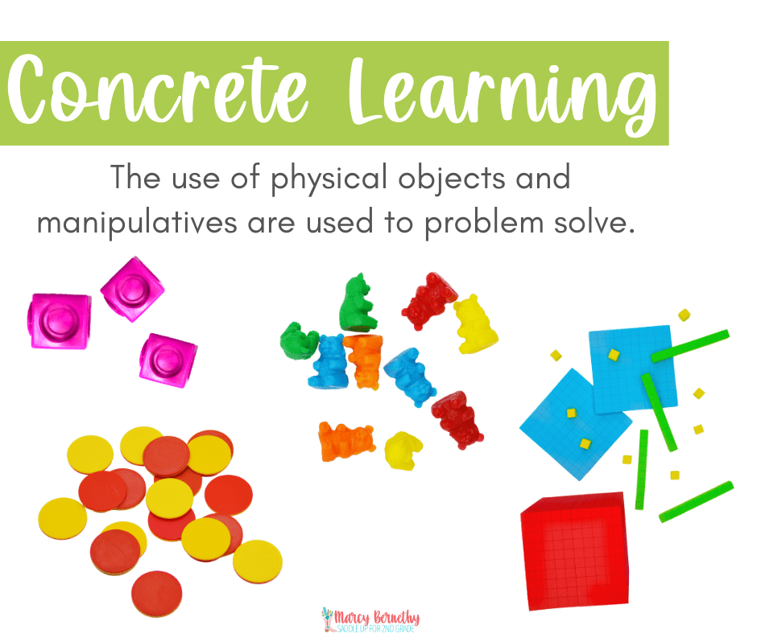
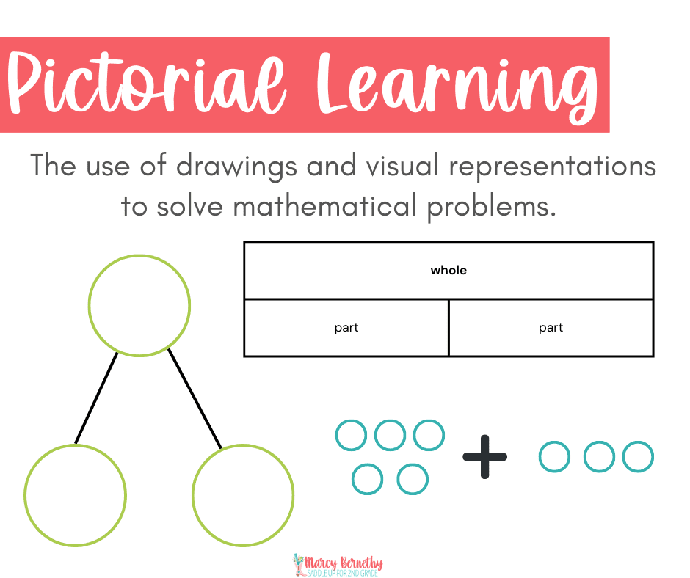
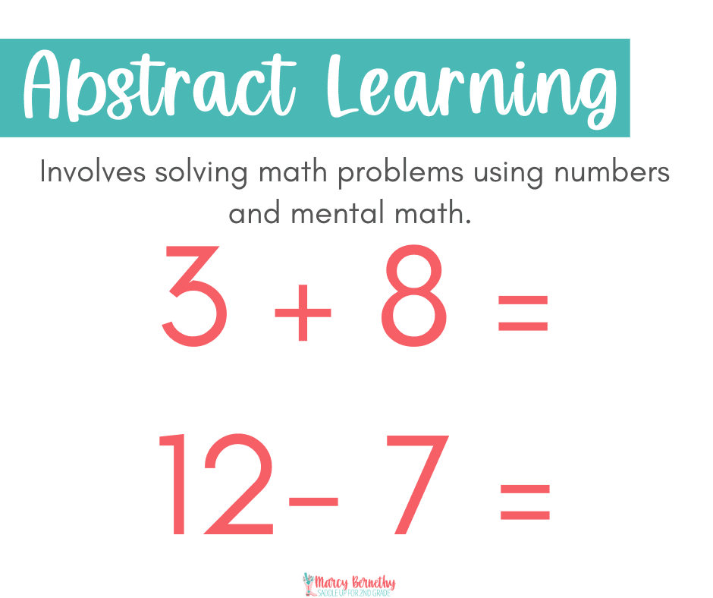
Maths
We are following the White Rose Maths plans and guidance.
We always prompt the children to explain their thinking and ask them to verbally explain how they worked things out – this helps them make links in their learning and understand their own thinking. Giving them a good base for onwards learning .

Slide 18
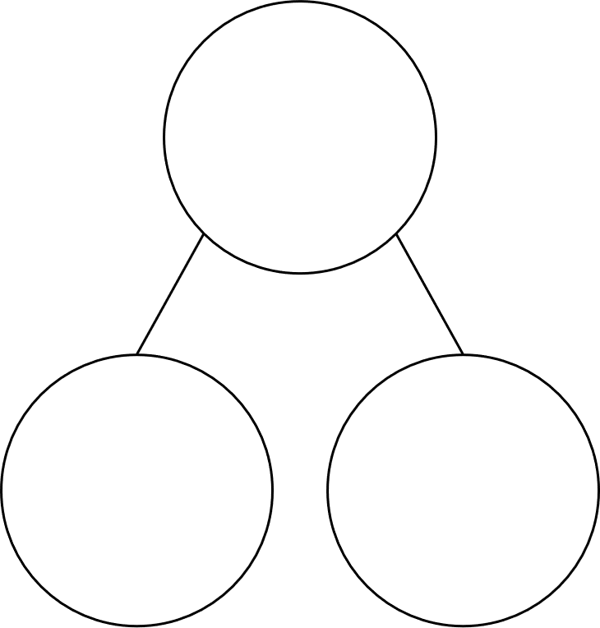
Maths
In Year 2 there is a real emphasis on the understanding of place value.
Place value is the value of each digit in a number. For example, the first 5 in 55 represents 5 tens, or 50; however, the second 5 in 55 represents 5 ones, or 5. It is important that children understand that while a digit can be the same, its value depends on where it is in the number. Understanding that 1 ten = 10 and 2 tens = 20 etc.
Securing the children’s knowledge of the number bonds to 10 will help the children to relate facts with number bonds to 20 and 100.
10
20
100
2
8
12
8
20
80

Slide 19
11th January
Beginning of new term Mass
27th March
Holy week Mass
1 Red
19/1/18
1 Ruby
26/1/18
Class
Class Mass
11am- Friday- in classroom
11th January
Beginning of new term Mass
27th March
Holy week Mass
1 Red
19/1/18
1 Ruby
26/1/18
Class
Class Mass
11am- Friday- in classroom
Computing — What is a computer?
-Safety—Keeping safe online
To recognise the parts of a computer.
To recognise how technology is controlled.
To recognise technology
To create a design for an invention
To understand the role of computers.
Science - Local Habitats
‘Are the things I find alive, have they never been alive or were they once alive?’
Children will learn about different local habitats, make observations, understand similarities and differences and identify what animals/plants live there.
Food chains
English
RE — Creation and Covenant
Year 2
Autumn Term 1 2024
English
RE — Creation and Covenant
Year 2
Autumn Term 1 2024
This half term, Year 2 children will be:
Continuing to develop their reading, writing and verbal skills using phonics as a strategy
Building up their confidence, fluency and
expression when reading aloud
Applying an increasing range of reading strategies to read, comprehend and respond to fiction and
non-fiction texts
Broadening their vocabulary and using more high frequency words and adjectives
Beginning to use expanded noun phrases in their own writing
Participating in storytelling and using role -plays and other activities to express themselves
Learning about the different types of sentences: statements and questions
Practising beginning sentences with capital letters and ending with full stops/question marks.
Listening to a range of stories and poems.
Learning how to write a repeating poem.
Learning about commas and practising using them in lists.
Core texts:
What Do You See When I Look At A Tree by Emma Carlisle
A Home can Be… by Stephanie Seidler
It starts with a seed by Laura Knowles
Hear
By the end of this unit of study, the children will have encountered the following key texts:
The story of Noah, focusing on God’s covenant (promise) with Noah and all living beings in the sign of the rainbow (Genesis 9:7-17).145
‘Through Noah, who remained innocent and just, God decided to open a path of salvation. In this way he gave humanity the chance of a new beginning. All it takes is one good person to restore hope!’ (Laudato Si)
In praise of God’s Creation of each of us and his love for us. (Psalm 139)
Believe
By the end of this unit of study, the children will know that the Church teaches:
God makes a covenant (promise) with Noah to save all living things.
That people in the story of Noah turned away from God and chose to act badly; this is behaviour called sin.
The Sacrament of Baptism is when a person becomes part of the Christian family and promises to love God.
That the Christian Bible is split into two parts, the Old Testament, and the New Testament.
Celebrate
By the end of this unit of study, the children will know:
Psalms are prayers to praise God.
Sacraments are living signs of Jesus’ love for all people.
Baptism is the first sacrament which welcomes people into the Christian family.
Live
By the end of this unit of study, the children will know:
Ways in which we can show care for God’s world (stewardship) as part of our care for each other.
How a baby is baptised in the Catholic Church.
The children will be invited to share personal responses to what they have studied through personal reflection, sharing thoughts and ideas, listening to the views and opinions of others, and reflecting on what they have heard. Pupils will spend reflective time to experience awe and wonder about what they have studied. Pupils will be invited to respond through individual or collective prayer, singing, or music. Pupils will think about how what they have studied has implications for their own lives and the lives of others locally and globally They will reflect on their personal experiences in light of learning about other cultures, communities, and traditions. Throughout the year, the children may express their creative or critical reflections through different mediums, such as writing, poetry, art, music, or dance.
This half term, Year 2 children will be:
Continuing to develop their reading, writing and verbal skills using phonics as a strategy
Building up their confidence, fluency and
expression when reading aloud
Applying an increasing range of reading strategies to read, comprehend and respond to fiction and
non-fiction texts
Broadening their vocabulary and using more high frequency words and adjectives
Beginning to use expanded noun phrases in their own writing
Participating in storytelling and using role -plays and other activities to express themselves
Learning about the different types of sentences: statements and questions
Practising beginning sentences with capital letters and ending with full stops/question marks.
Listening to a range of stories and poems.
Learning how to write a repeating poem.
Learning about commas and practising using them in lists.
Core texts:
What Do You See When I Look At A Tree by Emma Carlisle
A Home can Be… by Stephanie Seidler
It starts with a seed by Laura Knowles
Hear
By the end of this unit of study, the children will have encountered the following key texts:
The story of Noah, focusing on God’s covenant (promise) with Noah and all living beings in the sign of the rainbow (Genesis 9:7-17).145
‘Through Noah, who remained innocent and just, God decided to open a path of salvation. In this way he gave humanity the chance of a new beginning. All it takes is one good person to restore hope!’ (Laudato Si)
In praise of God’s Creation of each of us and his love for us. (Psalm 139)
Believe
By the end of this unit of study, the children will know that the Church teaches:
God makes a covenant (promise) with Noah to save all living things.
That people in the story of Noah turned away from God and chose to act badly; this is behaviour called sin.
The Sacrament of Baptism is when a person becomes part of the Christian family and promises to love God.
That the Christian Bible is split into two parts, the Old Testament, and the New Testament.
Celebrate
By the end of this unit of study, the children will know:
Psalms are prayers to praise God.
Sacraments are living signs of Jesus’ love for all people.
Baptism is the first sacrament which welcomes people into the Christian family.
Live
By the end of this unit of study, the children will know:
Ways in which we can show care for God’s world (stewardship) as part of our care for each other.
How a baby is baptised in the Catholic Church.
The children will be invited to share personal responses to what they have studied through personal reflection, sharing thoughts and ideas, listening to the views and opinions of others, and reflecting on what they have heard. Pupils will spend reflective time to experience awe and wonder about what they have studied. Pupils will be invited to respond through individual or collective prayer, singing, or music. Pupils will think about how what they have studied has implications for their own lives and the lives of others locally and globally They will reflect on their personal experiences in light of learning about other cultures, communities, and traditions. Throughout the year, the children may express their creative or critical reflections through different mediums, such as writing, poetry, art, music, or dance.
Computing — What is a computer?
Computing — What is a computer?
-Safety—Keeping safe online
To recognise the parts of a computer.
To recognise how technology is controlled.
To recognise technology
To create a design for an invention
To understand the role of computers.
-Safety—Keeping safe online
To recognise the parts of a computer.
To recognise how technology is controlled.
To recognise technology
To create a design for an invention
To understand the role of computers.
Science - Local Habitats
Science - Local Habitats
‘Are the things I find alive, have they never been alive or were they once alive?’
Children will learn about different local habitats, make observations, understand similarities and differences and identify what animals/plants live there.
Food chains
‘Are the things I find alive, have they never been alive or were they once alive?’
Children will learn about different local habitats, make observations, understand similarities and differences and identify what animals/plants live there.
Food chains
Foundation Subjects
Mathematics
Foundation Subjects
Mathematics
History: How was school different in the past?
Art: Drawing—Tell a story
To count to 100, forwards and backwards, beginning with 0 or 1, or from any given number
To learn the place value of a number and partition two-digit numbers into tens and ones
To be able to compare and order numbers
To recall addition and subtraction facts to 20 fluently.
To add and subtract numbers using concrete objects, pictorial representations and mentally.
To identify and describe the properties of 3D shapes, including the number of edges, vertices and faces.
To identify 2D shapes on the surface of 3D shapes.
To compare and sort common 2D and 3D shapes and everyday objects.
To be able to find fractions of shape.
History: How was school different in the past?
Art: Drawing—Tell a story
To count to 100, forwards and backwards, beginning with 0 or 1, or from any given number
To learn the place value of a number and partition two-digit numbers into tens and ones
To be able to compare and order numbers
To recall addition and subtraction facts to 20 fluently.
To add and subtract numbers using concrete objects, pictorial representations and mentally.
To identify and describe the properties of 3D shapes, including the number of edges, vertices and faces.
To identify 2D shapes on the surface of 3D shapes.
To compare and sort common 2D and 3D shapes and everyday objects.
To be able to find fractions of shape.
PE (Balance)
Games
2B
Thursday
Friday
2GS
Thursday
Tuesday
PE (Balance)
Games
2B
Thursday
Friday
2GS
Thursday
Tuesday
Homework set every Friday to be completed by the following Thursday.
Homework consists of reading, spellings and an extra task related to weekly learning.
Please return book bags on the morning of your child’s given reading day to enable us to change books. Book bags not brought in on the correct day will not be able to be changed until the following week.
Class
Class Mass
11am- Friday- in classroom
￼
￼
￼
￼
Homework set every Friday to be completed by the following Thursday.
Homework consists of reading, spellings and an extra task related to weekly learning.
Please return book bags on the morning of your child’s given reading day to enable us to change books. Book bags not brought in on the correct day will not be able to be changed until the following week.
Class
Class Mass
11am- Friday- in classroom
￼
￼
￼
￼

Slide 20
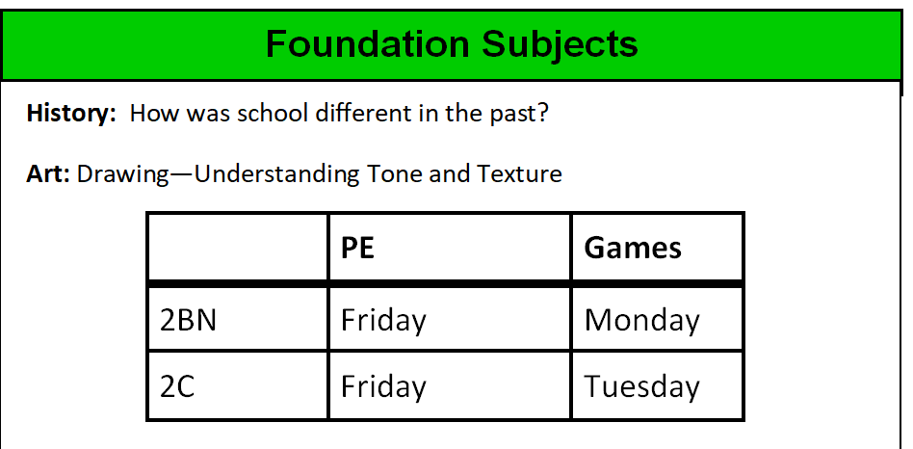
11th January
Beginning of new term Mass
27th March
Holy week Mass
1 Red
19/1/18
1 Ruby
26/1/18
Class
Class Mass
11am- Friday- in classroom
11th January
Beginning of new term Mass
27th March
Holy week Mass
1 Red
19/1/18
1 Ruby
26/1/18
Class
Class Mass
11am- Friday- in classroom
English
RE — Creation and Covenant
Year 2
Autumn Term 1 2024
English
RE — Creation and Covenant
Year 2
Autumn Term 1 2024
This half term, Year 2 children will be:
Continuing to develop their reading, writing and verbal skills using phonics as a strategy
Building up their confidence, fluency and
expression when reading aloud
Applying an increasing range of reading strategies to read, comprehend and respond to fiction and
non-fiction texts
Broadening their vocabulary and using more high frequency words and adjectives
Beginning to use expanded noun phrases in their own writing
Participating in storytelling and using role -plays and other activities to express themselves
Learning about the different types of sentences: statements and questions
Practising beginning sentences with capital letters and ending with full stops/question marks.
Listening to a range of stories and poems.
Learning how to write a repeating poem.
Learning about commas and practising using them in lists.
Core texts:
What Do You See When I Look At A Tree by Emma Carlisle
A Home can Be… by Stephanie Seidler
It starts with a seed by Laura Knowles
Hear
By the end of this unit of study, the children will have encountered the following key texts:
The story of Noah, focusing on God’s covenant (promise) with Noah and all living beings in the sign of the rainbow (Genesis 9:7-17).145
‘Through Noah, who remained innocent and just, God decided to open a path of salvation. In this way he gave humanity the chance of a new beginning. All it takes is one good person to restore hope!’ (Laudato Si)
In praise of God’s Creation of each of us and his love for us. (Psalm 139)
Believe
By the end of this unit of study, the children will know that the Church teaches:
God makes a covenant (promise) with Noah to save all living things.
That people in the story of Noah turned away from God and chose to act badly; this is behaviour called sin.
The Sacrament of Baptism is when a person becomes part of the Christian family and promises to love God.
That the Christian Bible is split into two parts, the Old Testament, and the New Testament.
Celebrate
By the end of this unit of study, the children will know:
Psalms are prayers to praise God.
Sacraments are living signs of Jesus’ love for all people.
Baptism is the first sacrament which welcomes people into the Christian family.
Live
By the end of this unit of study, the children will know:
Ways in which we can show care for God’s world (stewardship) as part of our care for each other.
How a baby is baptised in the Catholic Church.
The children will be invited to share personal responses to what they have studied through personal reflection, sharing thoughts and ideas, listening to the views and opinions of others, and reflecting on what they have heard. Pupils will spend reflective time to experience awe and wonder about what they have studied. Pupils will be invited to respond through individual or collective prayer, singing, or music. Pupils will think about how what they have studied has implications for their own lives and the lives of others locally and globally They will reflect on their personal experiences in light of learning about other cultures, communities, and traditions. Throughout the year, the children may express their creative or critical reflections through different mediums, such as writing, poetry, art, music, or dance.
This half term, Year 2 children will be:
Continuing to develop their reading, writing and verbal skills using phonics as a strategy
Building up their confidence, fluency and
expression when reading aloud
Applying an increasing range of reading strategies to read, comprehend and respond to fiction and
non-fiction texts
Broadening their vocabulary and using more high frequency words and adjectives
Beginning to use expanded noun phrases in their own writing
Participating in storytelling and using role -plays and other activities to express themselves
Learning about the different types of sentences: statements and questions
Practising beginning sentences with capital letters and ending with full stops/question marks.
Listening to a range of stories and poems.
Learning how to write a repeating poem.
Learning about commas and practising using them in lists.
Core texts:
What Do You See When I Look At A Tree by Emma Carlisle
A Home can Be… by Stephanie Seidler
It starts with a seed by Laura Knowles
Hear
By the end of this unit of study, the children will have encountered the following key texts:
The story of Noah, focusing on God’s covenant (promise) with Noah and all living beings in the sign of the rainbow (Genesis 9:7-17).145
‘Through Noah, who remained innocent and just, God decided to open a path of salvation. In this way he gave humanity the chance of a new beginning. All it takes is one good person to restore hope!’ (Laudato Si)
In praise of God’s Creation of each of us and his love for us. (Psalm 139)
Believe
By the end of this unit of study, the children will know that the Church teaches:
God makes a covenant (promise) with Noah to save all living things.
That people in the story of Noah turned away from God and chose to act badly; this is behaviour called sin.
The Sacrament of Baptism is when a person becomes part of the Christian family and promises to love God.
That the Christian Bible is split into two parts, the Old Testament, and the New Testament.
Celebrate
By the end of this unit of study, the children will know:
Psalms are prayers to praise God.
Sacraments are living signs of Jesus’ love for all people.
Baptism is the first sacrament which welcomes people into the Christian family.
Live
By the end of this unit of study, the children will know:
Ways in which we can show care for God’s world (stewardship) as part of our care for each other.
How a baby is baptised in the Catholic Church.
The children will be invited to share personal responses to what they have studied through personal reflection, sharing thoughts and ideas, listening to the views and opinions of others, and reflecting on what they have heard. Pupils will spend reflective time to experience awe and wonder about what they have studied. Pupils will be invited to respond through individual or collective prayer, singing, or music. Pupils will think about how what they have studied has implications for their own lives and the lives of others locally and globally They will reflect on their personal experiences in light of learning about other cultures, communities, and traditions. Throughout the year, the children may express their creative or critical reflections through different mediums, such as writing, poetry, art, music, or dance.
Computing — What is a computer?
Computing — What is a computer?
-Safety—Keeping safe online
To recognise the parts of a computer.
To recognise how technology is controlled.
To recognise technology
To create a design for an invention
To understand the role of computers.
-Safety—Keeping safe online
To recognise the parts of a computer.
To recognise how technology is controlled.
To recognise technology
To create a design for an invention
To understand the role of computers.
Science - Local Habitats
Science - Local Habitats
‘Are the things I find alive, have they never been alive or were they once alive?’
Children will learn about different local habitats, make observations, understand similarities and differences and identify what animals/plants live there.
Food chains
‘Are the things I find alive, have they never been alive or were they once alive?’
Children will learn about different local habitats, make observations, understand similarities and differences and identify what animals/plants live there.
Food chains
Foundation Subjects
Mathematics
Foundation Subjects
Mathematics
History: How was school different in the past?
Art: Drawing—Tell a story
To count to 100, forwards and backwards, beginning with 0 or 1, or from any given number
To learn the place value of a number and partition two-digit numbers into tens and ones
To be able to compare and order numbers
To recall addition and subtraction facts to 20 fluently.
To add and subtract numbers using concrete objects, pictorial representations and mentally.
To identify and describe the properties of 3D shapes, including the number of edges, vertices and faces.
To identify 2D shapes on the surface of 3D shapes.
To compare and sort common 2D and 3D shapes and everyday objects.
To be able to find fractions of shape.
History: How was school different in the past?
Art: Drawing—Tell a story
To count to 100, forwards and backwards, beginning with 0 or 1, or from any given number
To learn the place value of a number and partition two-digit numbers into tens and ones
To be able to compare and order numbers
To recall addition and subtraction facts to 20 fluently.
To add and subtract numbers using concrete objects, pictorial representations and mentally.
To identify and describe the properties of 3D shapes, including the number of edges, vertices and faces.
To identify 2D shapes on the surface of 3D shapes.
To compare and sort common 2D and 3D shapes and everyday objects.
To be able to find fractions of shape.
PE (Balance)
Games
2B
Thursday
Friday
2GS
Thursday
Tuesday
PE (Balance)
Games
2B
Thursday
Friday
2GS
Thursday
Tuesday
Homework set every Friday to be completed by the following Thursday.
Homework consists of reading, spellings and an extra task related to weekly learning.
Please return book bags on the morning of your child’s given reading day to enable us to change books. Book bags not brought in on the correct day will not be able to be changed until the following week.
Class
Class Mass
11am- Friday- in classroom
￼
￼
￼
￼
Homework set every Friday to be completed by the following Thursday.
Homework consists of reading, spellings and an extra task related to weekly learning.
Please return book bags on the morning of your child’s given reading day to enable us to change books. Book bags not brought in on the correct day will not be able to be changed until the following week.
Class
Class Mass
11am- Friday- in classroom
￼
￼
￼
￼

Slide 21
Homework
Homework will be uploaded on DB Primary on a Friday.
Homework consists of reading and spelling and an extra activity based on our weekly learning at school.
Spellings – spellings are uploaded weekly and are tested the following Friday. We are encouraging the children to spell the words correctly beyond their spelling test.
When going over spellings with your children it is a good idea to get them to also write the words in a sentence to help them understand context and meaning. Also to encourage clear letter formation.
We don’t mind if you submit online or bring in a paper copy of your work. We understand that not everyone may be able to print homework. Work may be done practically and photos may be taken or can be typed/written on any paper/whiteboard.
Once every half term there will be an RE homework set, please may this be brought into school as we will stick it into the children’s RE books.
Notes:
Brittany

Slide 22
Educational Visits and Events
Throughout the school year we will walk to Church to celebrate Mass and as an extension of our RE lessons.
Class Assembly – Parents will be invited to join us lead an assembly.
Year 2 Christmas Carol Concert in school
An educational visit will be arranged to support the children’s learning.
Notes:
Brittany

Slide 23
Communication
Parent consultations take place each term.
If you would like to speak to us concerning your child please email or call the office – the office staff will ensure any messages are passed onto us; we will then contact you.
We are available to talk to you at the end of the day if you do not mind waiting until we have finished dismissing the whole class.
Notes:
Charlotte

Slide 24
Time for Questions
Please feel free to write any questions on the list or email and we will get back to you.

Slide 25
Thank you for your time today. We are looking forward to working with you and your children this year.
Please leave any comments/feedback in the Parent Communication Book

