Slide 1

Welcome to Year 3
September 2026

Slide 2
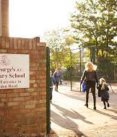
A Typical Day
8.45: Soft Start
9.00: Registration.
9.05- 9.20: Early morning work/targeted interventions / reading
9.30: Maths
10.30: Playtime (children encouraged to bring a piece of fruit in for their snack)
10.45: Literacy/RE
12.00: Lunch
1.00-1.15: quiet reading
2:15 – 2:30: daily run
1.15-3.30: Topic / Humanities

Slide 3
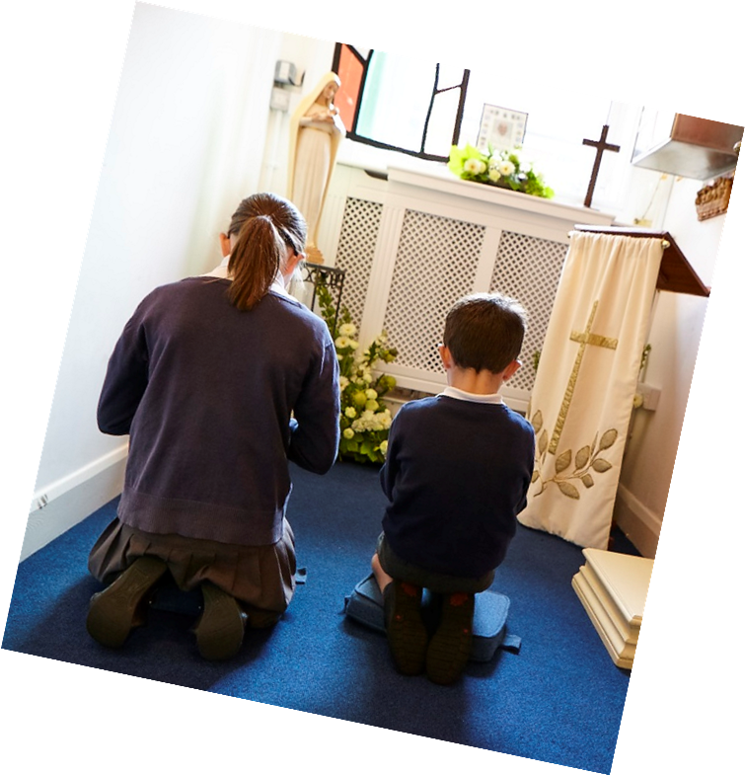
RE, Prayer and Catholic Life of the School
‘In everything we do today, we are following Jesus and His way.’
RE is at the heart of everything we do here at St George’s. It is through Religious Education that we that we lay the foundations for our pupils to grow into respectful, spiritual and moral individuals; supporting them in developing and deepening their relationship with God. The children are encouraged to reflect and ask questions about their faith.
Children engage and take part in Collective Worship in the classroom, and have the opportunity to plan and lead their own worship, choosing appropriate resources to aid this (i.e.. candles, pebbles) and their own mission for everyone to work on such as: say kind words to someone. This ownership of their worship allows the children to further strengthen their beliefs and relationship with God.
Our topics this year in RE are:
Creation and Covenant 4. Desert and Garden
Prophecy and Promise 5. To the ends of the Earth
Galilee and Jerusalem 6. Dialogue and Encounter

Slide 4
RSE
Module 2: Created to Love Others
Created to Love Others explores the individual’s relationship with others. Building on the understanding that we have been created out of love and for love, this module explores how we take this calling into our family, friendships and relationships, and teaches strategies for developing healthy relationships and keeping safe both online and in our daily lives.
Module 1: Created and Loved by God
Module 3: Created to Live in Community
Created and Loved by God explores the individual. Rooted in the teaching that we are made in the image and likeness of God, it helps children to develop an understanding of the importance of valuing themselves as the basis for personal relationships.
Created to Live in Community explores the individual’s relationship with the wider world. Here we explore how human beings are relational by nature and are called to love others in the wider community through service, through dialogue and through working for the Common Good. In Life to the Full Plus, further exploration of careers and money lead to understanding that true happiness comes from knowing God’s love and finding our identity and worth in Him.

Slide 5

Homework
Maths homework will be set on a Friday, once the homework books have been purchased. This will be due to be completed by the following Thursday. An order can be placed through Parent Pay.
Occasionally other homework may be set.
Spelling tests are carried out in class on a Friday, the spellings are available on DB Primary.
Home readers will be sent home on a Monday / Friday and should be returned a week later.
The book does not need to be read and changed every week. The book bag with the reading record should be brought into school every week – even if the book is not finished.
Please ensure that when you read with your child you are writing a small comment in their reading journal so that we can further monitor their progress in school. Children choose their own home reader from the class library.

Slide 6

Reading
We continue to use the ‘Big Cats’ reading scheme for KS2 children. Children have been assessed for fluency and comprehension skills and matched with a book suitable to their guided reading sessions in class.
Within their class, they are grouped with readers working at the same level and read together through daily guided reading activities..

Slide 7

Spellings
Spellings are uploaded on DB Primary on a Friday and children are then tested on these words the following Friday.
Spellings are taught systematically within word families, all 100 common exception words are taught through spelling practice and exposure to the words in guided reading books and activities.

Slide 8
Literacy
Reading Comprehension:
checking understanding
discussing the words in the text
finding inferences and justifying with evidence
making predictions
summarising what they have read
Handwriting:
increase legibility and practice the cursive style with correct letter formations.
There is a whole school focus on cursive handwriting this year,
Writing:
understand different genres
create characters, plot and setting
Use organisational devices such as paragraphs, headings and sub headings
The writing task is often linked to the class reader.
Grammar and punctuation:
Capital letters, full stops, commas, speech marks
Use of conjunctions, nouns, pronouns
Understanding when to use ‘a’ or ‘an’.
Children are also encouraged to proofread and edit their work, making improvements according to
a success criteria.

Slide 9
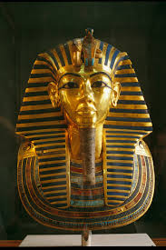
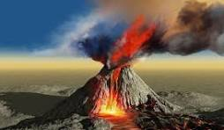

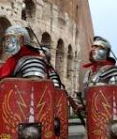
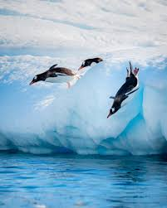
History and Geography
Why do people live near volcanoes? (Autumn 1 )
Would you prefer to have lived in the Stone Age, Bronze Age or Iron Age? (Autumn 2)
Why did the Romans settle in Britain? (Spring 1)
Who lives in Antarctica? (Spring 2)
What did the Ancient Egyptians believe? (Summer 1)
What are rivers and how are they formed? (Summer 2) .

Slide 10
Maths - White Rose
White Rose maths is a popular approach used in schools to teach maths in a way that builds deep understanding.
It breaks down the curriculum into small, manageable steps, helping children grasp concepts fully before moving on.
The scheme is designed to ensure all students achieve a level of mastery in maths, regardless of their starting point.
White Rose Maths places a big emphasis on developing your child’s problem-solving and reasoning skills. This means children are regularly asked to explain how they solved a problem, consider different approaches, and apply their maths t to real-life situations. This helps them become confident, flexible thinkers who can approach maths in different ways.

Slide 11
Why White Rose?
We’ve chosen White Rose maths because it aligns well with the national curriculum and focuses on developing reasoning, problem-solving, and fluency in maths.
The structured approach means that children don’t just memorise facts or formulas—they really understand the "why" behind the maths they’re doing. This deeper understanding is key to their future success.

Slide 12
Year 3 curriculum
In Year 3, your child will cover a range of mathematical topics, including:
- Place Value: Understanding numbers up to 1,000.
- Addition and Subtraction: Working with three-digit numbers.
- Multiplication and Division: Learning the 3, 4, and 8 times tables.
- Fractions: Recognising fractions and beginning to add and subtract them.
- Measurement: Measuring length, weight, and volume, and understanding time.
- Geometry: Exploring shapes and angles.
- Statistics: Interpreting and presenting data.
Each of these areas is broken down into smaller steps to ensure children have a thorough understanding of each topic.

Slide 13
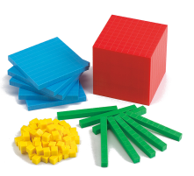
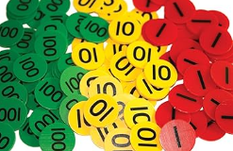
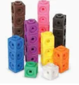
Lesson Structure
White Rose Maths lessons are structured to help children move from concrete understanding to abstract thinking. We use:
Concrete objects like counters, cubes, or base ten blocks to help students understand concepts physically.

Slide 14
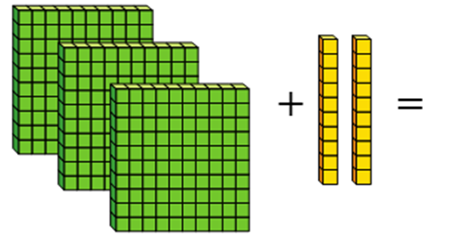
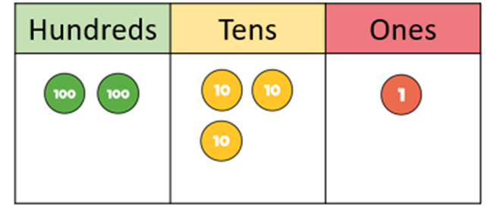
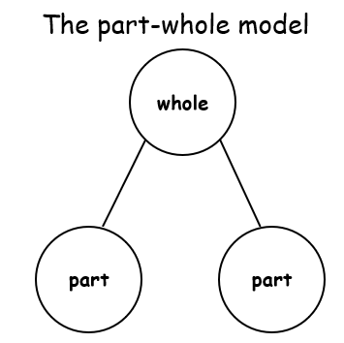

Year 3 maths
Pictorial representations like number lines or diagrams to help them visualise.

Slide 15
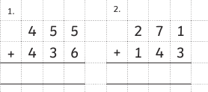
Year 3 maths
Abstract methods like written calculations once they have a solid grasp of the topic.
345 - 100 =
10 x 7 =
This approach ensures that children can apply what they’ve learned in a variety of ways.

Slide 16

Times Table Tests
From the 2021/22 academic year, the multiplication tables check (MTC) is statutory for all year 4 pupils in England.
Schools administer the check in June.
In preparation for this test in year 4, we encourage children in year 3 to practise their multiplication and related division facts for the x2, x3, x4, x5, x8 and x10 times tables
TT Rockstars/Numbergym
Timestables.co.uk.

Slide 17





How can you support your child at home?
Look at the parents’ information section on the website: Helping your child at home.
Read with your child and encourage discussion around the book to develop children reading for meaning.
Continue daily times table practice on TT Rockstars.
Practise weekly spellings.
If you have any issues with passwords or logging into the learning platforms please let us know.

Slide 18
How is my child’s progress assessed?
We regularly assess your child’s progress in maths and literacy. This can be through:
Ongoing assessments during lessons to check their understanding.
End-of-term assessments to review their progress in key areas.
If your child struggles with any concepts, we offer support in the form of extra practice, additional work, or pre-learning

Slide 19
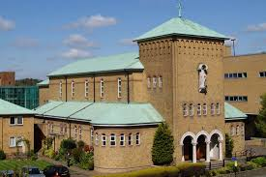
Educational Visits, Church and Library Visits
As always, parent volunteers are greatly appreciated since these events would not be able to take place without them. A request will go out in advance once dates are set.
Autumn Term
Library visit
Spring
St Albans Cathedral – Romans topic.
Summer
Egyptian Day / local town walk linked to settlements

Slide 20

General Reminders
Please ensure children come to school in their PE kit on their PE days.
3M: Wednesday and Friday; 3S: Tuesday and Friday
Snack – should be fruit or fruit based. No nuts
Smart watches: Children can wear watches to school however, smart watches are not permitted.
No jewellery allowed including friendship bracelets.
(forms part of our risk assessment and school policy)

