Slide 1


Slide 2
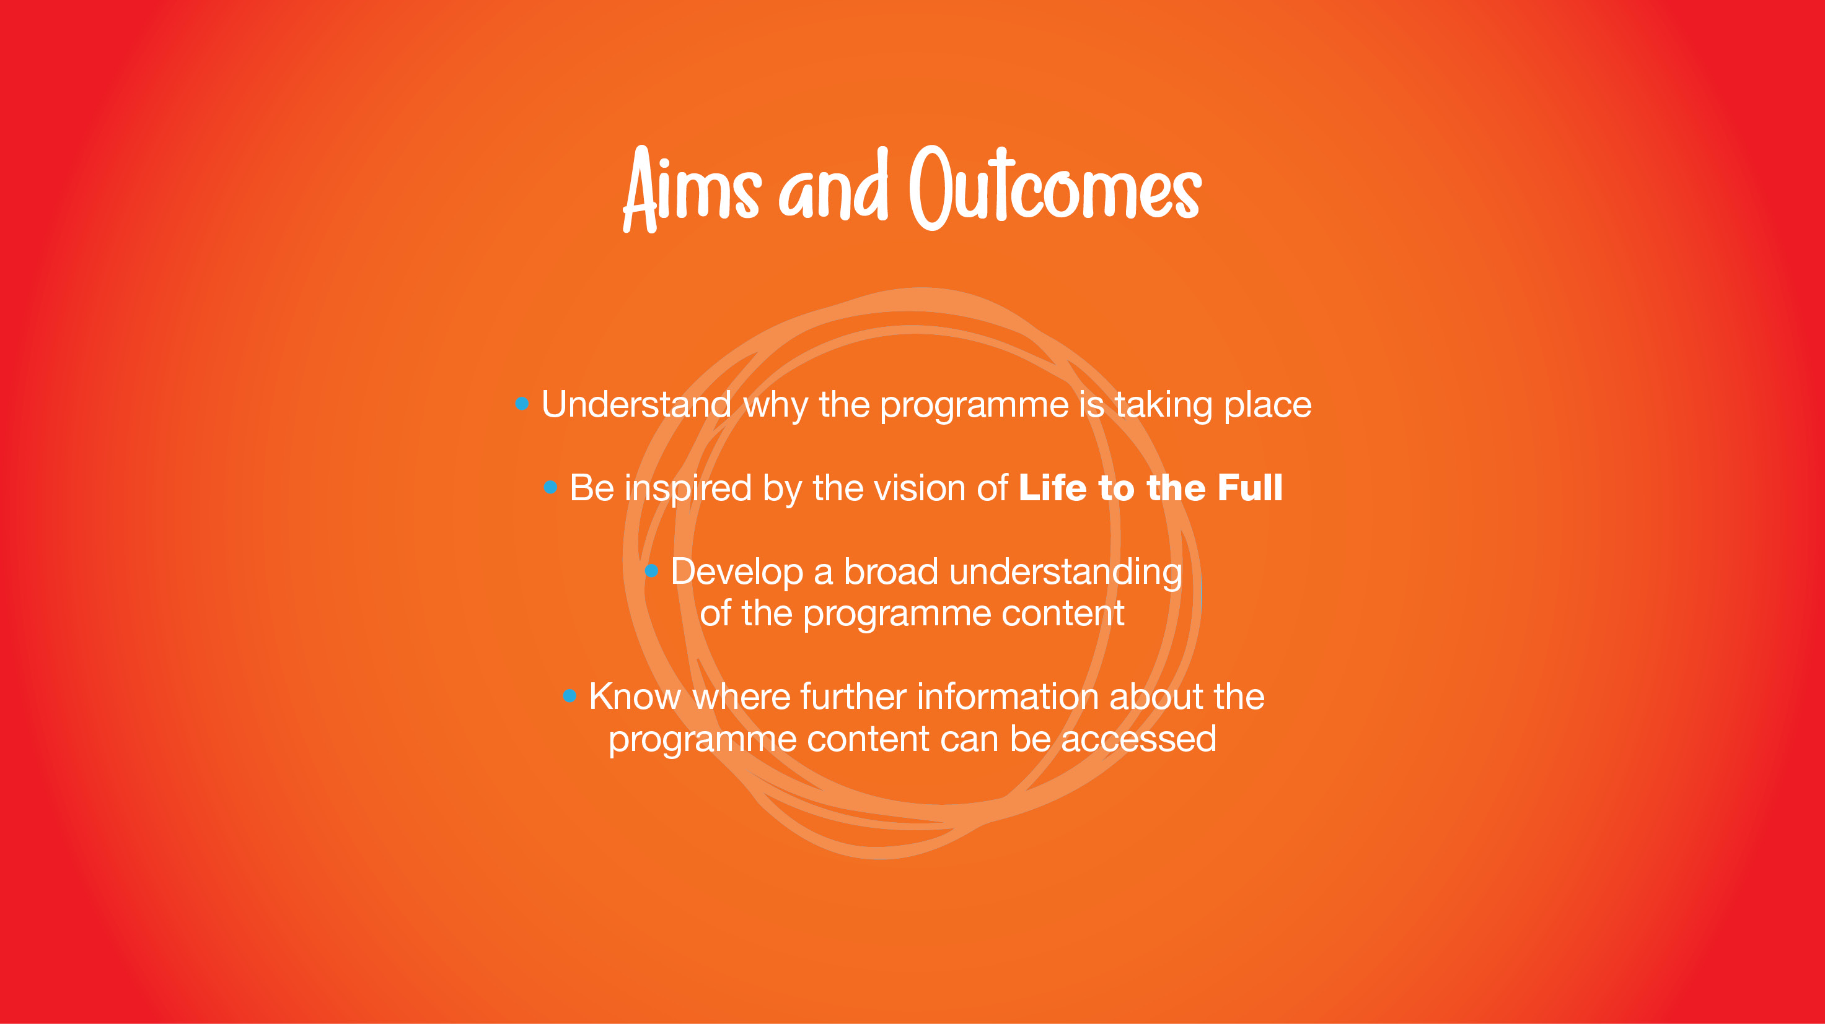

Slide 3
What is life to the full?
It is a programme in Relationships and Health Education based on the Department of Education guidance which became statutory during the academic year 2020/21. This programme is rooted in a Christian understanding of the human person, based on “A Model Catholic RSE Curriculum” provided by the Catholic Education Service.

Slide 4

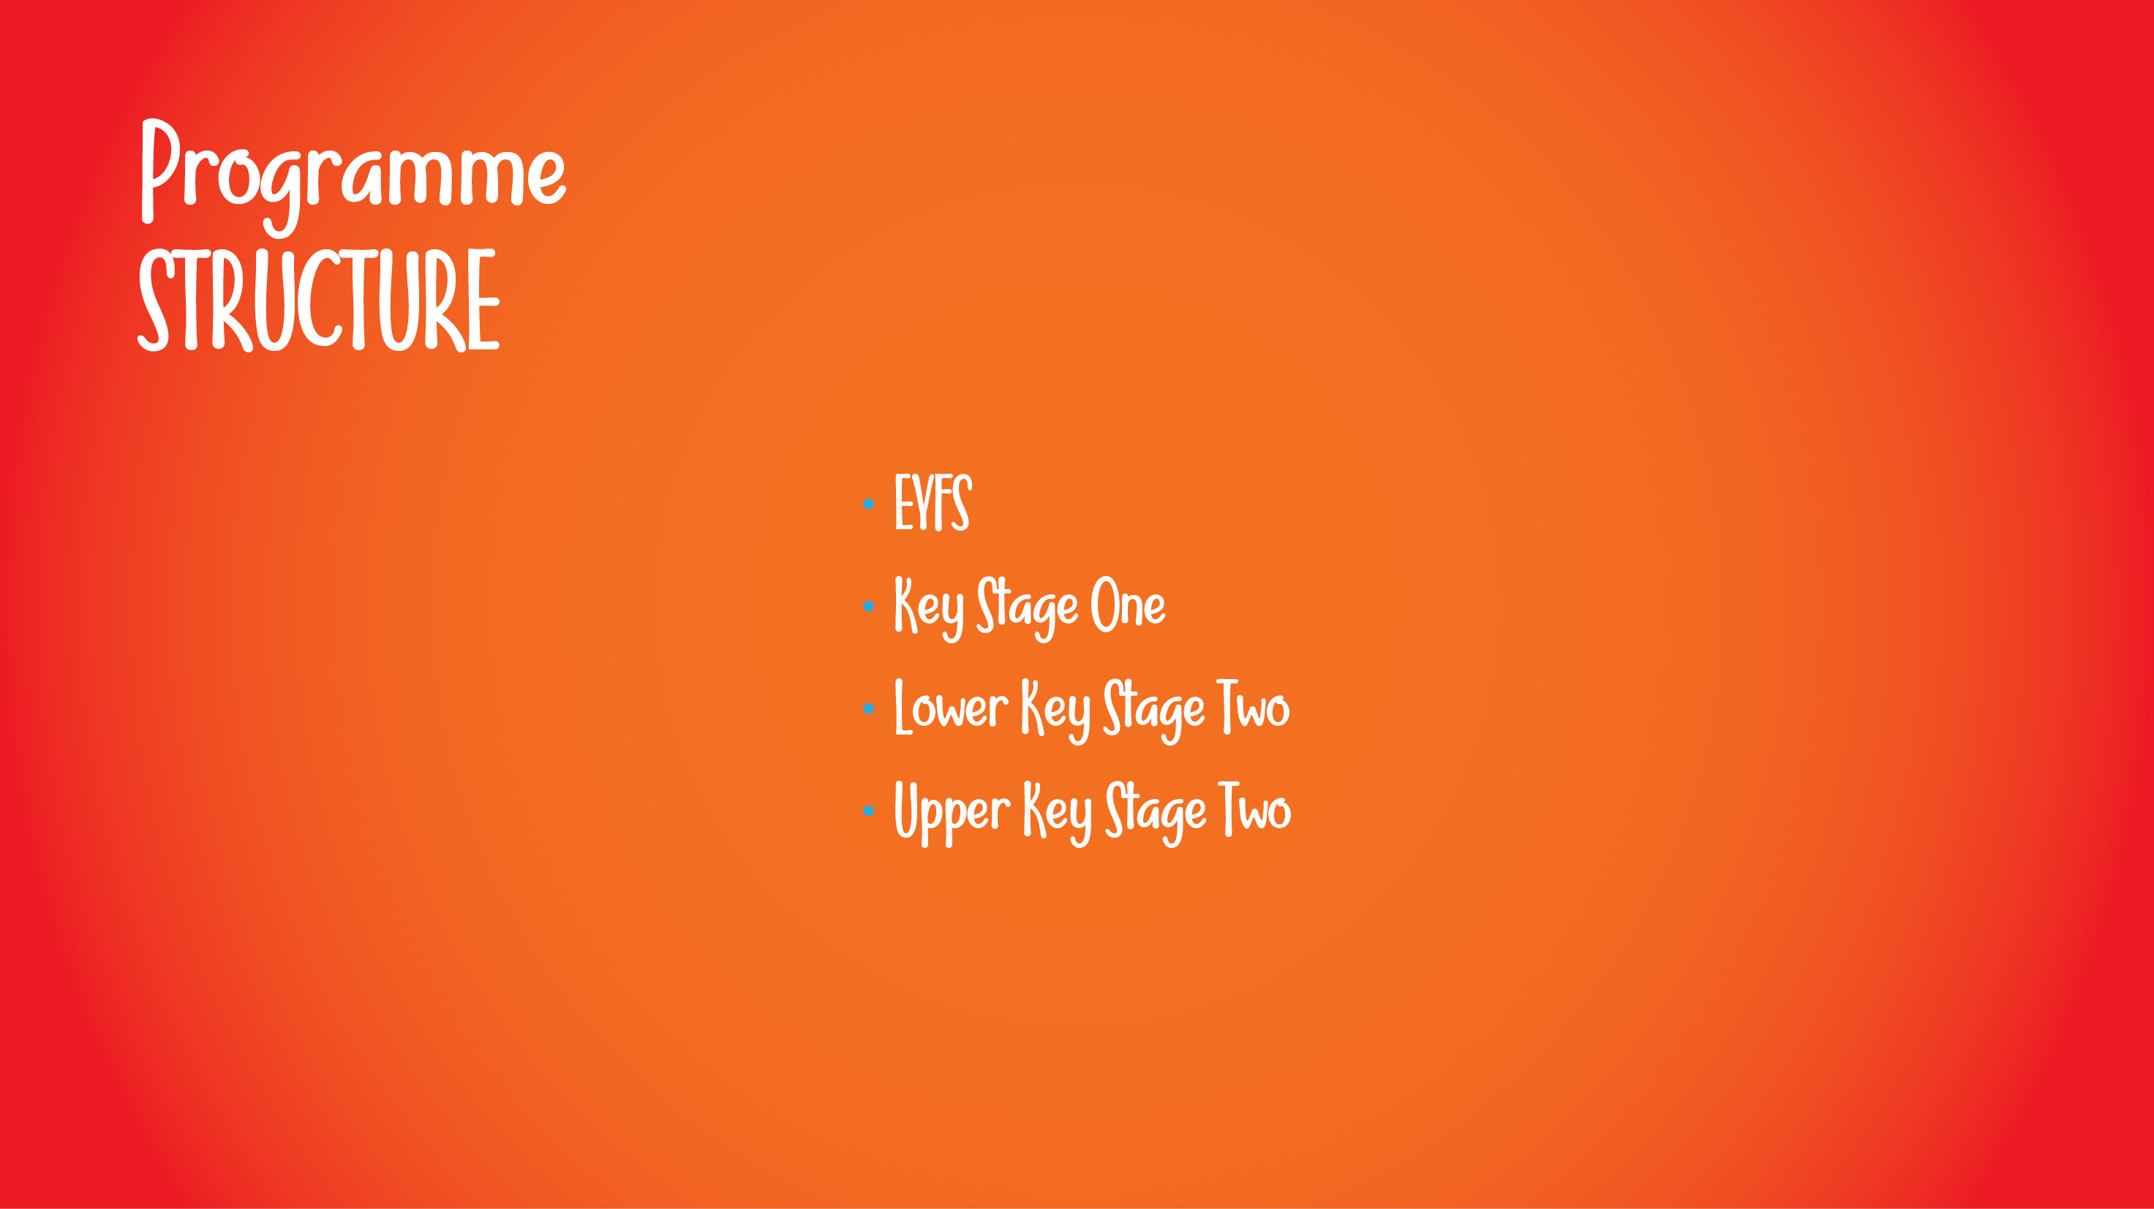
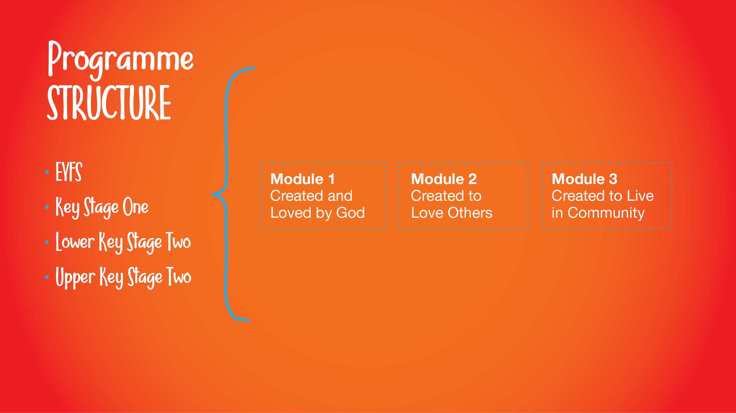
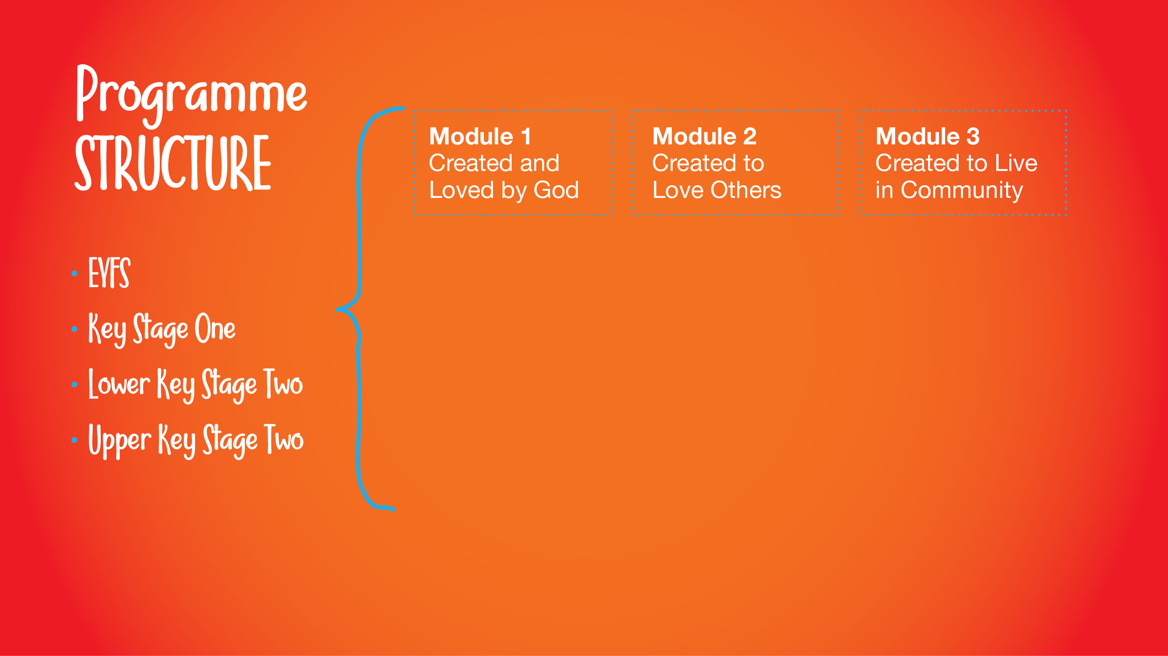
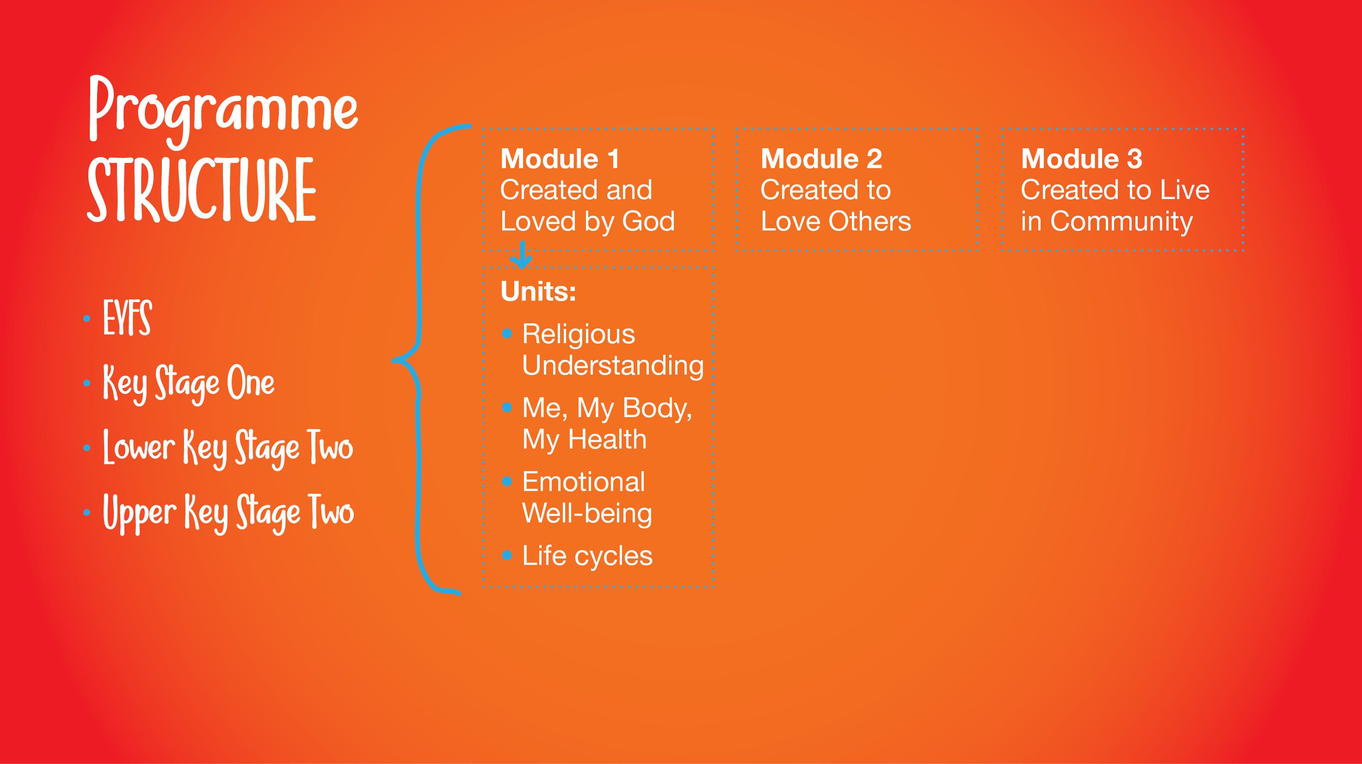
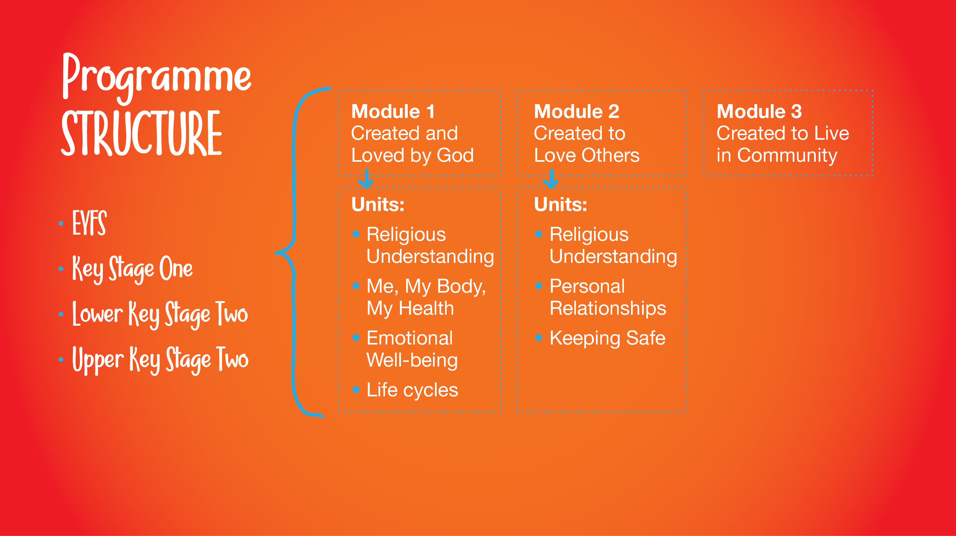
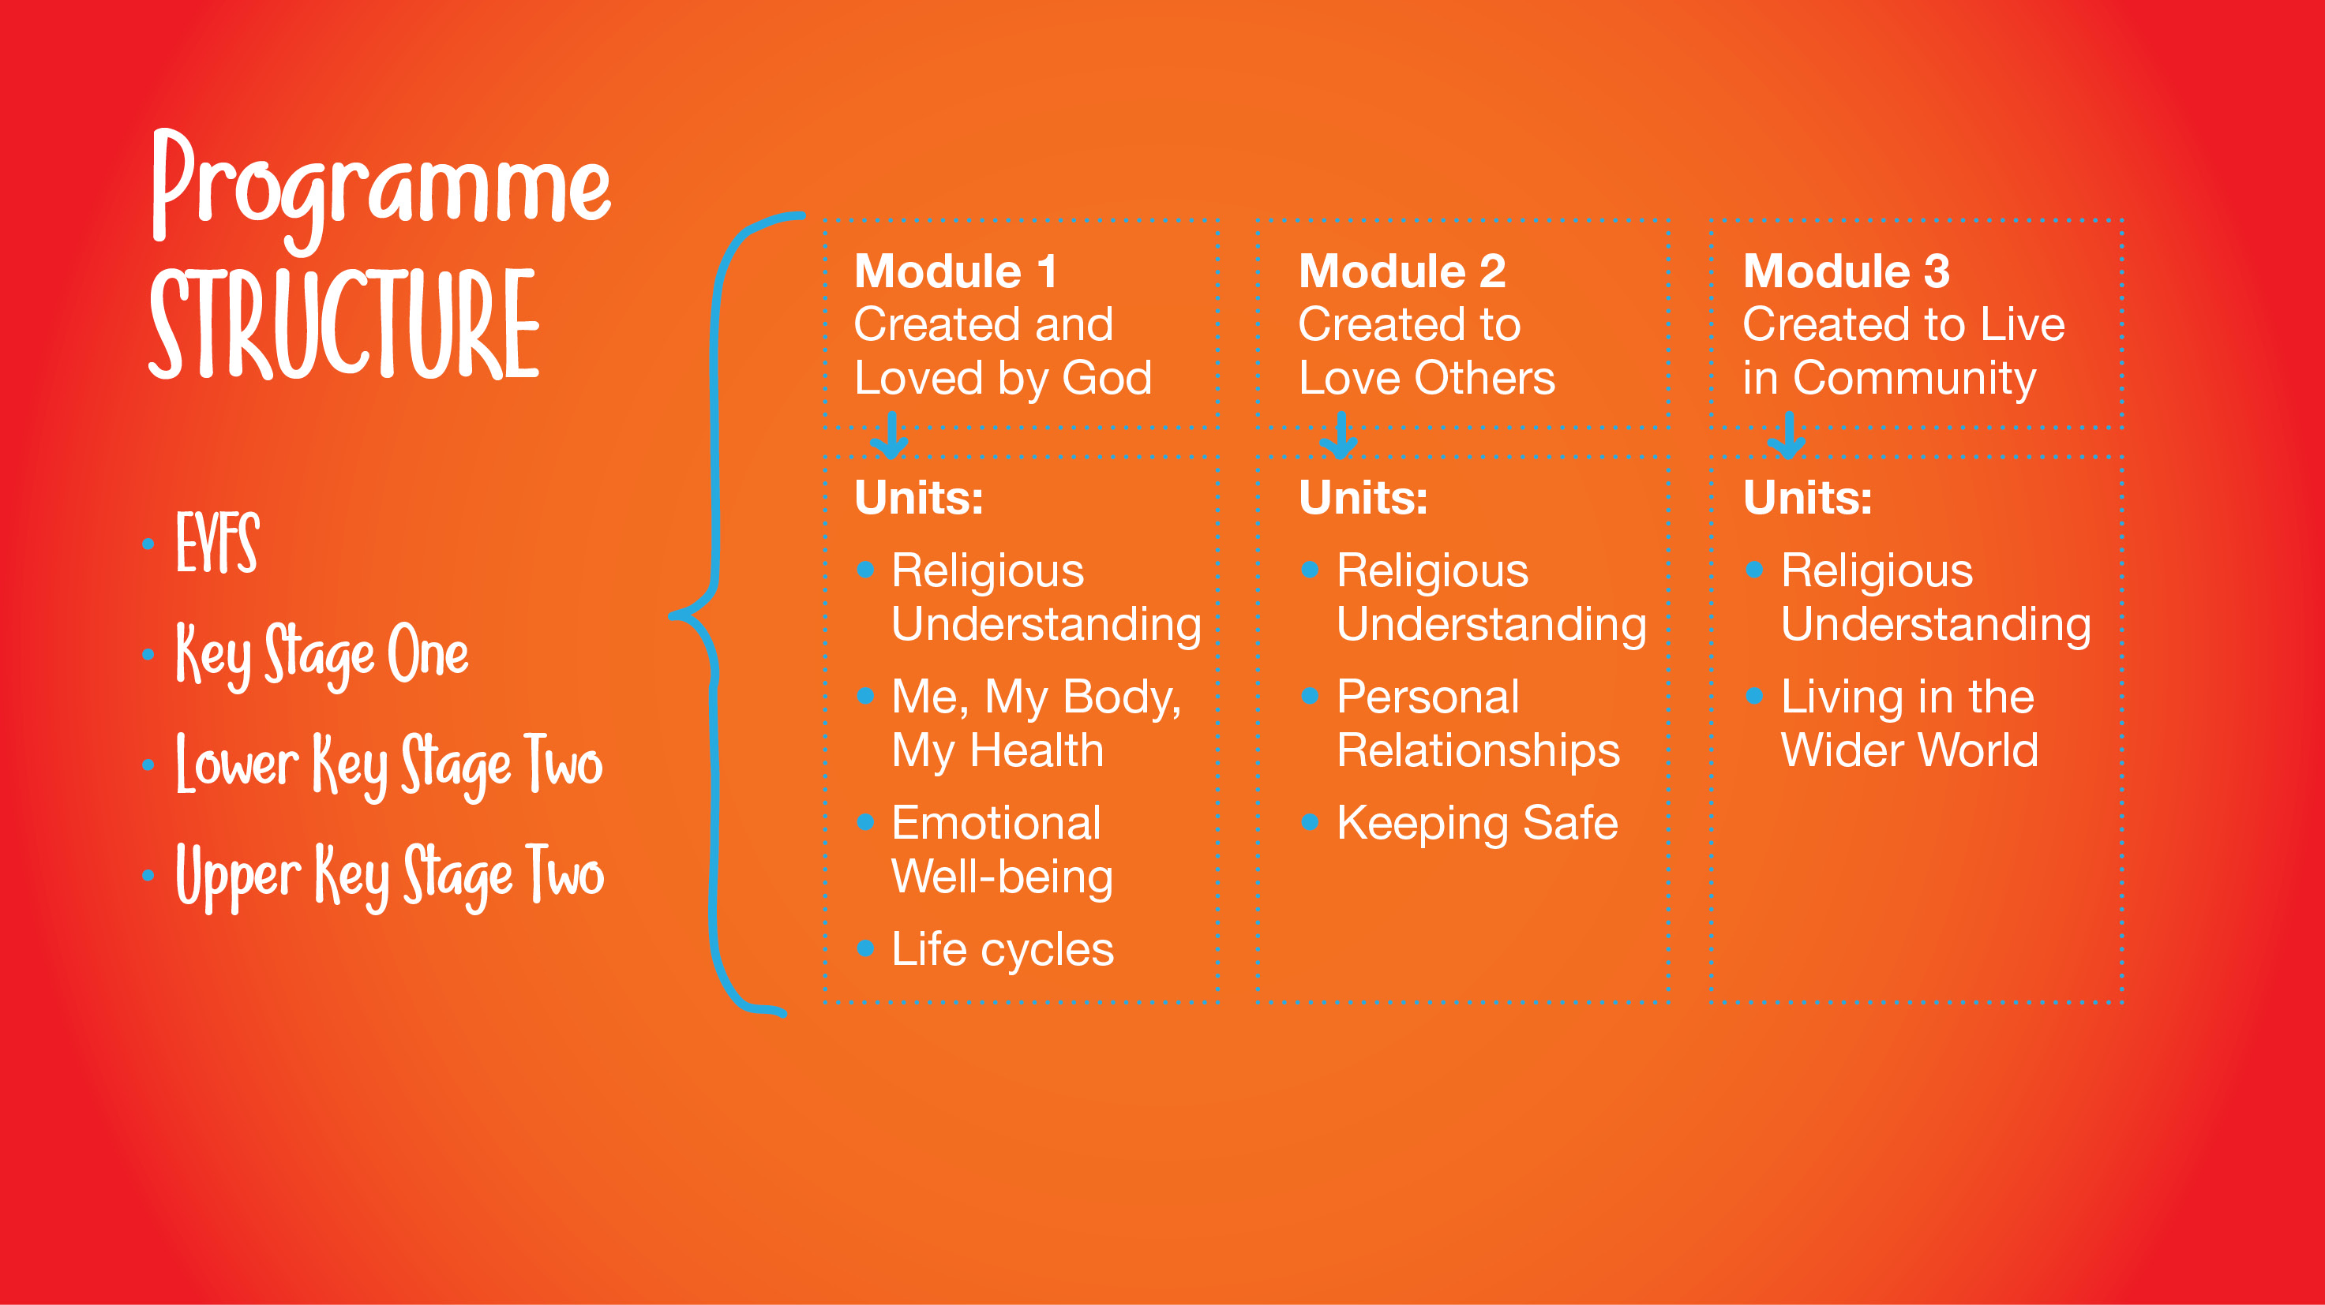
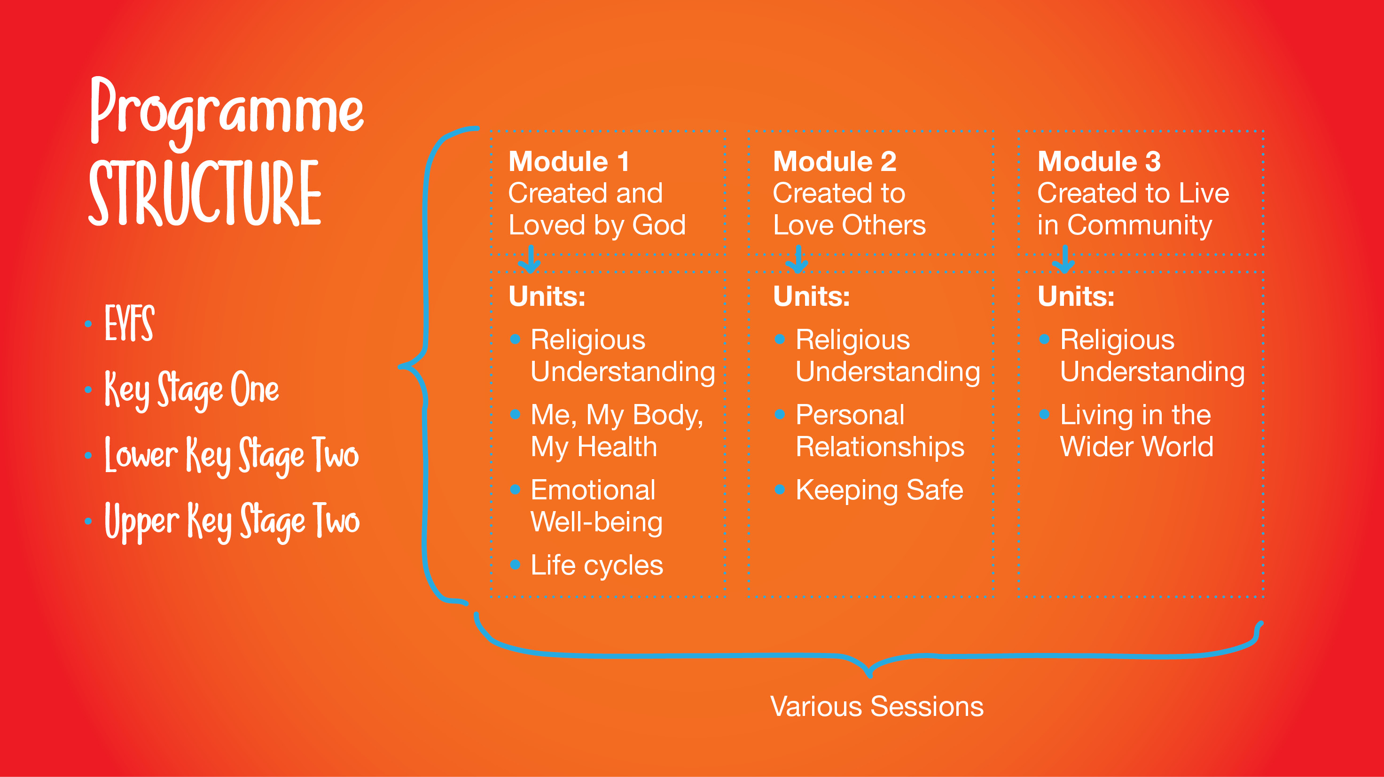

Slide 5
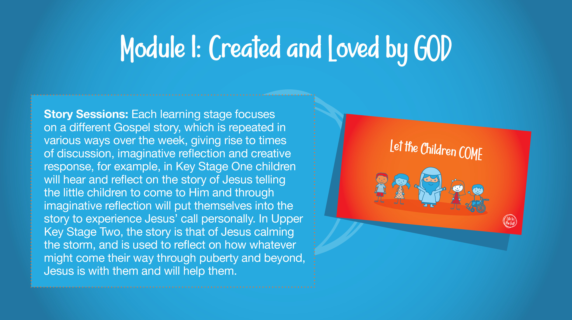

Slide 6
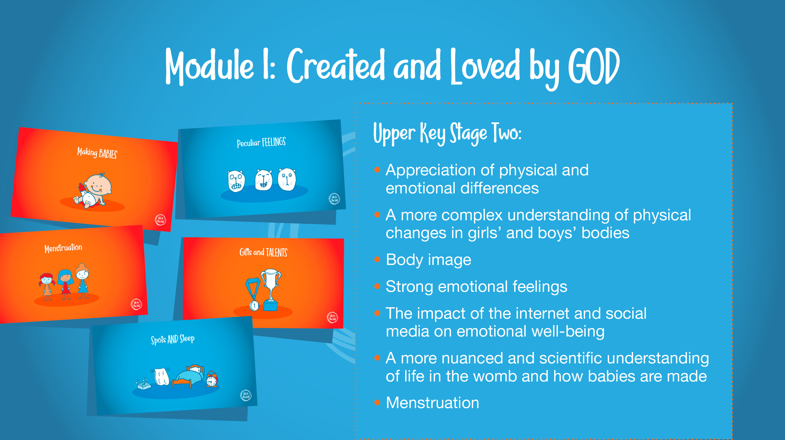

Slide 7
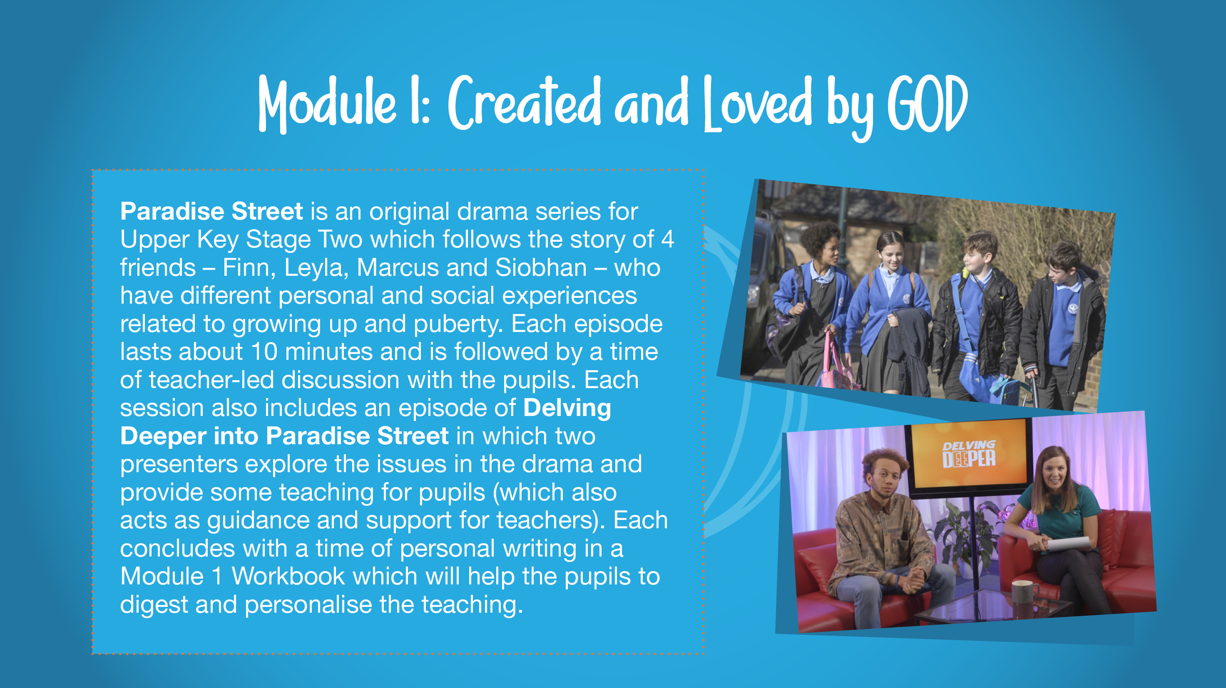

Slide 8
Module 1: Created and Loved by God
Unit 1: Religious Understanding
Calming the Storm
We were created individually by God who cares for us and wants us to put our faith in Him.
Physically becoming an adult is a natural phase of life.
Lots of changes will happen during puberty and sometimes it might feel confusing, but it is all part of God’s great plan – and the results will be worth it!

Slide 9
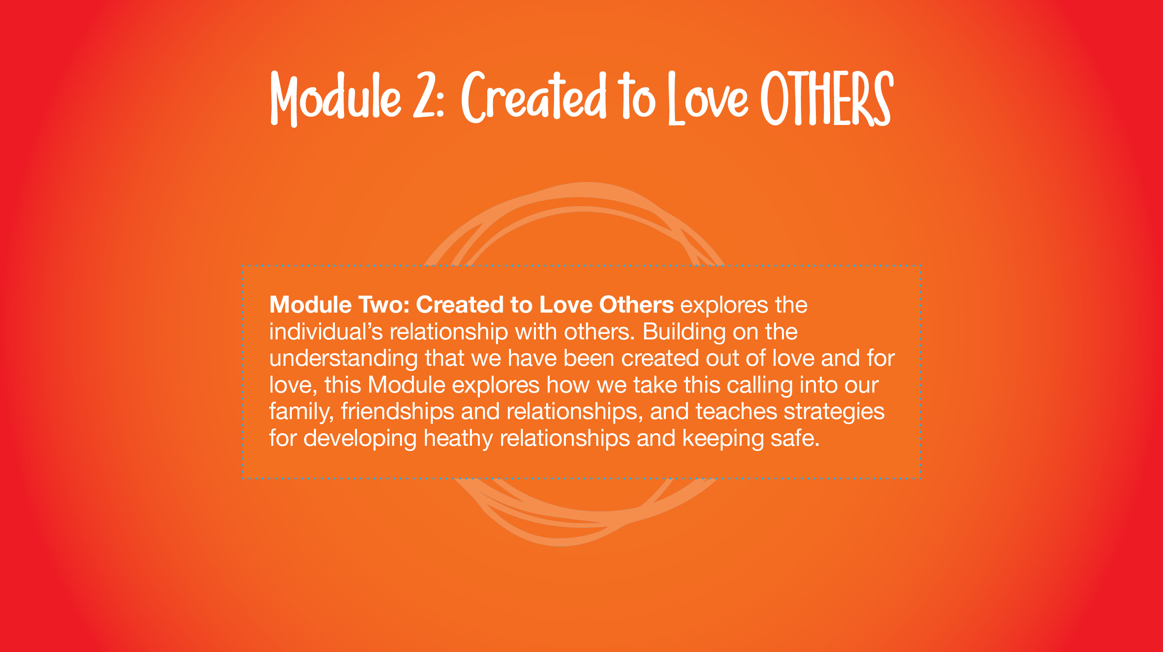

Slide 10
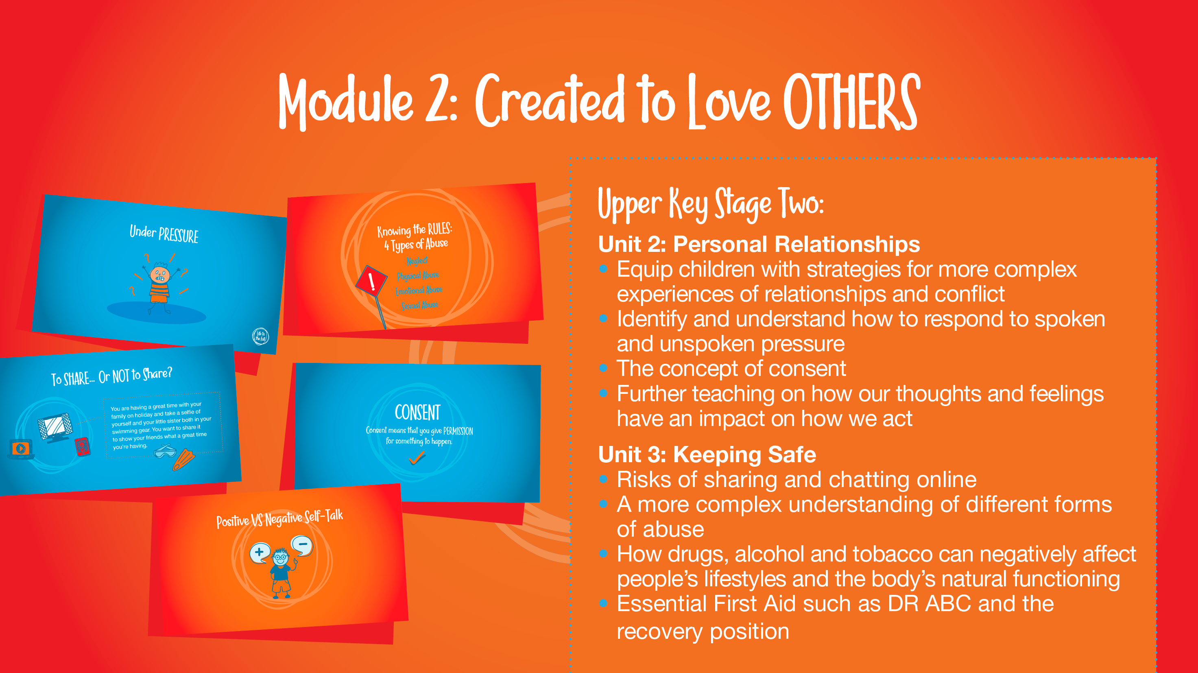

Slide 11
Module 2: Created and loved by others
Unit 1: Religious Understanding
God is calling you
In this session, pupils will look at the nature of God’s call to love others. Children will study and imaginatively consider the story of Zacchaeus’ conversion and explore ways in which they can hear God’s call in their lives.

Slide 12
Unit 2
Personal Relationships
Under Pressure
Pressure comes in different forms, and what those different forms are;
There are strategies that they can adopt to resist pressure.
Do You Want a Piece of Cake?
Understand what consent and bodily autonomy means;
Discuss and reflect on different scenarios in which it is right to say ‘no’.
Self-Talk
Learn about how thoughts and feelings impact on actions, and develop strategies that will positively impact their actions;
Apply this approach to personal friendships and relationships.

Slide 13
Module 2: Created to love others
Unit 3 Keeping Safe
Cyberbullying
What the term cyberbullying means and examples of it;
What cyberbullying feels like for the victim and how to get help if they experience cyberbullying.
Sharing Isn’t Always Caring
This session focuses children making safe and sensible decisions about what content to share or not share, including photos, passwords and other personal information. Children will discuss how this can be damaging and dangerous, and will rules to remember to keep themselves safe.

Slide 14
Impacted Lifestyles
• Understand the effect that a range of substances including drugs, tobacco and alcohol can have on the body.
• Learn how to make good choices about substances that will have a positive impact on their health.
• Know that our bodies are created by God, so we should take care of them and be careful about what we consume.
Making Good Choices
• Recognise how they may come under pressure when it comes to drugs, alcohol and tobacco
• Learn that they are entitled to say “no” for all sorts of reasons, but not least in order to protect their God-given bodies.
Giving assistance
The recovery position can be used when a person is unconscious but breathing
DR ABC is a primary survey to find out how to treat life-threatening conditions in order of importance

Slide 15
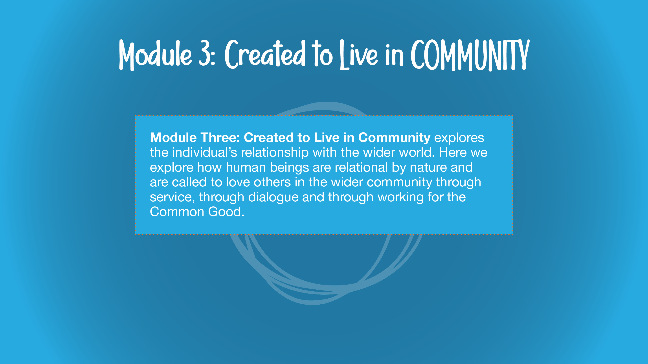
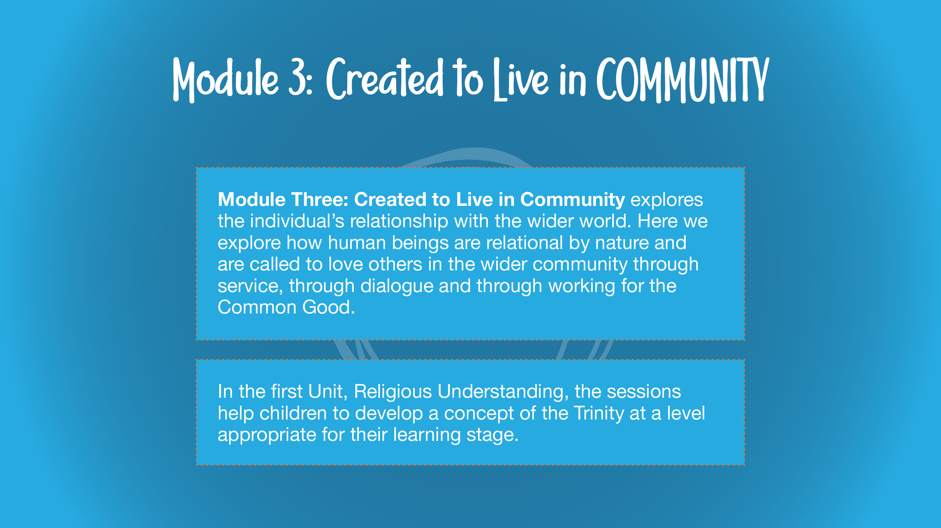

Slide 16
Module 3: Created to live in community
Unit 1: Religious understanding
Session 1: The Holy Trinity
To know that God the Father, God the Son and God the Holy Spirit make up the three persons of the Trinity.
To know that the Holy Spirit works through us to bring God’s love and goodness to others.

Slide 17
Module 3: Created to live in community
Religious understanding
Session 2: Catholic Social Teaching (CST)
They will learn the principles of CST, how we can apply these to daily life and how ‘loving our neighbour’ might mean acting in ways that affect global organisations as well as individuals.
Living in the wider world
Session 3: Reaching out
Learn to apply the principles of Catholic Social Teaching to current issues.
Find ways in which they can spread God’s love in their community.

Slide 18
After each session, children will complete work related to the lesson.
On a separate piece of paper, children can write any other questions they have, with the option of being anonymous.
These questions will be addressed at the beginning of the next session.

Slide 19
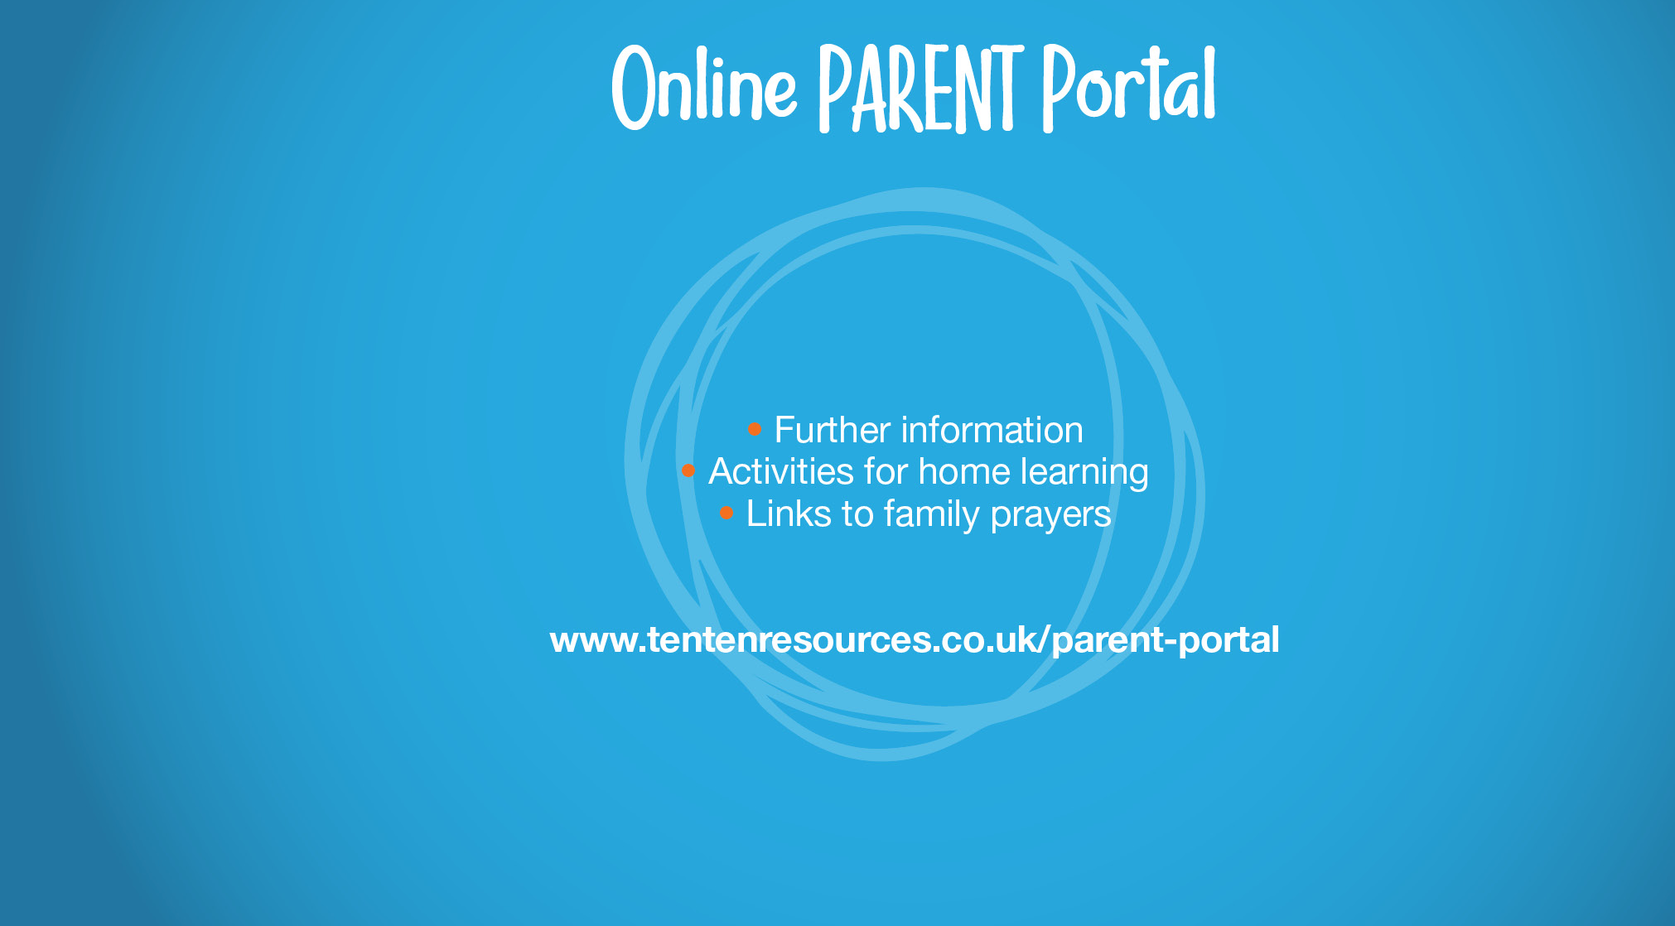
The Online Parent Portal provides parents of children in schools who subscribe to Life to the Full with:
Information about the programme children will be following;
Access to resources;
Suggestions for further activity at home.
To access it, follow the links to the year group your child is in. Your school will provide more details about what lessons your child will be learning and when.

Slide 20
Parent Portal Log in details for parents
Username
st-george-en2
Password
april-dragon
Parent Portal
https://www.tentenresources.co.uk/parent-portal/
Parent Consultation Tool
https://www.tentenresources.co.uk/parent-consultation-tool-primary/

