Slide 1
Welcome to Year 6
September2026

Slide 2
Meet the Staff
Ms Bonner (6B)
Miss Whitmore (6W)
Mrs Cattini/Mrs Kyriacou (6CK)
Mrs Pickles (TA)

Slide 3

A Typical Day
8.45: Soft Start
9.00: Registration
9.00 – 9.45: Act of worship/morning work/ guided reading
9.45: Maths
10.45: Playtime (children encouraged to bring a piece of fruit in for their snack)
11.00: Literacy
11:00-11:30am Hymn Practice (Tuesdays)
12.30: Lunch
1.30-2.30: RE/Topic/P.E/Computing/Music/Spanish
2.30 3.30:
RE/Topic/P.E/Computing/Music/Spanish/Enrichment

Slide 4

Catholic Life of the School
‘
In everything we do today, we are following Jesus and His way.’
RE is at the heart of everything we do here at St George’s. It is through Religious Education that we that we lay the foundations for our pupils to grow into respectful, spiritual and moral individuals; supporting them in developing and deepening their relationship with God. The children are encouraged to reflect and ask questions about their faith.
Our topics this year in RE are:
Branch 1: Creation and Covenant
Branch 2: Prophecy and Promise
Branch 3: Galilee to Jerusalem
Branch 4: Desert to Garden
Branch 5: To The Ends of the Earth
Branch 6: Dialogue and Encounter

Slide 5

Reading
We are following a reading scheme called ‘Big Cats’.
Pupils are assessed in Autumn Term 1
Fluency and a range of comprehension skills in the following reading domains are practised weekly: meaning of vocabulary, making inferences, predicting, analysing, retrieving information and summarizing
Children are grouped with readers working at the same level in guided reading activities.
Reading independently at home daily for a minimum of 15 – 20 minutes. The children should be reading challenging texts.
Class text termly in literacy.
Comprehension tasks weekly.
Reading records checked weekly-parents to sign only
Recommended reading list:
https://www.st-georges.enfield.sch.uk/page/?title=Recommended+Reading+List+KS2%26%238203%3B%26%238203%3B%26%238203%3B%26%238203%3B%26%238203%3B%26%238203%3B%26%238203%3B&pid=84

Slide 6

Spellings
Your child will need to know their log-ins for DB Primary. Spellings are set on DB Primary at the beginning of each half term. We upload a half termly overview and the children will learn the spellings for the corresponding week. The children are then tested every Friday.
Spelling activities in class weekly.
Spellings are taught systematically within word families where possible.
Spelling practice is so important; spelling, reading, writing and comprehension skills are all closely linked. The more children practise key spellings the more likely they are to enjoy reading and writing.

Slide 7
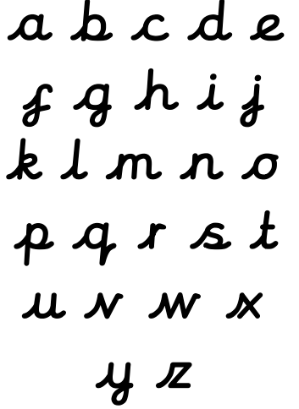
Handwriting and presentation in Year 6
Children should maintain legibility in joined, cursive handwriting when writing at speed.
Letter formation
Size
Writing on the line
Pace
Presentation is important – children must take pride in their work. This is a whole school priority across all subjects.
https://www.st-georges.enfield.sch.uk/page/?title=Handwriting&pid=54

Slide 8
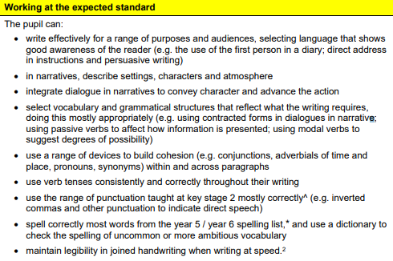

Slide 9
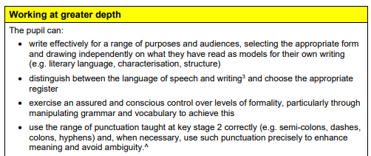

Slide 10
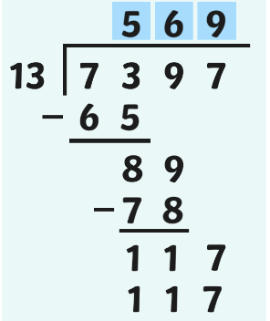
Maths in Year 6
In maths, we strive for efficient and clear arithmetic strategies to enable the children to solve real-life reasoning problems.
Children must use TT Rockstars for 15 minutes a day to develop their fluency so that they can apply these multiplicative skills in all topic areas.
Presentation is again very important.

Slide 11
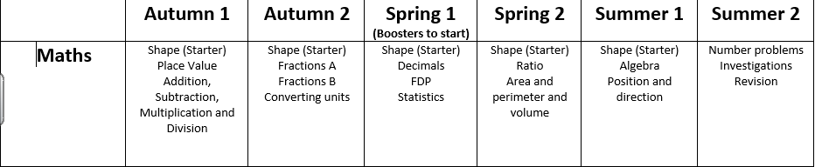

Slide 12

Maths groups
In the upcoming weeks, the children in Year 6 will be organised in to maths groups. Each maths group will be covering the same topics throughout the year; your child may be working with a different Year 6 teacher. There is a possibility of movement between the groups throughout the year- this is at the discretion of the Year 6 teachers. Our groupings are based on performance in class, rapid recall of key facts, pace and their attainment in regular assessments.

Slide 13
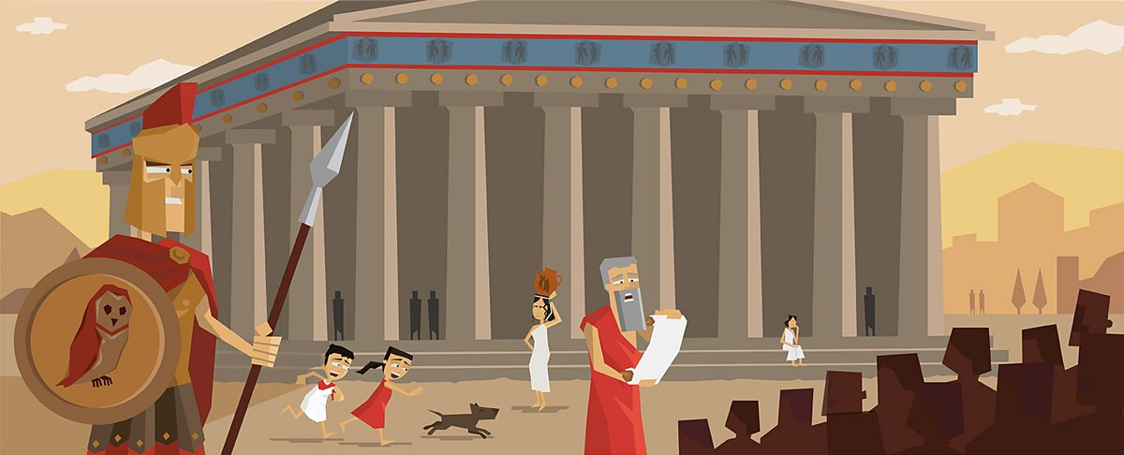
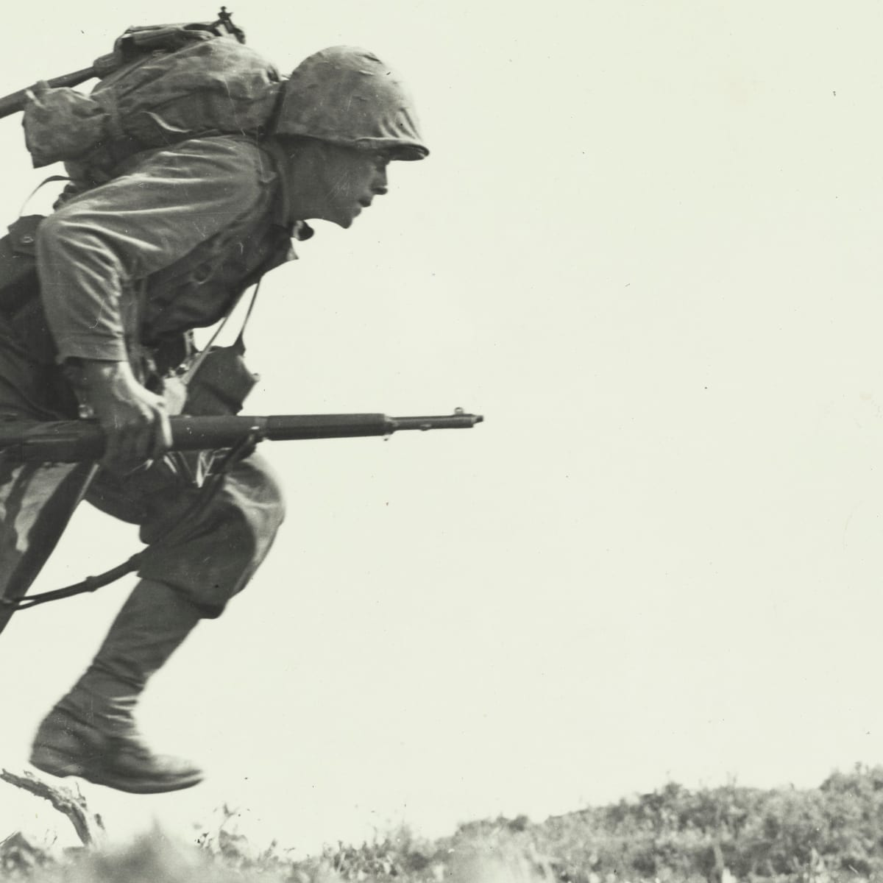
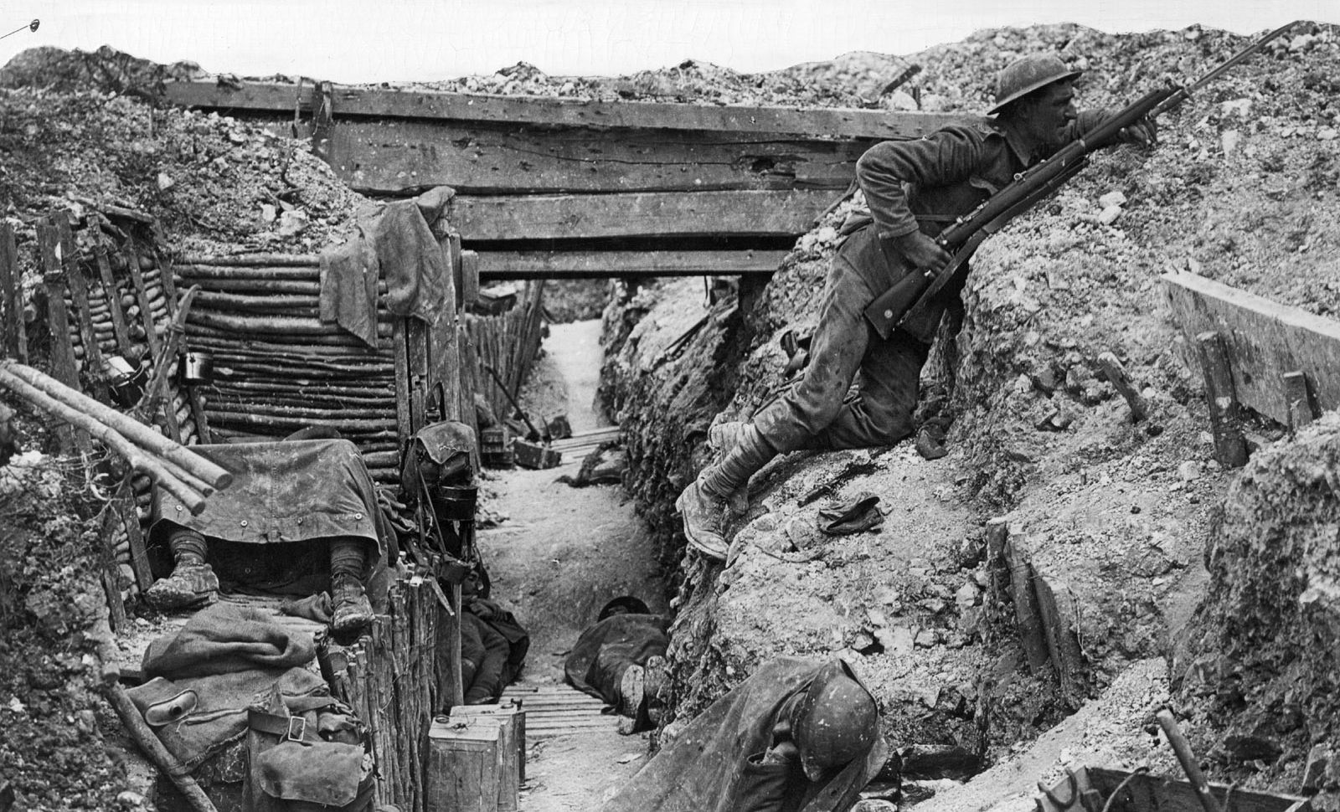

History and Geography
Where does energy come from? (Autumn 1: Geography)
Ancient Greece: What did the Greeks ever do for us? (Autumn 2: History)
Why does population change? (Spring 1: Geography)
What was the impact of World War Two? (Spring 2: History)
Independent fieldwork enquiry (Summer Term: Geography)

Slide 14

CGP books
Revision books for reading, grammar punctuation & spelling and maths.
The books provide test style exercises on all the content that children need to know for the SATs in May.
Weekly timetable on DB Primary.
Weekly marking in class.
Enable smooth transition for homework in secondary school.
Any changes to our homework schedules will be informed over text.

Slide 15
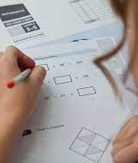
SATs
The statutory key stage 2 tests are timetabled from Monday 10th May to Thursday 13th May 2027.
Children will sit the following papers:
Maths arithmetic paper 1
Maths Paper 2 and 3 ( reasoning)
Literacy comprehension
Literacy Grammar and Punctuation
Literacy spelling
Boosters
Interventions
CGP books
Assessments every half-term

Slide 16

General Reminders
Please ensure children come to school in their PE kit on their PE days. 6CK: Wednesday and Thursday
6B: Monday and Wednesday
6W: Tuesday and Thursday
We require a written note if your child is unable to attend a P.E lesson as P.E is statutory.
Please see the school website for guidance about the appropriate school uniform and PE kits.
A weeks notice is required if your child is changing from packed lunch to school dinners and vice versa. It allows kitchen staff to amend their ordering.
Smart watches: Children can wear watches to school however, smart watches are not permitted.

Slide 17
Leaver’s Hoodies
Children will be allowed to wear these on the last week of school.

Slide 18
Collection
If your child is being collected by another adult, the class teacher must be informed via email ( preferably before 12.30pm). We cannot release children unless we are in receipt of this information.

Slide 19

How can you support your child at home?
Read with your child and encourage discussion around the book to develop children reading for meaning.
Continue daily times table practice on TT Rockstars.
Reinforce learning at home.
CGP homework books
Practise weekly spellings.
Login to DB Primary to access homework timetable.
Support our whole school behaviour policy.

Slide 20
Resources for home support: Maths
https://whiteroseeducation.com/parent-pupil-resources/maths/free-downloads
https://whiteroseeducation.com/parent-pupil-resources/maths/home-learning?year=year-6-new
CGP workbooks ( addition to homework books)
DB Primary: Resources uploaded every half-term in the folder called Year 6 maths support
https://www.thenational.academy/pupils/programmes/maths-primary-year-6/units This is designed for teachers but you can access it at home

Slide 21
Resources for home support: Literacy
CGP workbooks ( addition to homework books)
DB Primary: Resources uploaded every half-term in the folder called Year 6 Literacy support
https://www.thenational.academy/pupils/programmes/english-grammar-primary-year-6-l/units This is designed for teachers but you can access it at home.
BBC Bitesize

